Slide 1
New strawberry disease caused by NEO.PESTA.LO.TIOP.SIS rosae
By
J. Mertely, J. Baggio, N. A. Peres,
and the strawberry pathology team

Slide 2
HISTORY OF “PESTALOTIA” DISEASES IN FLORIDA
FUNGUS | DISEASE | SEASON
Pestalotia longisetula | fruit spot | 1972-73
Pestalotiopsis clavispora | root rot crown rot | 2014-15*
Neopestalotiopsis rosae | leaf spot fruit spot | 2017-18, 2018-19
*P. clavispora associated with weak growth and poor establishment of transplants.

Slide 4
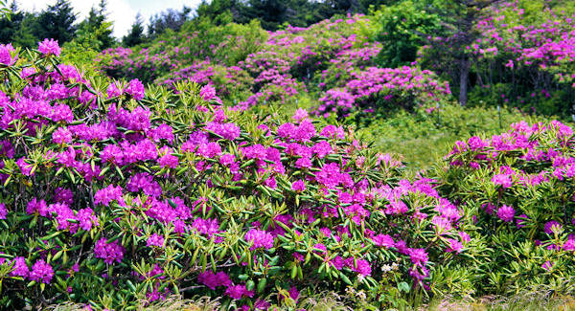
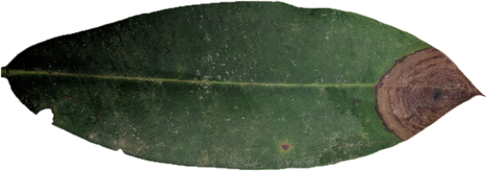
Rhododendron leaf
Neopestalotiopsis rosae

Slide 5
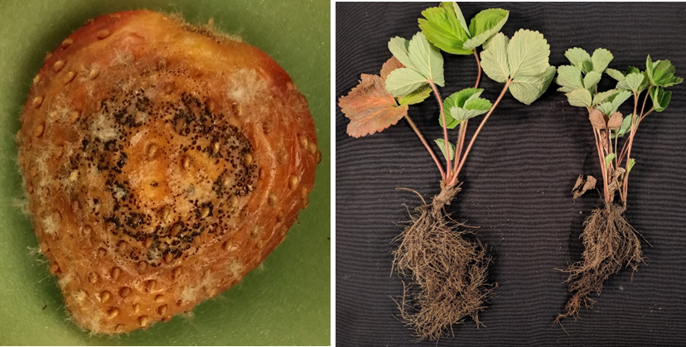
Conclusion from genetic taxonomy
Isolates from leaf, fruit, root, and crown = all the same group
Neopestalotiopsis rosae

Slide 6
LEAF SPOT AND FRUIT ROT SYMPTOMS

Slide 7
LEAF BLIGHT?

Slide 8
EFFECT ON FIELD OF ‘RADIANCE’

Slide 9
Sensitivity to Fungicides @ 100 ppm
Fungicide name | Fungicide type | Growth ↓ min. | Growth ↓ max. | AVG
Abound | strobilurin | 35.0 | 86.2 | 49.3
Captan | multi-site | 87.6 | 97.3 | 92.6
Velum prime | SDHI | 19.9 | 51.6 | 32.3
Fontellis | SDHI | 29.6 | 53.4 | 41.0
Rhyme | DMI | 88.4 | 100 | 99.1
Mettle | DMI | 97.6 | 100 | 99.6
Switch | phenylpyrrole | 100 | 100 | 100
Topsin | benzimidazole | 7.5 | 100 | 29.6

Slide 10
Sensitivity to Fungicides @ 1ppm
Fungicide name | Fungicide type | Growth ↓ min. | Growth ↓ max. | Avg.
Abound | strobilurin | 0.0 | 70.9 | 49.3
Captan | multi-site
Velum Prime | SDHI | 0.0 | 24.0 | 6.4
Fontelis | SDHI | 0.0 | 28.4 | 10.3
Rhyme | DMI | 14.1 | 97.4 | 30.6
Mettle | DMI | 8.4 | 100.0 | 30.2
Switch | phenylpyrrole | 97.6 | 100.0 | 99.6
Topsin | benzimidazole | 0.0 | 27.5 | 7.4

Slide 11
FUNGICIDE TRIAL RESULTS Sensation ‘FL-127’
Fungicide | % Dis leaves |  | Fungicide | % Dis leaves
Omega | 5.9 | a | Topsin | 12.9 | bc
Switch | 10.2 | ab | Procure | 13.4 | bc
Oxidate | 10.4 | ab | Thiram | 14.0 | bc
Protexio | 10.9 | ab | Fontelis | 14.2 | bcd
Kenja | 11.9 | b | Rhyme | 14.5 | bcd
Merivon | 12.4 | bc | Captan | 15.3 | bcd
Aprovia | 12.5 | bc | Control | 15.7 | bcd
Tavano | 12.5 | bc | Luna T | 15.8 | bcd
Rally | 12.6 | bc | Elevate | 18.2 | cd
Mettle | 12.8 | bc | Abound | 19.8 | d

Slide 12
CULTIVAR TRIAL RESULTS

Slide 13
CULTIVAR TRIAL RESULTS

Slide 14
Summary
Neopestalotiopsis rosae represents an increasing threat to strawberry crops in Florida, and other parts of the world.
Two fungicides control the disease, but most do not.
Omega (fluazinam), which is not labeled for strawberry production fields
Switch (fludioxonil)
Disease resistance is a good option.
Brilliance shows resistance to both leaf and fruit spots phases.
Sensation is less susceptible to leaf spotting than Radiance.
Some advanced selections appear to have good resistance.

Slide 15
Thank you

