Slide 1
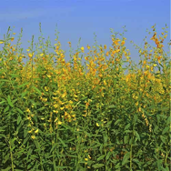
Importance of root-knot and lesion nematodes in strawberries and potential of cover crops for their management
Johan Desaeger and Tristan Watson,
University of Florida / IFAS, GCREC, Balm, FL
Agritech, April 2019, Plant City, FL

Slide 2
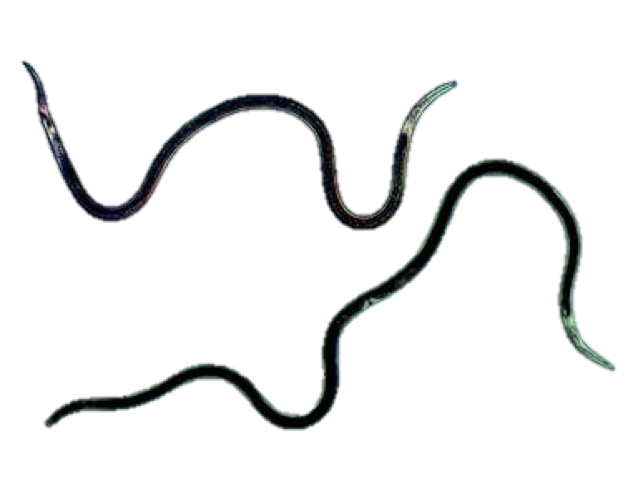
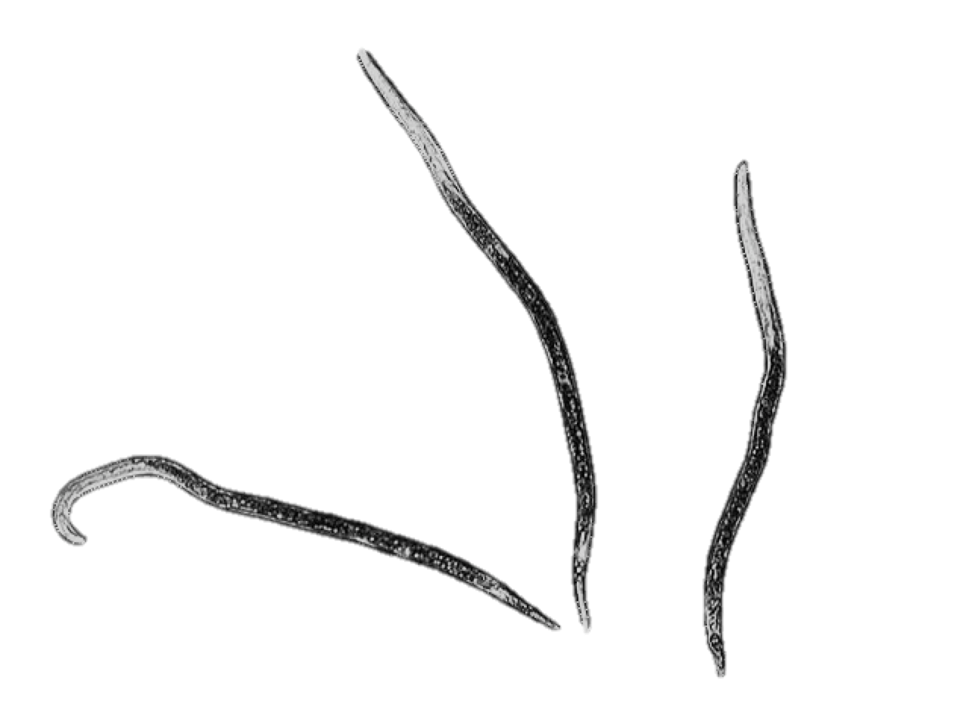
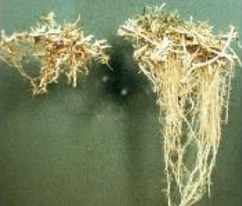
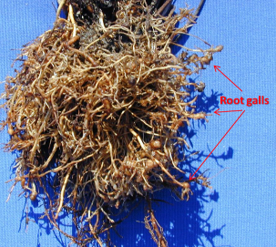
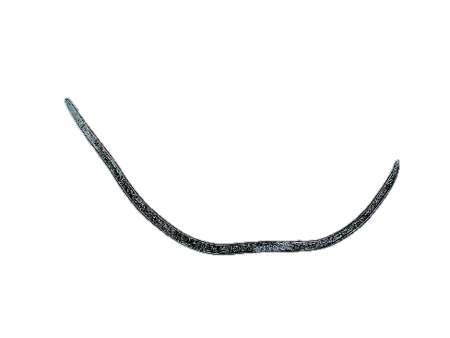
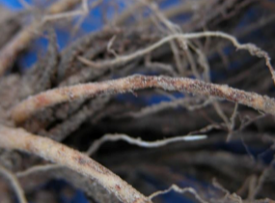
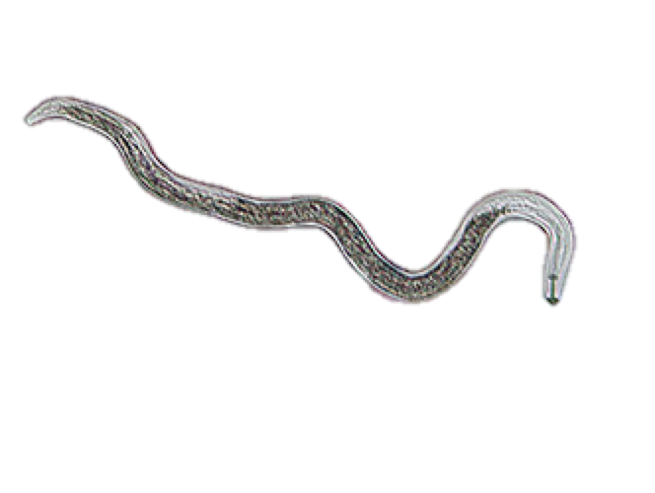
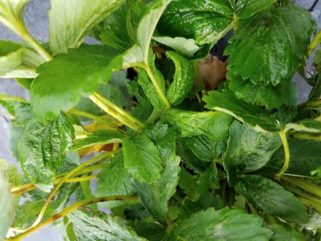
Main nematodes on Strawberry in Florida
Sting Nematode
Belonolaimus longicaudatus
Root-Knot Nematode - northern
Meloidogyne hapla
Root-Lesion Nematode - northern
Pratylenchus penetrans
Foliar Nematode
Aphelenchoides besseyi
Notes:
Strawberries are susceptible to multiple nematode species. Every strawberry grower in FL knows sting nematode, #1 nema, very devastating if not managed well; most growers not so familiar with these other potentially damaging nematodes such as … which are less common than sting probably introduced with transplant material from outside FL
Very different feeding habits … top 3 root feeders, but very different in the way they feed on roots, with sting ecto,and rkn and rl endo, foliar obviously leaves looks like ecto

Slide 3
Strawberry nurseries
Notes:
Large plants > roots > Many nematodes esp. endoparasites (hide in roots) come in with transplants

Slide 4
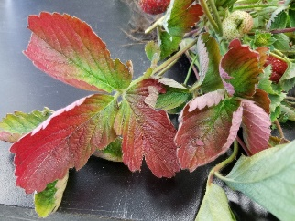
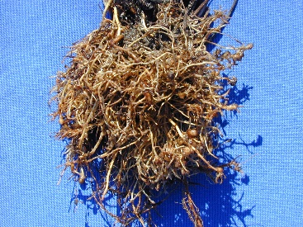
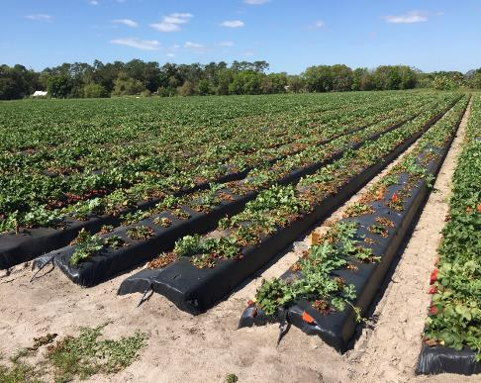
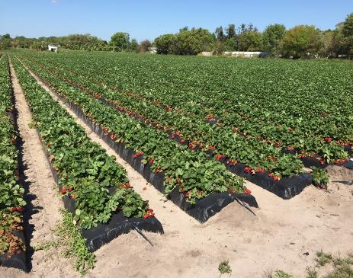
Northern Root Knot Nematode (Meloidogyne hapla)
Canadian bare root source of Radiance
North Carolina bare root source of Radiance
End of season plant collapse
RYFarm, March 22, 2016- Radiance and watermelon collapsing from Meloidogyne hapla
Notes:
One of those is NRKN, common in NE and CA, Hapla present in 43% of surveyed fields in Ontario;
growers usu. think they have sting, similar symptoms, stunting, reddish leaves, and galls, small !; rkn very common on vegetables in FL, many spp.; only 1 sp infects strawberry – nrkn-hapla,;usu. late season collapse of crop, … same farm – 2 nursery sources – Ca vs NC … here also watermelon double crop

Slide 5
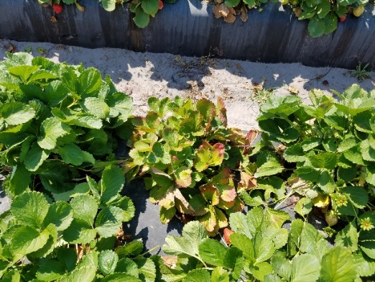
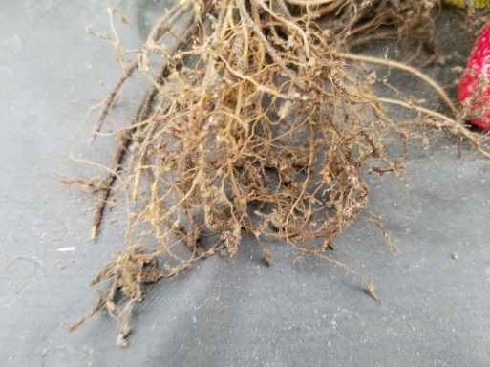
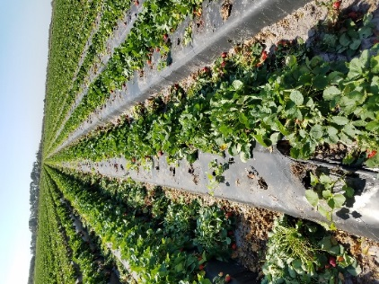
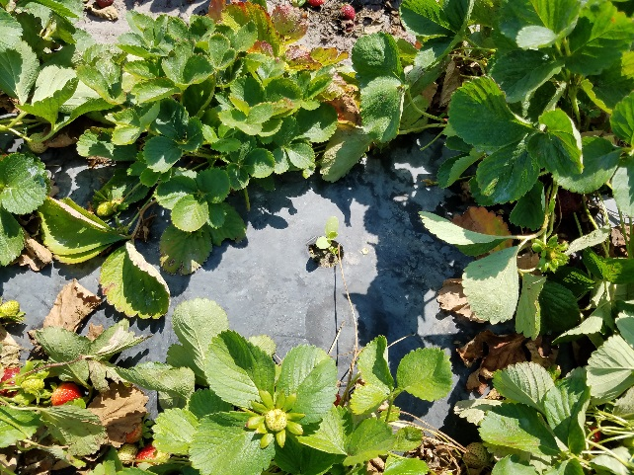
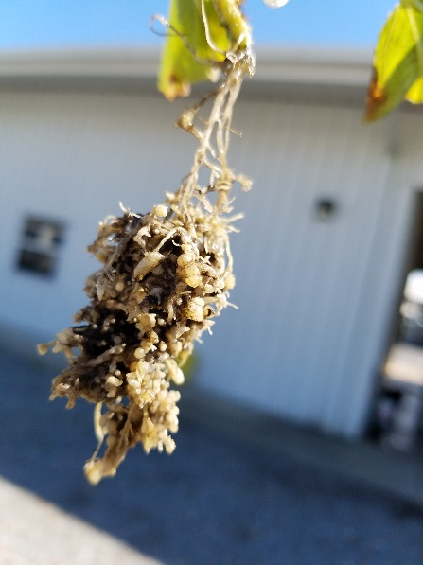
Root-knot nematode often only recognized on a double-crop (cantaloupe, watermelon, …)
Notes:
Strawberries may or may not be symptomatic, but double crop, esp. direct seeded

Slide 6
RKN Survey Research
Sting Nematode:
42.9% of farms sampled
Root-Knot Nematode:
64.3% of farms sampled
Lesion Nematode:
14.3% of farms sampled
Stubby root Nematode:
28.6% of farms sampled
Recap of Last Season (2017-2018):
 | Nematodes per 200cc soil
Site | Belonolaimus longicaudatus | Meloidogyne hapla | Pratylenchus penetrans | Trichodorus spp.
Farm 1 | 37 | 0 | 0 | 2
Farm 2 | 80 | 0 | 0 | 0
Farm 3 | 0 | 332 | 0 | 0
Farm 4 | 0 | 612 | 0 | 0
Farm 5 | 170 | 0 | 0 | 0
Farm 6 | 230 | 0 | 0 | 0
Farm 7 | 0 | 1298 | 0 | 8
Farm 8 | 0 | 836 | 0 | 0
Farm 9 | 5 | 1512 | 0 | 0
Farm 10 | 0 | 2 | 0 | 0
Farm 11 | 0 | 202 | 0 | 0
Farm 12 | 0 | 830 | 16 | 10
Farm 13 | 0 | 752 | 4 | 8
Farm 14 | 594 | 0 | 0 | 0

Slide 7
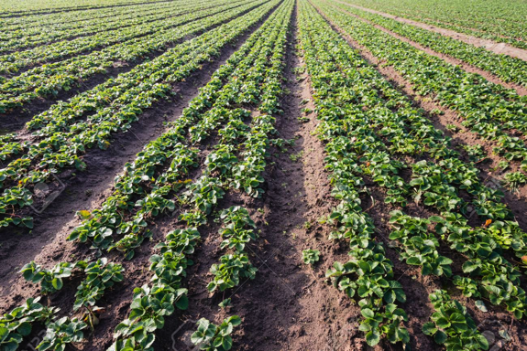
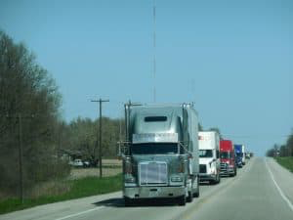
Screening 2018-2019 Transplant Material
Root-Knot Nematode:
0% of samples
Lesion Nematode:
20.4% of samples
# of Nurseries Sampled: 13
# of Transplant Shipments Sampled: 54
States/Provinces: California, North Carolina, Oregon, Washington, Idaho, Ontario, Nova Scotia

Slide 8
Survey of 2018-2019 Growing Season
 | Nematodes per 200cc soil
Site | Belonolaimus longicaudatus | Meloidogyne hapla | Pratylenchus penetrans | Trichodorus spp.
Farm 1 | 1 | 5 | 0 | 0
Farm 7 | 0 | 8343 | 0 | 0
Farm 8 | 0 | 852 | 0 | 0
Farm 14 | 94 | 0 | 0 | 0
Farm 15 | 13 | 126 | 0 | 6
Farm 16 | 31 | 0 | 0 | 0
Farm 17 | 0 | 86 | 0 | 3
Farm 18 | 0 | 1 | 1 | 1
Farm 19 | 0 | 0 | 0 | 23
Farm 20 | 2 | 10 | 0 | 8
Farm 21 | 26 | 0 | 0 | 1
Farm 22 | 206 | 0 | 0 | 0
Farm 23 | 0 | 1817 | 0 | 0
Farm 24 | 0 | 4 | 0 | 10
Farm 25 | 0 | 0 | 0 | 15
Farm 26 | 0 | 0 | 0 | 14
Farm 27 | 0 | 0 | 0 | 0
Farm 28 | 27 | 0 | 0 | 0
Farm 29 | 0 | 1817 | 0 | 0
Farm 30 | 0 | 0 | 0 | 0
Sting Nematode:
40.0% of farms sampled
Root-Knot Nematode:
50.0% of farms sampled
Lesion Nematode:
5.0% of farms sampled
Stubby Nematode:
45.5% of farms sampled

Slide 9
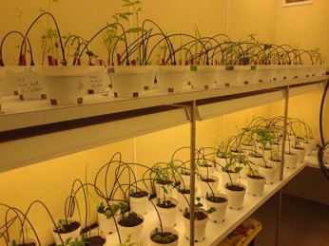
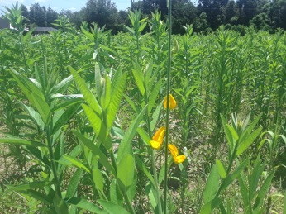
Cover Crop Research
Objectives:
Determine the host range of sting, lesion, and northern root-knot nematode to prospective summer cover crops
Growth Chamber Experiments
Identify the best summer cover crop mix to reduce plant-parasitic nematode populations and enhance soil health
Field Experiment

Slide 10
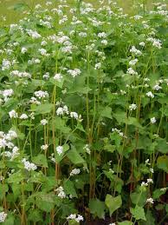
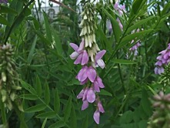
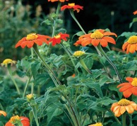
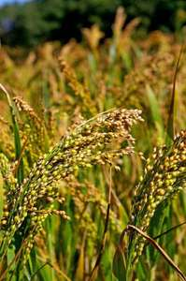
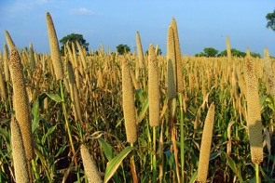
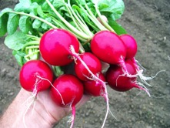
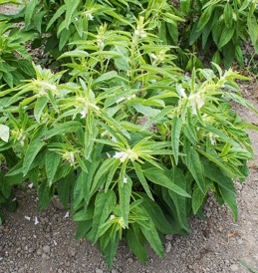
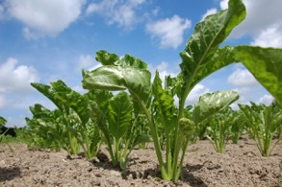
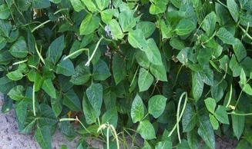
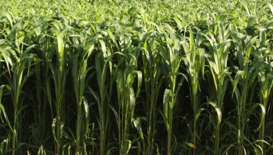
Prospective Cover Crops
Goat’s Rue
Marigold
Mexican Sunflower
Buckwheat
Crop | Cultivar | Species
Buckwheat | VNS | Fagopyrum esculentum
Goat's Rue | VNS | Tephrosia virginiana
Marigold | Nana Champion Flame | Tagetes patula
Mexican Sunflower | VNS | Tithonia diversifolia
Millet | German Foxtail | Setaria italica
Pearl Millet | Wonderleaf | Pennisetum glaucum
Radish | VNS | Raphanus sativus
Sesame | VNS | Sesamum indicum
Sorghum Sudangrass | AS 6201 | Sorghum x drummondii
Sorghum Sudangrass | AS 6401 | Sorghum x drummondii
Sourthern Peas | Iron & Clay | Vigna unguiculata
Sugar Beet | BL 47150 | Beta vulgaris
Sunflower | Peredovic | Helianthus annuus
Sunnhemp | VNS | Crotalaria juncea
Millet
Pearl Millet
Sunnhemp
Radish
Sunflower
Sugar Beet
Southern Pea
Sorghum Sudangrass
Sesame

Slide 11
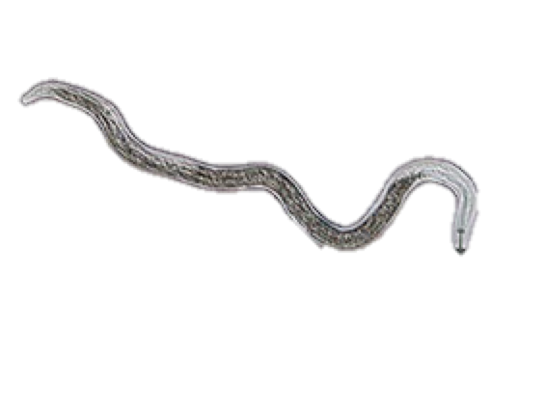
Growth Chamber Experiment
Experimental Design
3 Nematodes:
Root lesion nematode (Pratylenchus penetrans)
Northern root-knot nematode (Meloidogyne hapla)
Sting nematode (Belonolaimus longicaudatus)
16 Cover Crop Treatments:
14 summer cover crops
Strawberry (positive control)
Fallow (negative control)
8 Replicates per nematode x cover crop combination
Entire experiment performed twice
Pratylenchus penetrans
Meloidogyne hapla
Belonolaimus longicaudatus

Slide 12
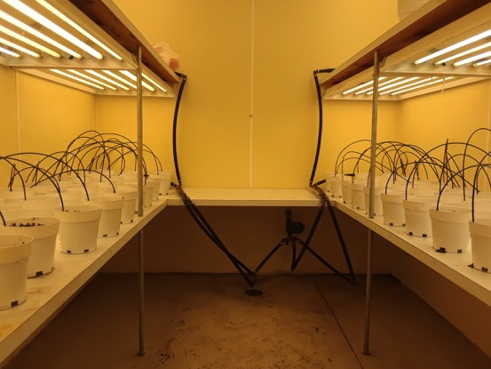
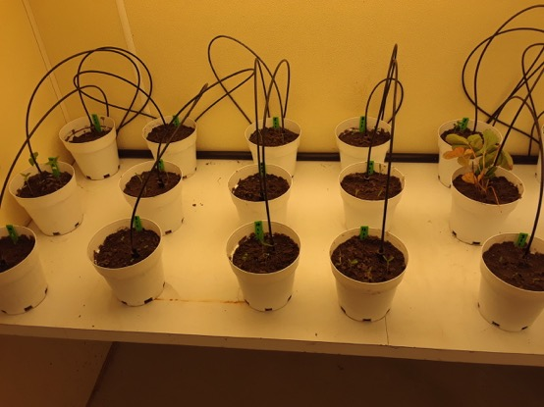
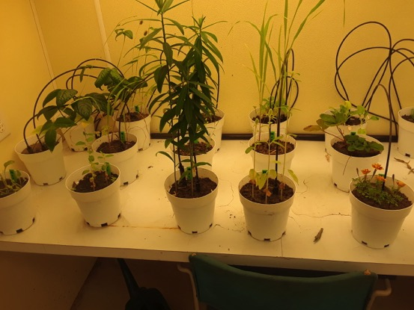
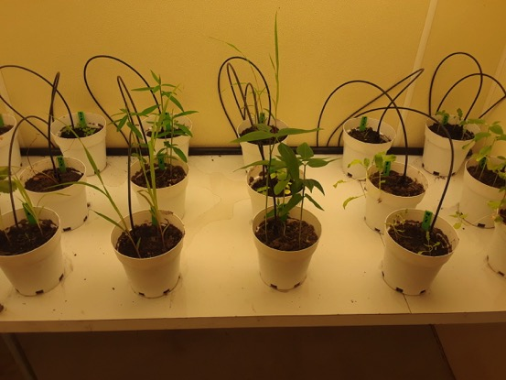
Growth Chamber Experiment
Planting – Early October 2018
1-Week Post-Planting
12-Weeks Post-Planting
6-Weeks Post-Planting

Slide 13
Host Range of Pratylenchus penetrans – the northern lesion nematode
Crop | Plant Biomass | Nematode Reproduction
Fallow | None | Poor
Buckwheat | Low | Moderate
Goat's Rue | Low | Poor
Marigold | Low | Poor
Mexican Sunflower | Low | High
Millet | Low | Poor
Pearl Millet | Low | Poor
Radish | Low | High
Sesame | Low | Moderate
Sorghum Sudangrass (AS6201) | Moderate | Moderate
Sorghum Sudangrass (AS6401) | High | Moderate
Southern Pea | High | Poor
Sugar Beet | Low | Poor
Sunflower | Low | High
Sunnhemp | High | Moderate
Strawberry | High | High
Summary:
Low nematode reproduction on known hosts may have been a result of poor root growth
Do not plant:
Mexican Sunflower
Radish
Sunflower
Maybe Plant:
Sunnhemp
Sorghum Sudangrass
Do Plant:
Southern Pea
Pratylenchus penetrans
Notes:
The growth chamber cover crop experiment slides are based on reproductive factor (Rf) values calculated for each pot (Rf = Final Population / Initial Population):
​​Poor (Rf-value <0.25; <25% nematode reproduction)
Moderate (Rf-value between 0.25 - 0.75; 25 - 75% nematode reproduction)
High (Rf-value >0.75; >75% nematode reproduction)
If anyone asks why the critical Rf value cut-off is low (i.e. not Rf = 1.0), it is because we used a high initial nematode population density (5,000 RKN / pot; 2,500 RLN / pot; 5 inch pot).The​ reason for this was that I was trying to mimic a heavy nematode infestation similar to population densities we see out in commercial fields. We expected Rf values to be on the lower end. Let me know if you have any questions.

Slide 14
Host Range of Meloidogyne hapla - the northern root-knot nematode
Crop | Biomass | Nematode Reproduction
Fallow | None | Poor
Buckwheat | Low | High
Goat's Rue | Low | Poor
Marigold | Low | Poor
Mexican Sunflower | Low | Moderate
Millet | Low | Poor
Pearl Millet | Low | Poor
Radish | Low | High
Sesame | Low | Moderate
Sorghum Sudangrass (AS6201) | Moderate | Poor
Sorghum Sudangrass (AS6401) | High | Poor
Southern Pea | High | High
Sugar Beet | Low | Poor
Sunflower | Low | Poor
Sunnhemp | High | Poor
Strawberry | High | High
Summary:
Low nematode reproduction on known hosts may have been a result of poor root growth
Do not plant:
Buckwheat
Radish
Southern Pea
Do Plant:
Sorghum Sudangrass
Sunnhemp
Meloidogyne hapla

Slide 15
Host Range of Belonolaimus longicaudatus - sting nematode
Crop | Biomass | Nematode Reproduction
Fallow
Buckwheat
Goat's Rue
Marigold
Mexican Sunflower
Millet
Pearl Millet
Radish
Sesame
Sorghum Sudangrass (AS6201)
Sorghum Sudangrass (AS6401)
Sourthern Peas
Sugar Beet
Sunflower
Sunnhemp
Strawberry
Currently in Progress...
Belonolaimus longicaudatus

Slide 16
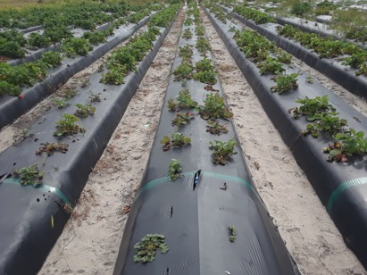
Field Experiment
Site: Nematode infested strawberry field at GCREC
Design: Small-plot field experiment (24 ft² plots)
Treatments:
Protocol:
Remove strawberry beds, disk land, mark plots ✔︎
Initial nematode populations and soil nutrition ✔
Plant cover crops in spring ✔
Incorporate cover crop into soil in summer
Final nematode populations and soil nutrition
Cover Crop Mix | Seeding Rate/A | Estimated Cost ($/A)
Sunnhemp | 50 lb | $200
Sunnhemp + Marigold | 25 lb + 2.5 lb | $275
Southern Pea | 15 lb | $120
Southern Pea + Marigold | 7.5 lb + 2.5 lb | $235
Sunnhemp + Southern Pea | 25 lb + 7.5 lb | $160
Sunnhemp + Southern Pea + Marigold | 16.7 lb + 5.0 lb + 1.67 lb | $234
Sorghum Sudangrass | 30 lb | $26
Weedy Fallow | - | $0

Slide 17
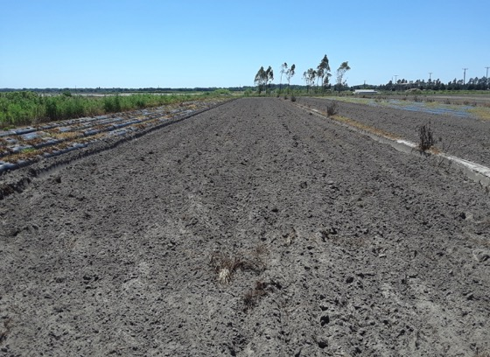
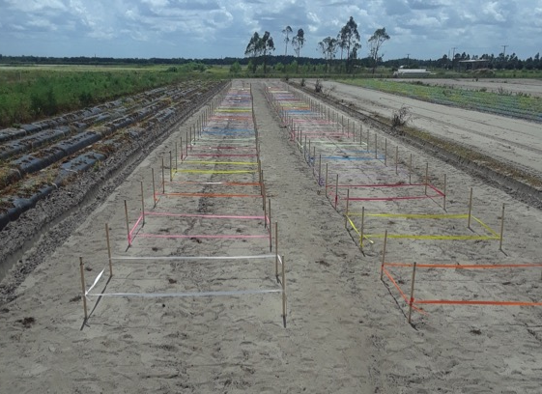
Field Experiment
March 9, 2019
Disked April 2, 2019
Currently in Progress...
Planted April 9, 2019

Slide 18
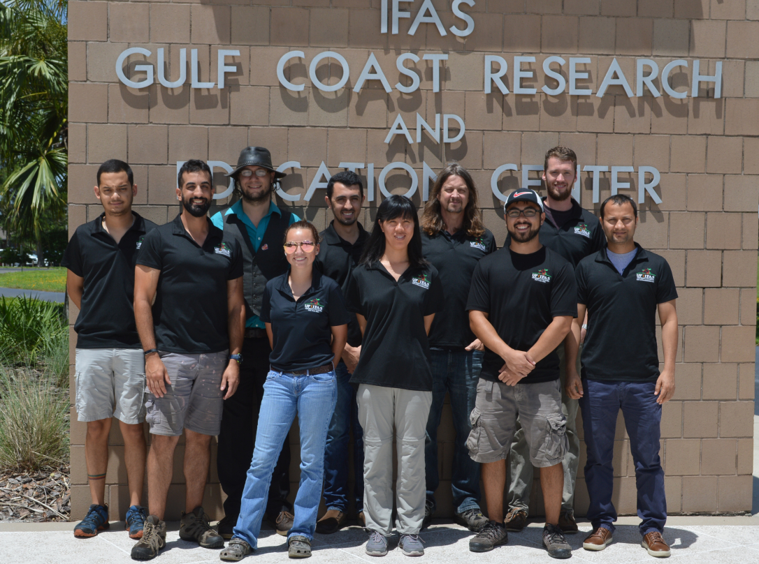
GCREC Nematology and Financial Support
Technical Support:
GCREC Nematology Lab Group
FSGA – FL AG Farm Crew
Funding:

