Slide 1
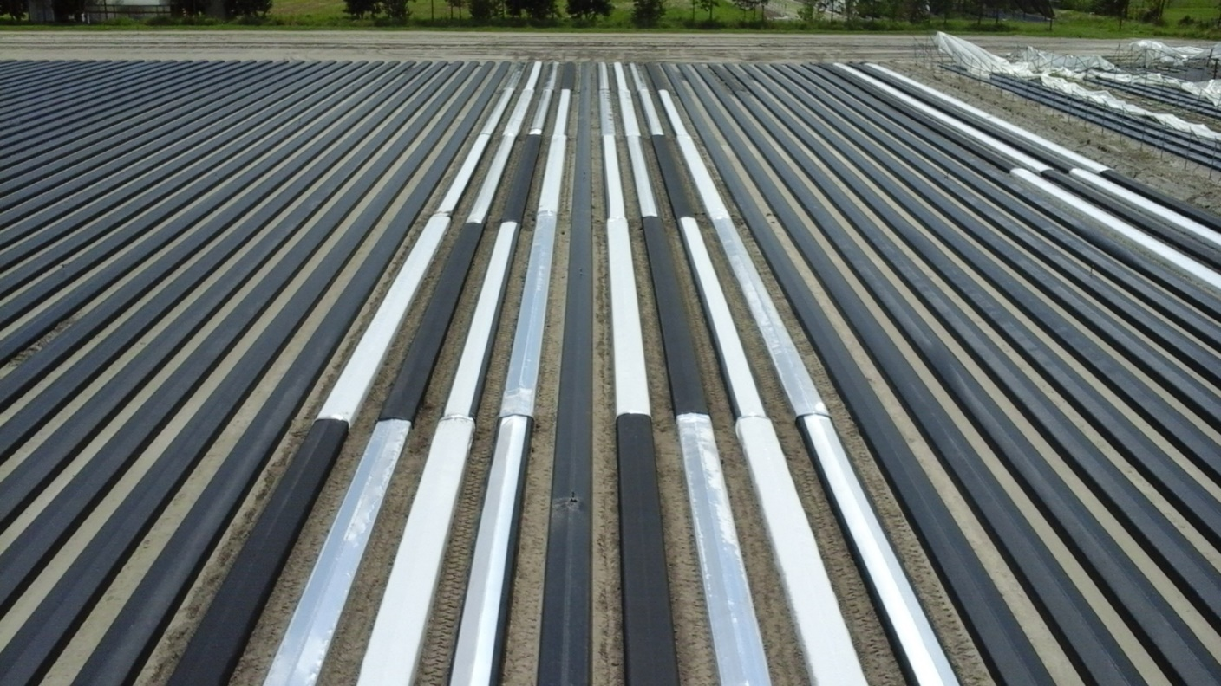
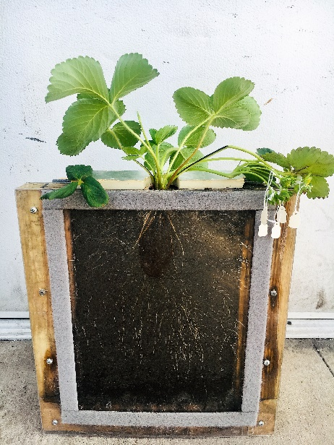
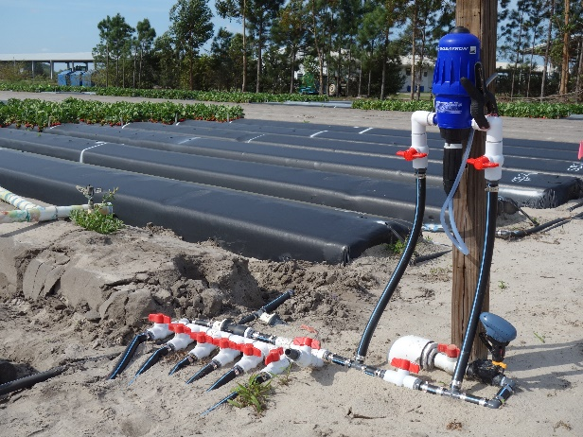


2019 AgriTech (Plant City, FL – Apr 16-17, 2019)
Production Recommendation Updates:
Plastic mulch, Fertilization, and Transplant Quality
Shinsuke Agehara
Assistant Professor, Plant Physiology
Gulf Coast Research and Education Center

Slide 2
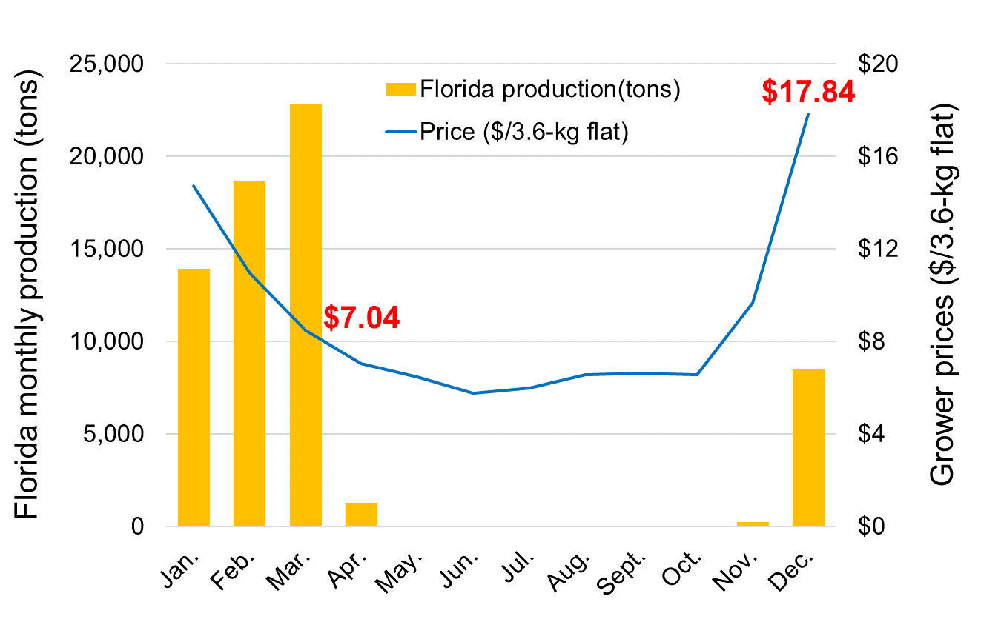
Horticulture programs
Program
Reflective/reflective-stripe mulch
Nitrogen fertilization rates for new cultivars
Transplant physiology (bare-root vs plug)
Objective
Develop/optimize crop management practices to improve yield distribution & profitability

Slide 3
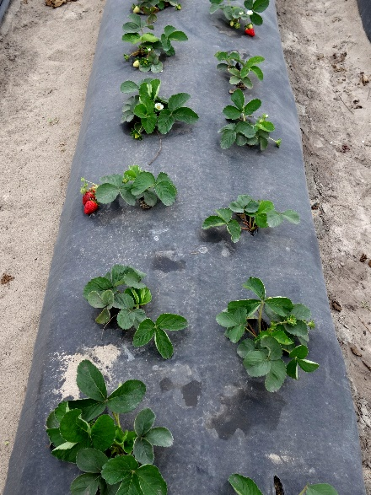
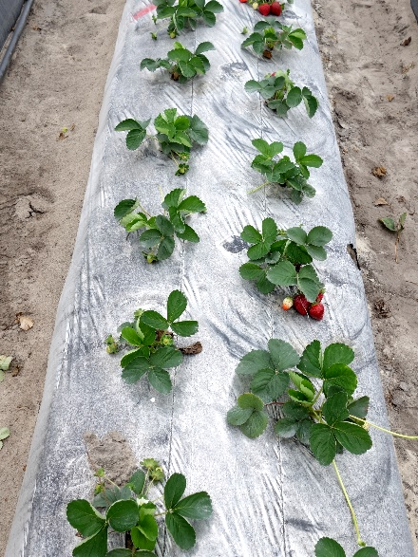
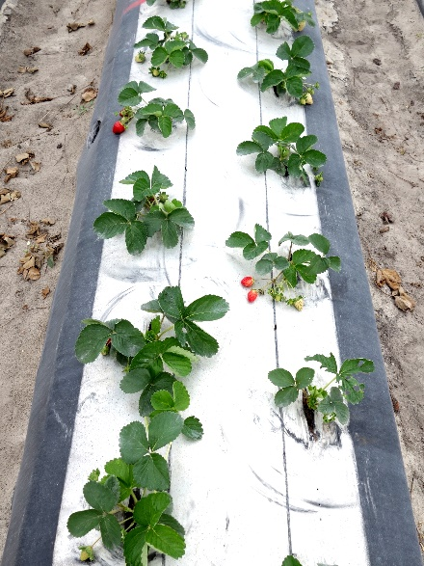
Reflective/reflective-stripe mulch
Black
Fully metalized
Metalized-stripe

Slide 4
Heat stress during establishment
Severe heat stress at >30 °C

Slide 5
Dual-benefits of reflective-striped mulch
Black plastic mulch
Entirely reflective plastic mulch
Plastic mulch with a reflective center stripe
Sunlight
Initial growth stage
(hot weather)
Heat
BAD
Excessive root-zone warming
GOOD
Root-zone cooling
GOOD
Root-zone cooling
Late growth stage
(cold weather)
GOOD
Root-zone warming
BAD
Root-zone cooling
GOOD
Root-zone warming

Slide 6
What’s new in the 2018-2019 season?
2016-2017 & 2017-2018 seasons
Bare-root transplants of ‘Radiance’ and ‘Beauty’ were used.
The magnitude of yield increases depended on cultivars, seasons, and harvest months.
2018-2019 season
‘Radiance’ and ‘Brilliance’ were used.
Both bare-root and plug transplants were used.

Slide 7
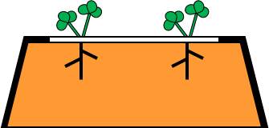
Cooling effects of reflective stripe
Position | Max temp diff vs. black mulch
5 cm above mulch | 2.3 °C ↓
0 cm above mulch | 2.4 °C ↓
0 cm below mulch | 4.0 °C ↓
5 cm below mulch | 3.9 °C ↓
3.1 °C ↓
2.7 °C ↓
Soil temperature (°C)

Slide 8
Dual-benefits of reflective-striped mulch
Black plastic mulch
Entirely reflective plastic mulch
Plastic mulch with a reflective center stripe
Sunlight
Initial growth stage
(hot weather)
Heat
BAD
Excessive root-zone warming
GOOD
Root-zone cooling
GOOD
Root-zone cooling
Late growth stage
(cold weather)
GOOD
Root-zone warming
BAD
Root-zone cooling
GOOD
Root-zone warming

Slide 9
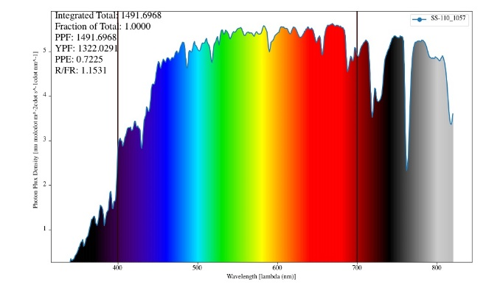
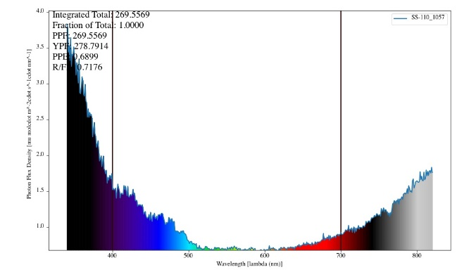
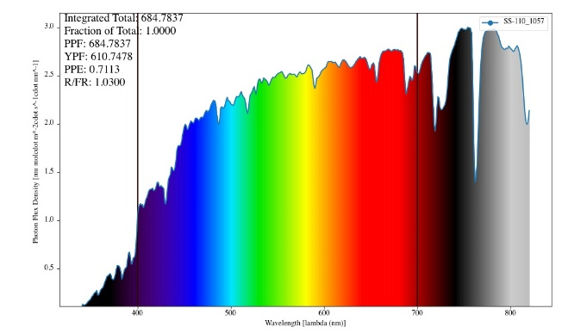
Reflection light quantity and quality
Reflected light from
black mulch
Reflected light from
Metalized-stripe mulch
Sunlight
Total PPF: 1700-1900
Total PPF: 85-266
Reflection: 5-14%
Total PPF: 1547-1881 Reflection: >91%
Light reflection ↑ → Photosynthesis ↑
Red/far red ratio in reflected light ↓ → Flowering ↑

Slide 10
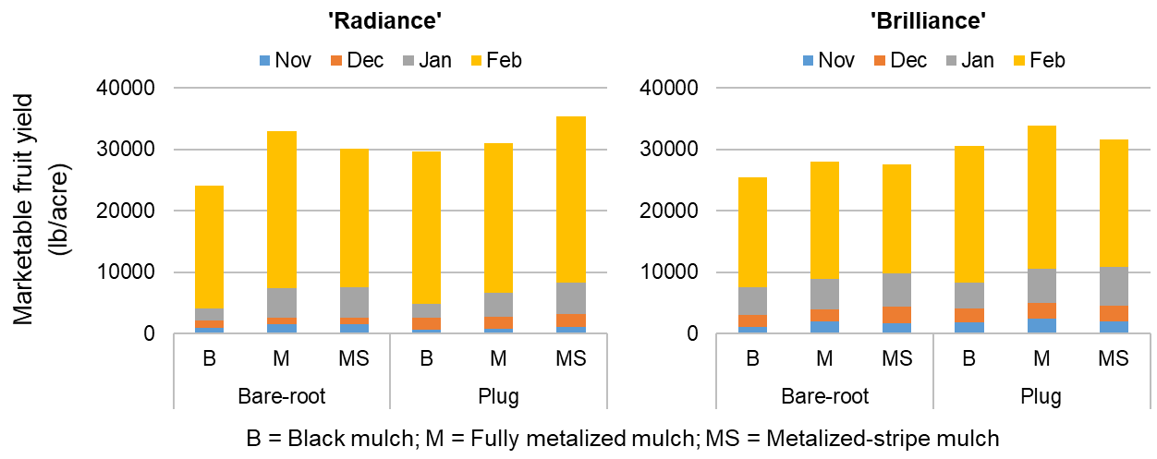
Marketable yield
37%↑
47%↑
115%↑
157%↑

Slide 11
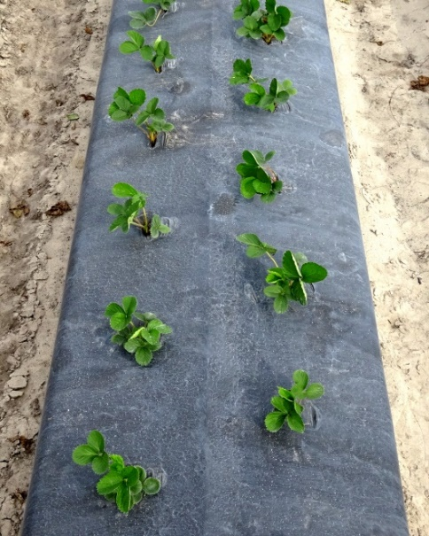
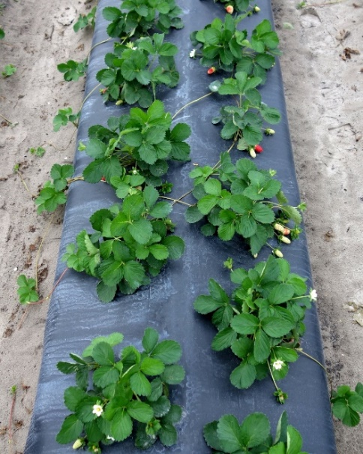
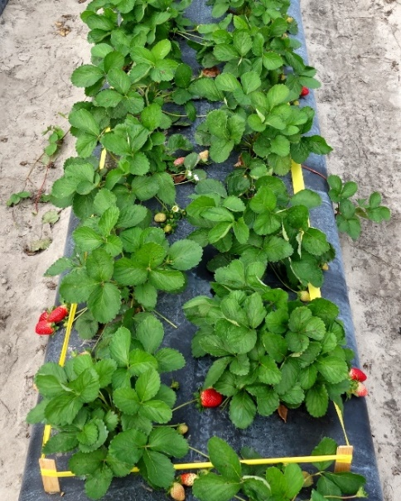
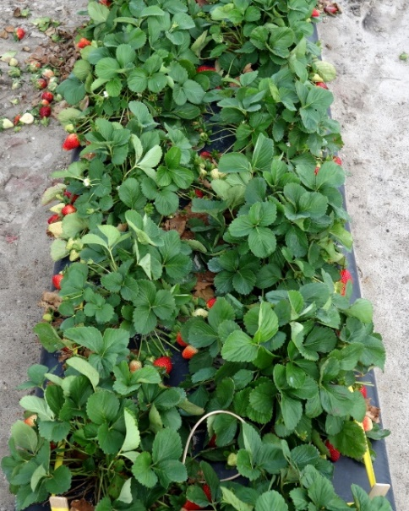
Nitrogen fertilization porgram
Establishment
Early harvest
Mid harvest
Late harvest
How much nitrogen is ideal during establishment?

Slide 12
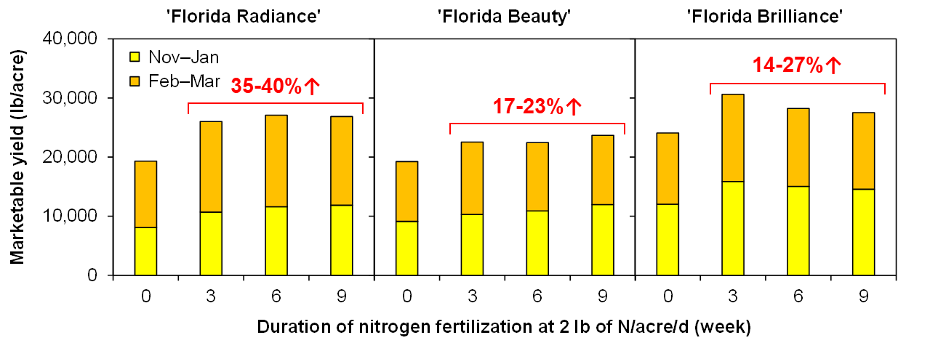
Nitrogen trial in the 2017-2018 season
Duration of 2 lb N/A/d | Oct |  | Nov |  | Dec |  | Jan | Feb
0 wk | 1 lb/A/d
3 wk | 2 lb | 1 lb/A/d
6 wk | 2 lb |  |  | 1 lb/A/d
9 wk | 2 lb |  |  |  |  | 1 lb/A/d

Slide 13
What’s new in the 2018-2019 season?
2018-2019 season
‘Brilliance’ were used.
Two planting dates: Sep 28 and Oct 11.
6 treatments: 0, 1, 2, 3, 4, and 6 wk at 2 lb/A/d
Duration of 2 lb N/A/d | Oct |  |  |  | Nov |  | Dec | Jan | Feb
0 wk | 1 lb/A/d
1 wk | 2 lb | 1 lb/A/d
2 wk | 2 lb |  | 1 lb/A/d
3 wk | 2 lb |  |  | 1 lb/A/d
4 wk | 2 lb |  |  |  | 1 lb/A/d
6 wk | 2 lb |  |  |  |  | 1 lb/A/d

Slide 14
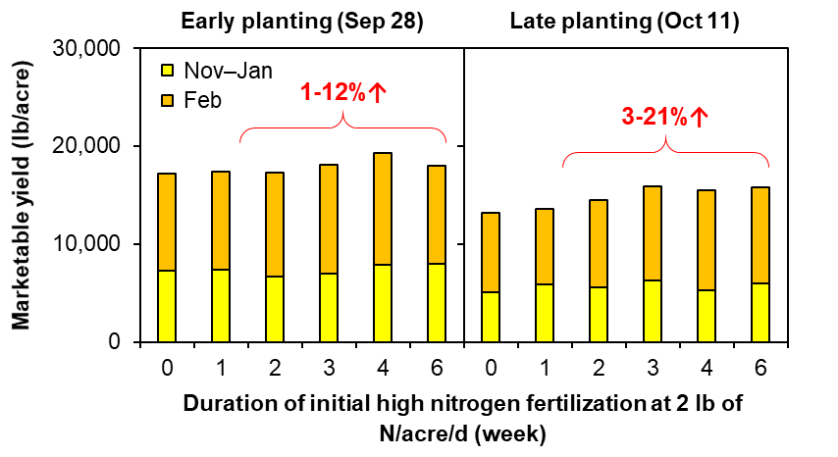
Marketable yield

Slide 15
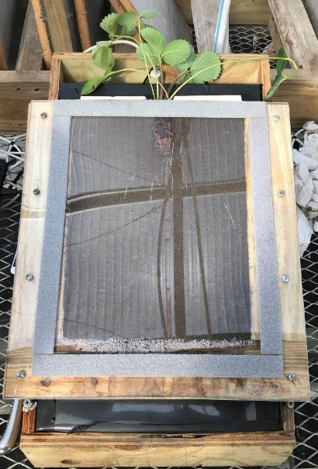
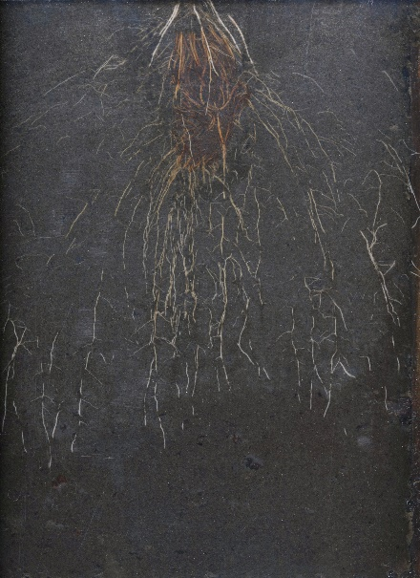
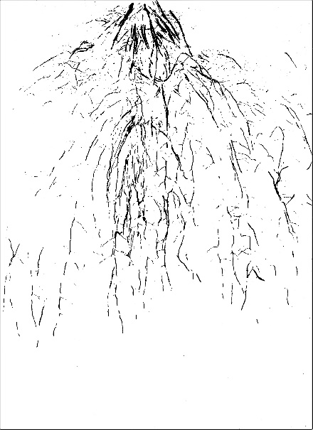
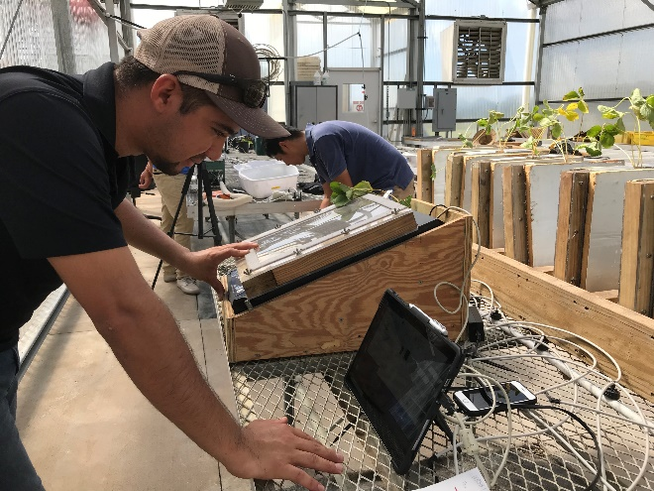
Transplant physiology
MS student: Jose Hernandez Monterroza
Rhizotron experiments
Initial leaves on bare-root transplants
Bare-root vs. plug transplants

Slide 16
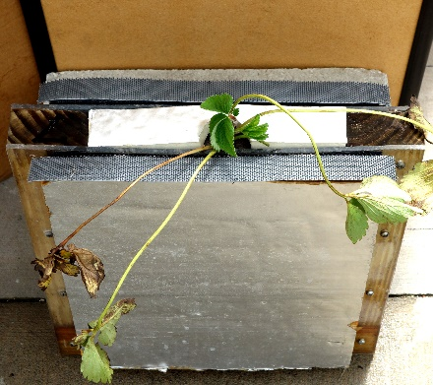
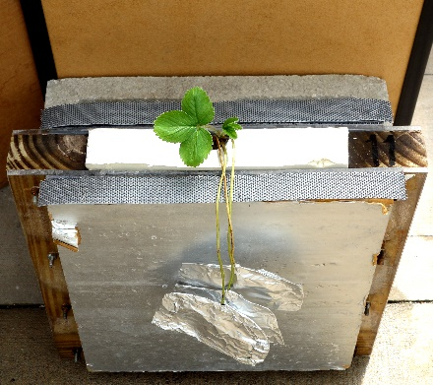
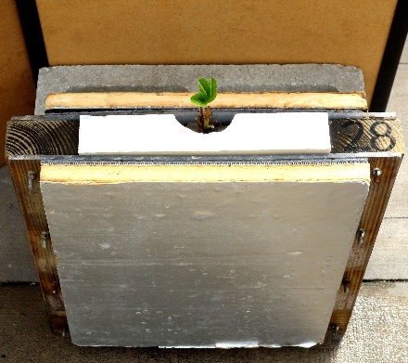
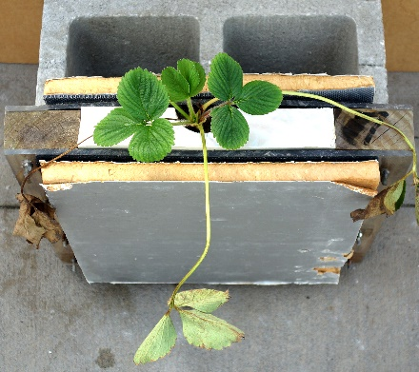
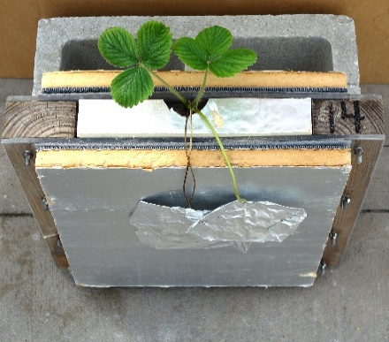
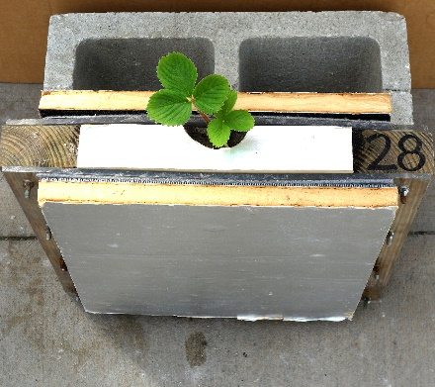
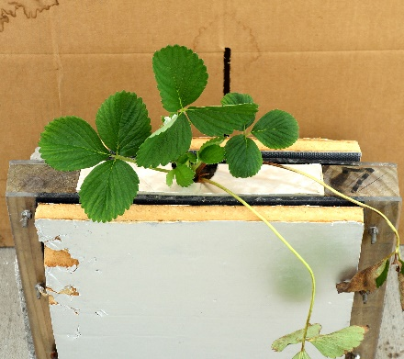
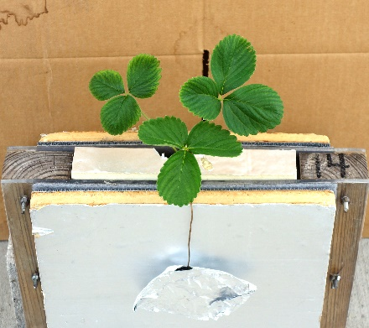
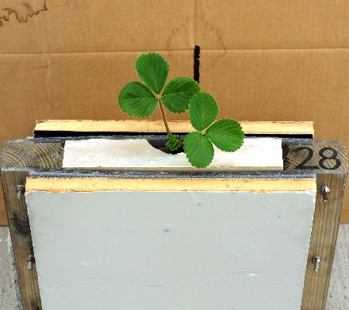
Are initial leaves important?
Control
Initial leaves covered
with aluminum foil
Initial leaves
trimmed
6 DAP
13 DAP
20 DAP

Slide 17
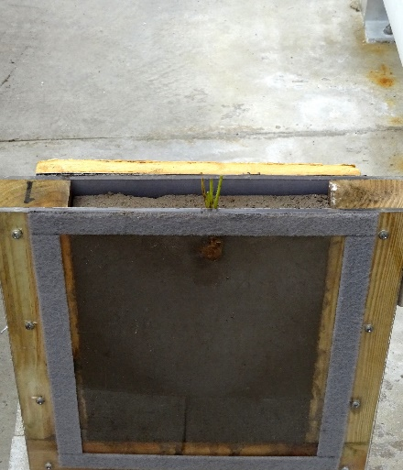
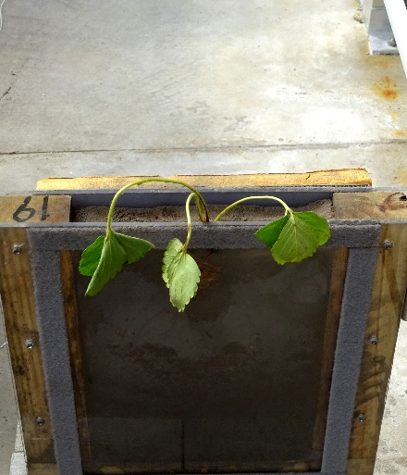
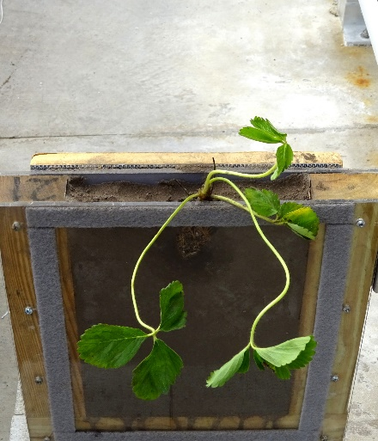
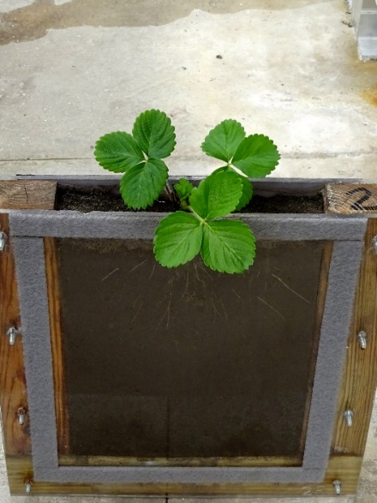
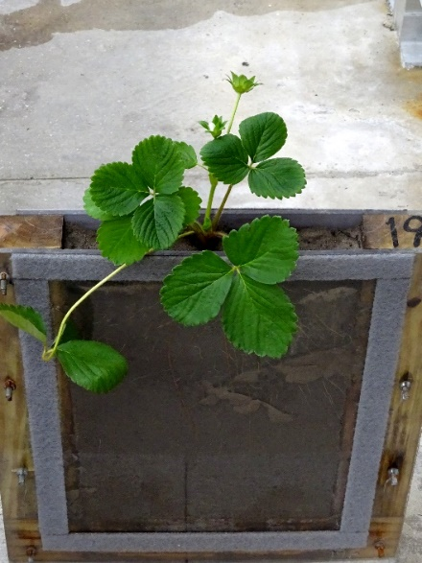
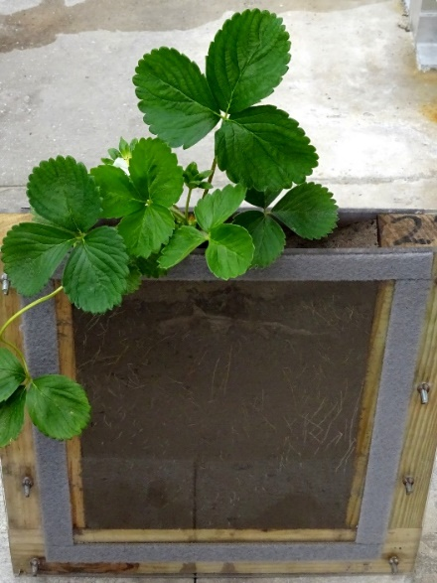
Bare-root vs. plug transplants
Bare-root transplant
Trimmed
Untrimmed
Plug transplant
Day 1
Day 35

Slide 18
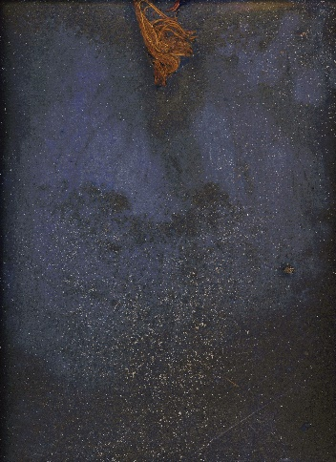
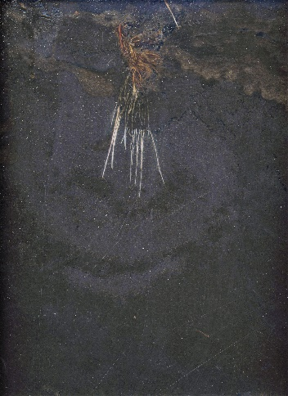
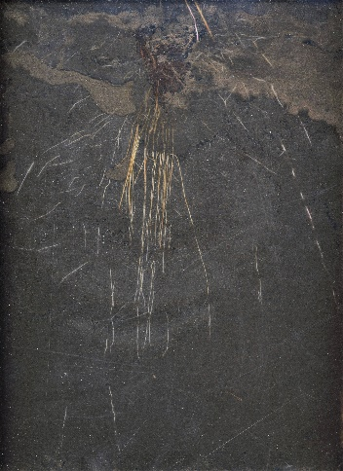
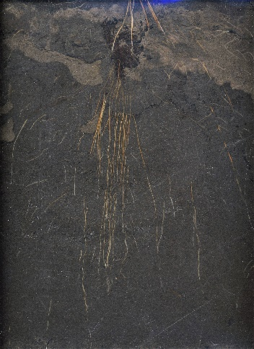

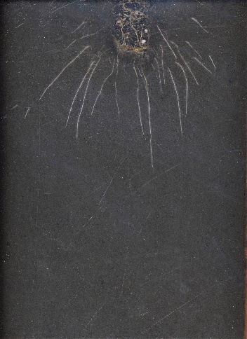
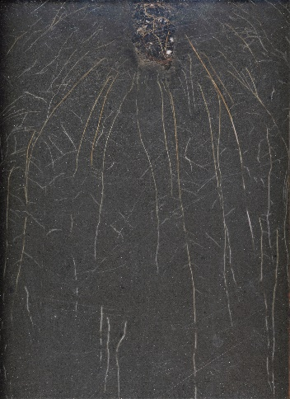
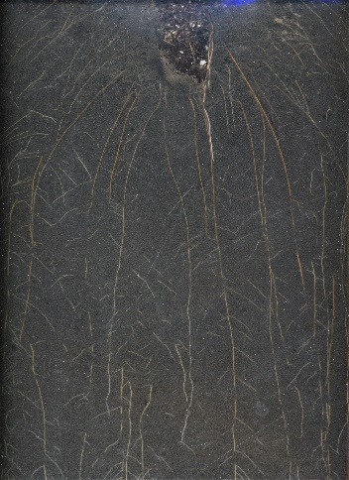
Root morphology
0 DAP
14 DAP
28 DAP
42 DAP
Bare-root transplant
Plug transplant

Slide 19
Summary
Reflective mulch is highly effective in improving early-season yield of both bare-root and plug transplants.
‘Radiance’ is most responsive to reflective mulch – heat sensitivity.
3-4 wk of initial high N fertilization is adequate for the establishment of ‘Brilliance’ plants.
Ideal canopy size depends on many factors – yield, insect damage, fruit exposure, spray penetration, etc.
Initial seedling leaves are important for the establishment – photosynthesis and nutrient translocation.

Slide 20


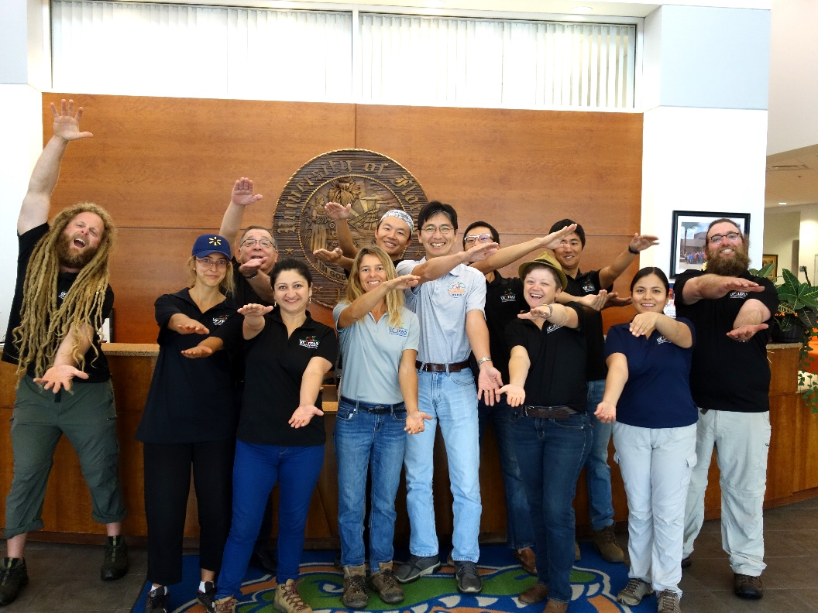
Acknowledgments
Funding
Florida Strawberry Research and Education Foundation
IMAFLEX USA, Inc.
Collaborators
Dr. Vance Whitaker
Ralf Dujardin, IMAFLEX
Tim Dolan, Intergro
Florida Strawberry Grower Association
Chemical Dynamics
Plant Physiology Lab
Tia Silvasy (Biological Scientist II)
Dr. Aleyda Acosta
Dr. Dante Pinochet
Dr. Atsushi Sanada
Syuan-you Lin (PhD)
Jose Hernandez (MS)
Chris DelCastillo
Bill Wang
Lilian Pride
Tyler Orr
Amanda Rivera

