Slide 1
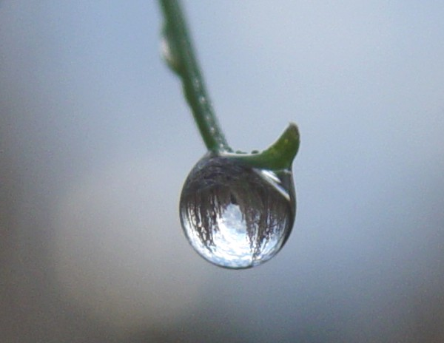
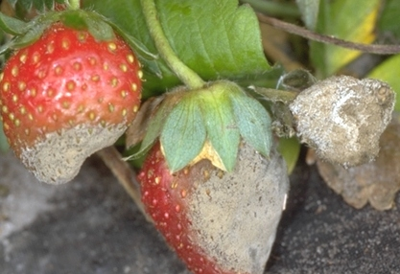
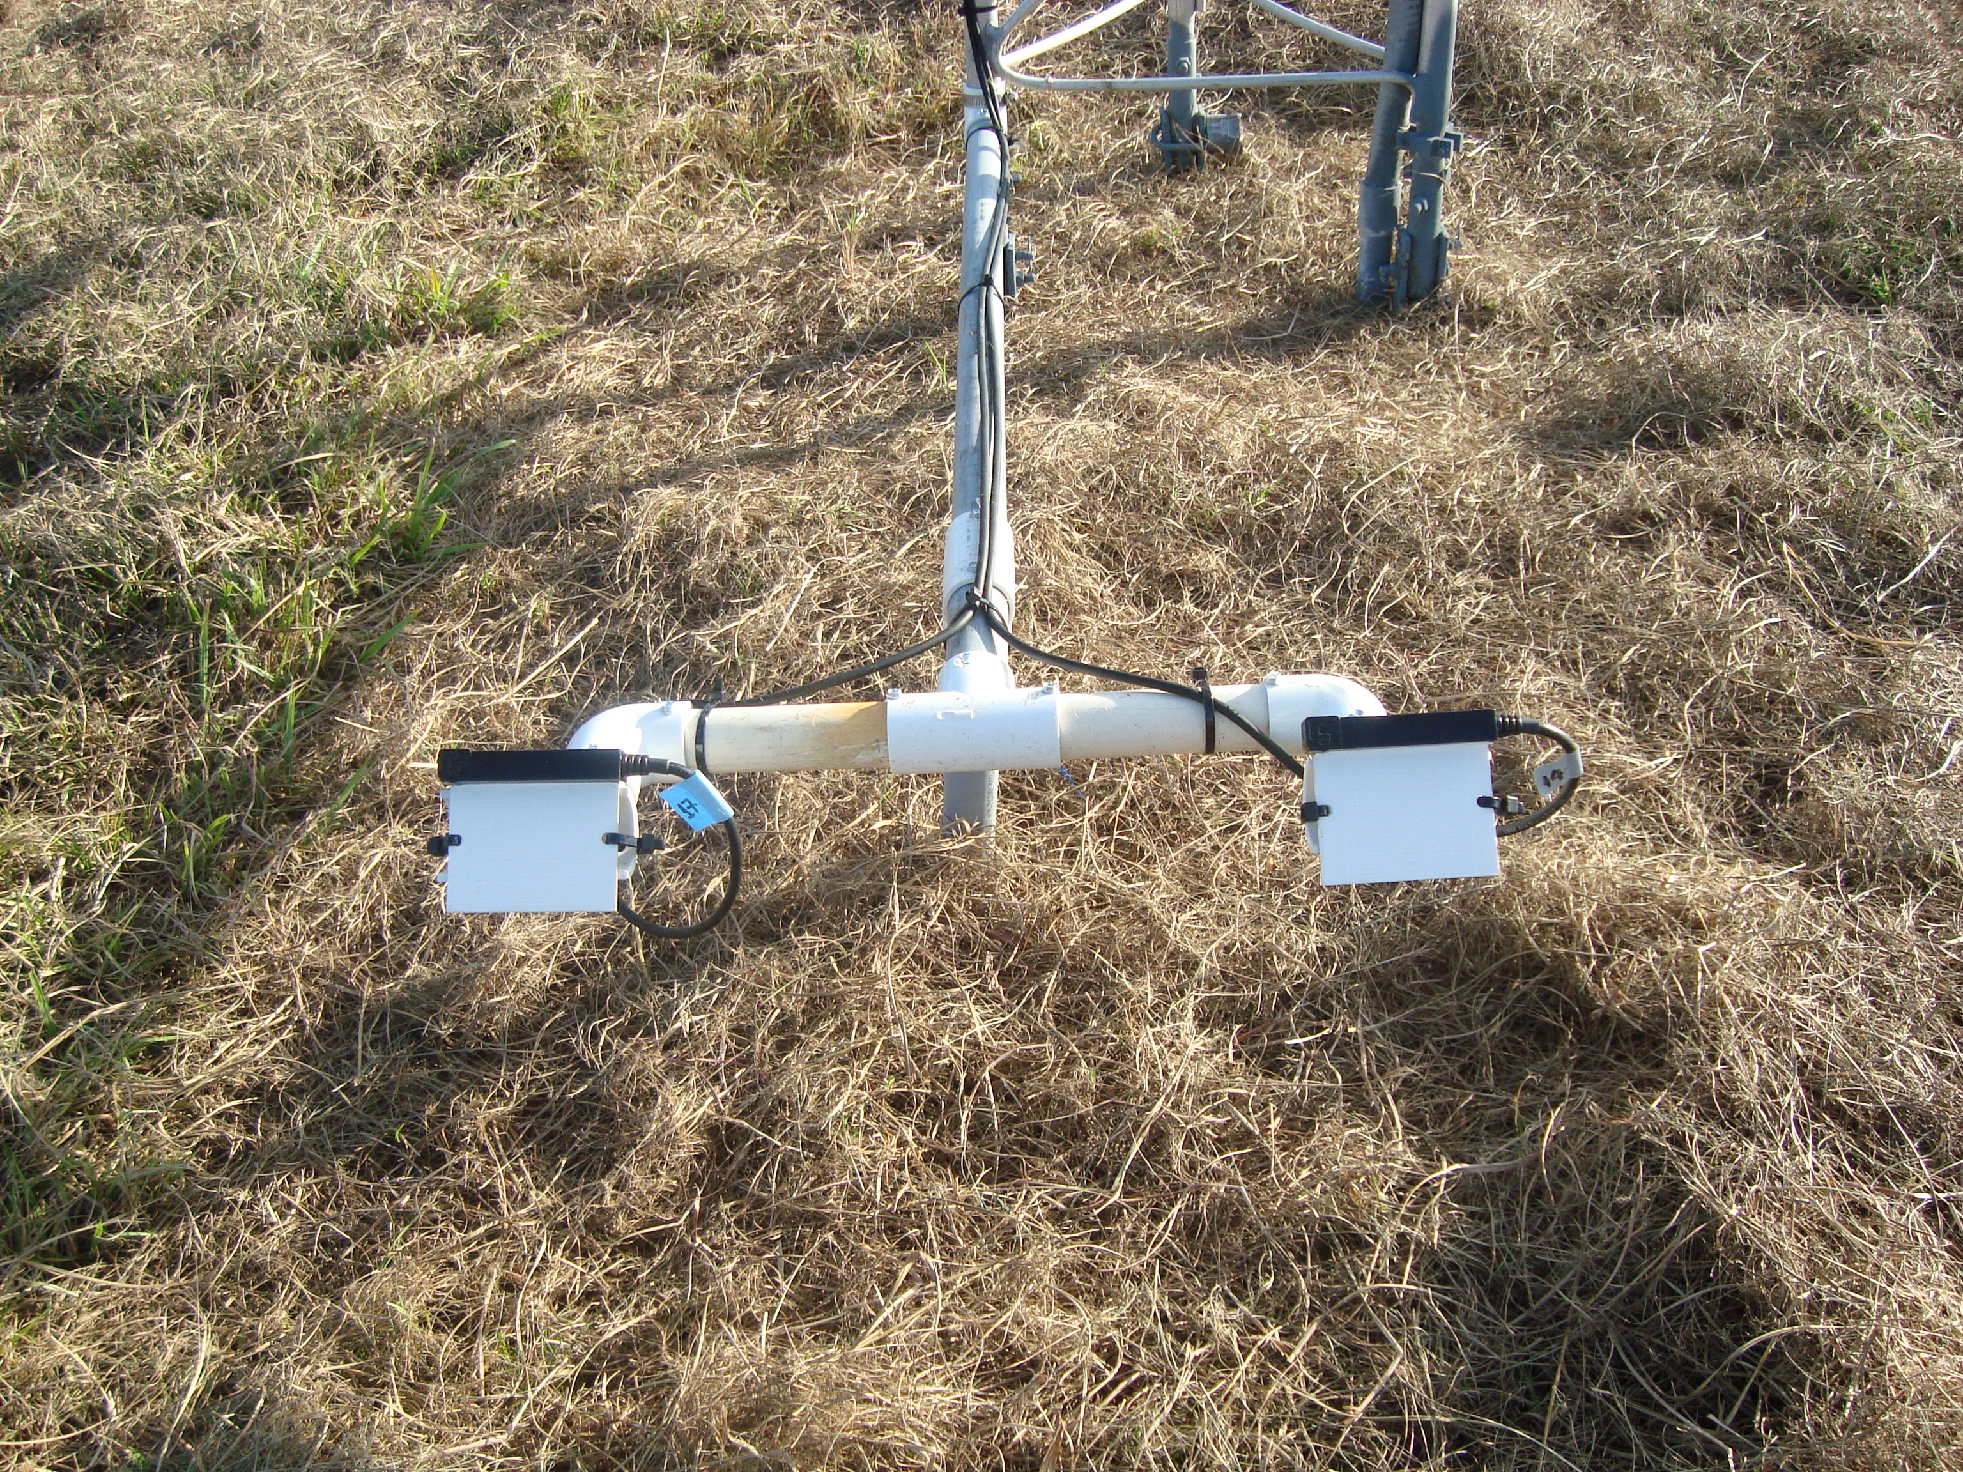
SAS Pro: A Mobile Tool for Strawberry Disease Control and Fungicide Resistance Strategies
Clyde Fraisse , José Andreis and Natália Peres
Strawberry Agritech
Plant City, Florida
April 2018

Slide 2
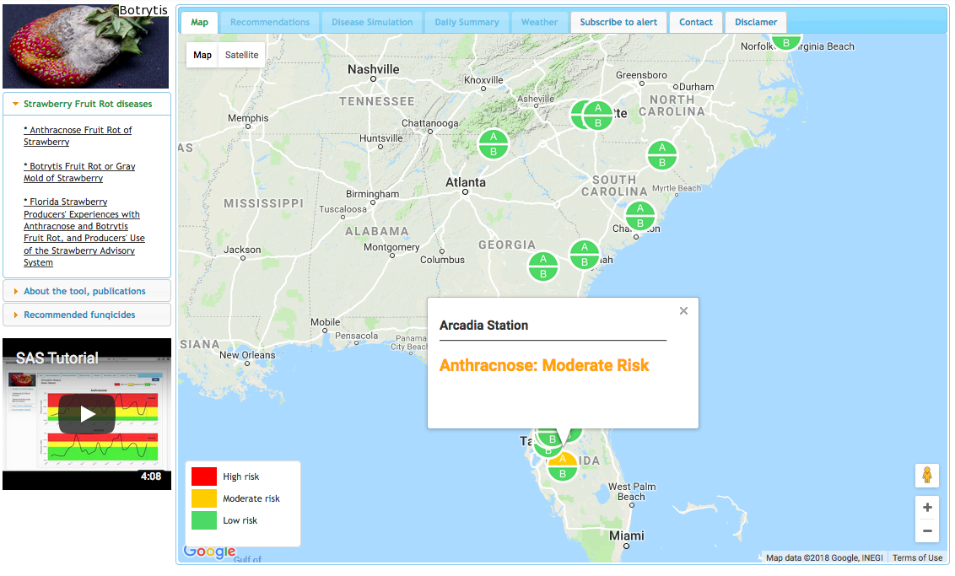
Strawberry Advisory System (SAS) Anthracnose and Botrytis
Fraisse, Clyde. UF-IFAS

Slide 3
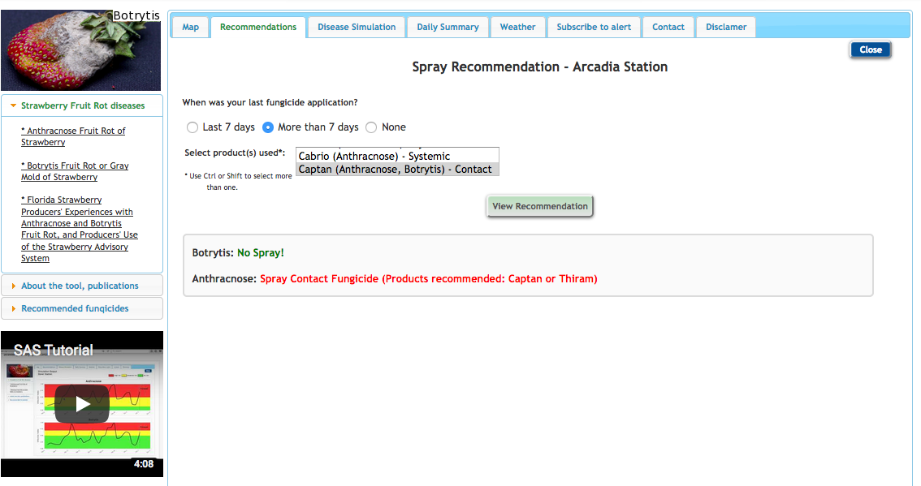
Strawberry Advisory System (SAS) Anthracnose and Botrytis
Fraisse, Clyde. UF-IFAS

Slide 4
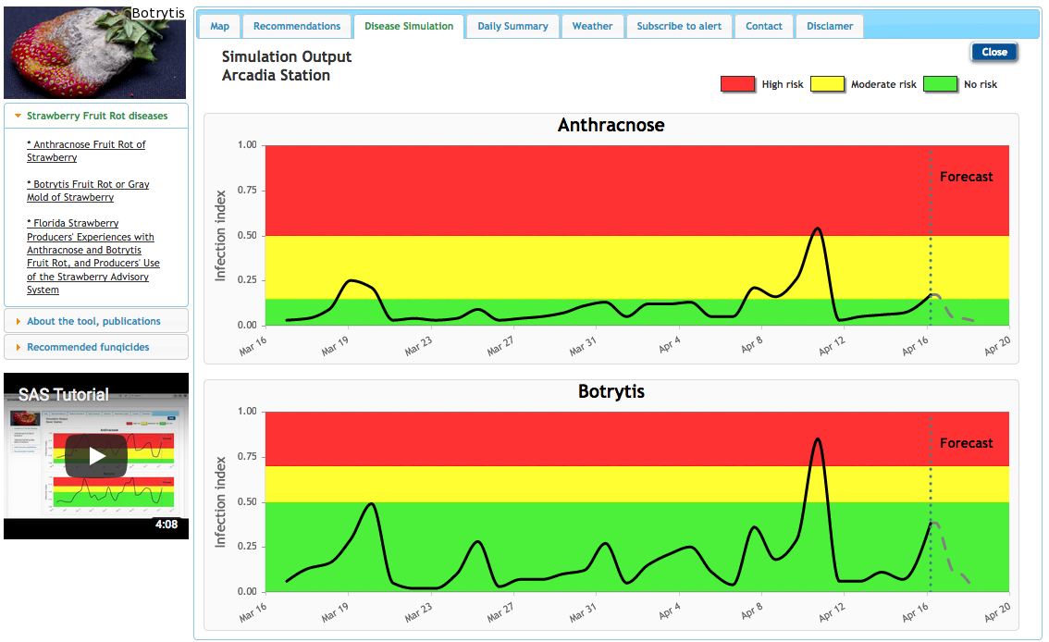
Strawberry Advisory System (SAS) Anthracnose and Botrytis
Fraisse, Clyde. UF-IFAS

Slide 5
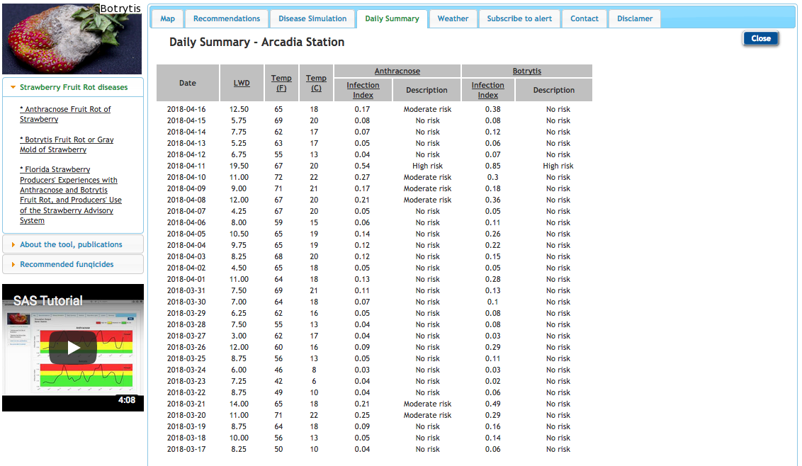
Strawberry Advisory System (SAS) Anthracnose and Botrytis
Fraisse, Clyde. UF-IFAS

Slide 6
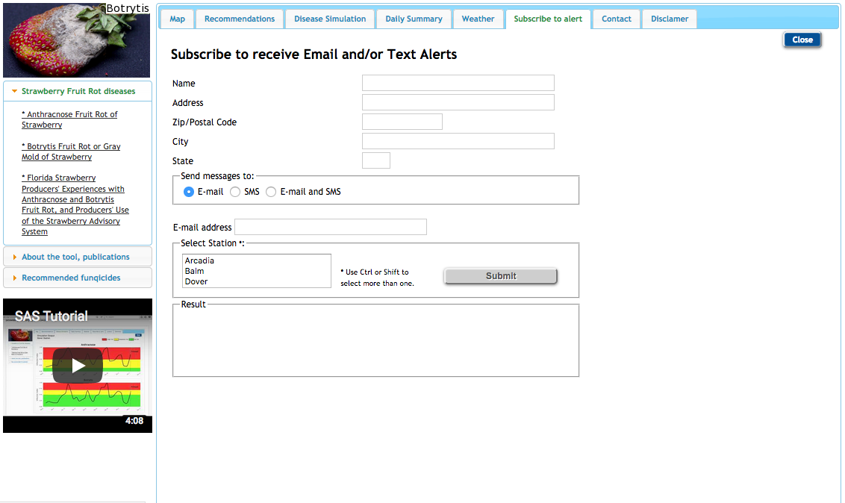
Strawberry Advisory System (SAS) Anthracnose and Botrytis
Fraisse, Clyde. UF-IFAS

Slide 7
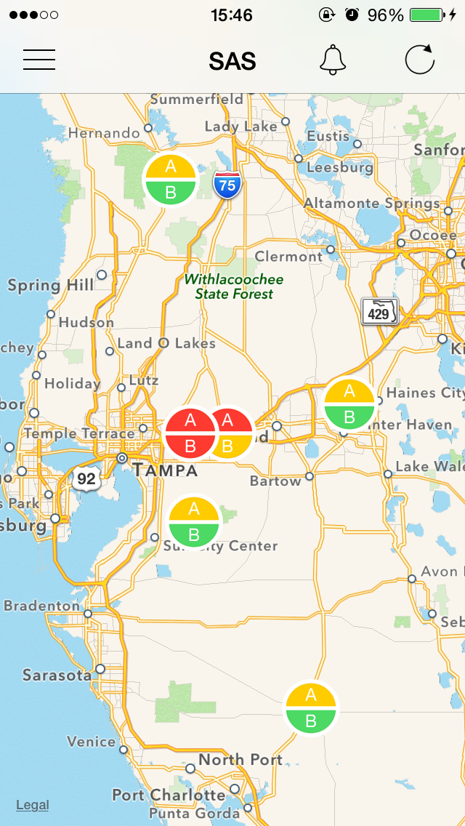
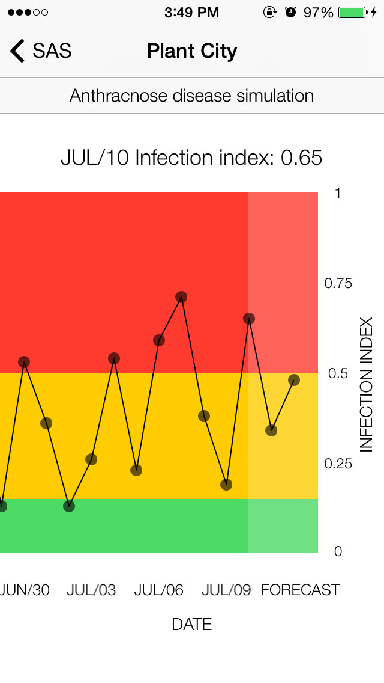
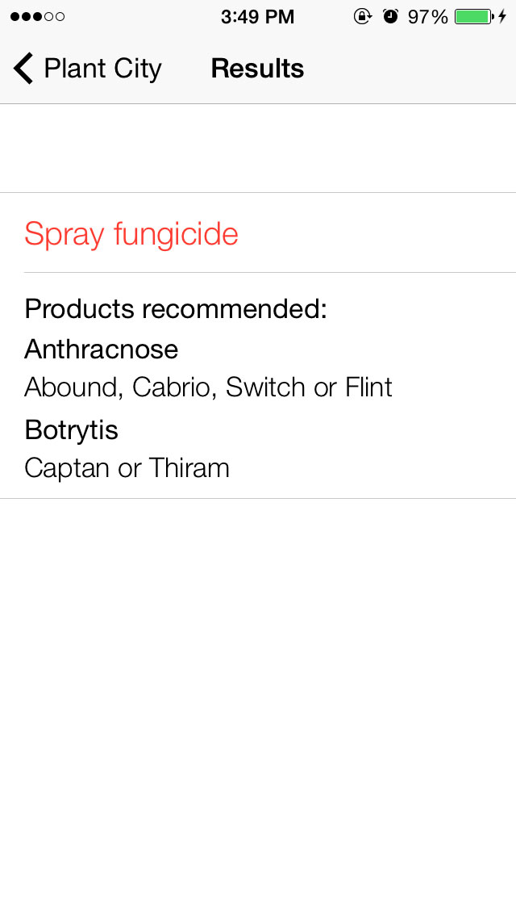
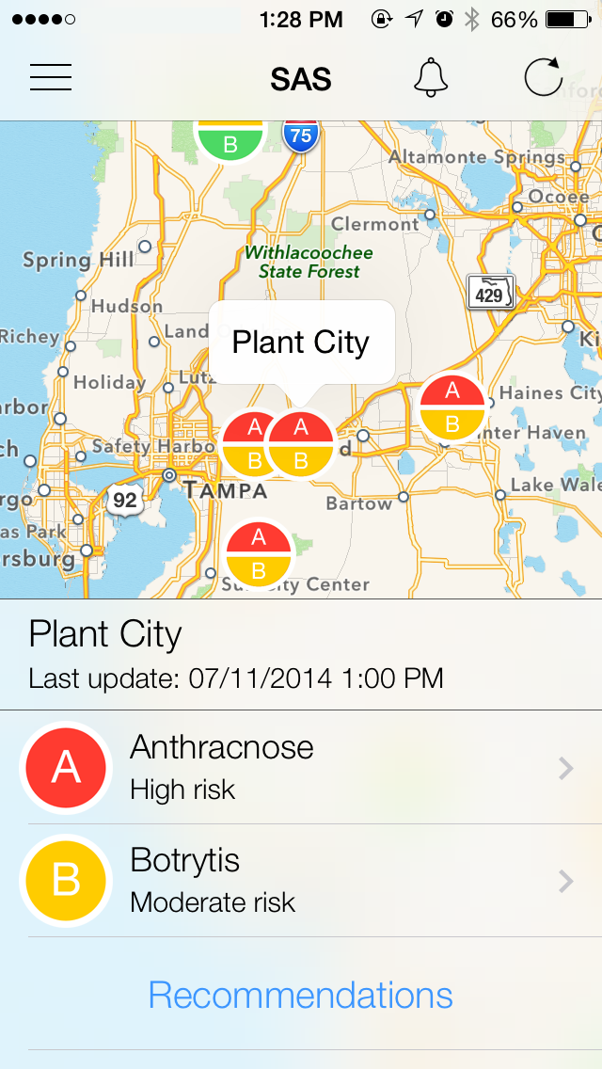
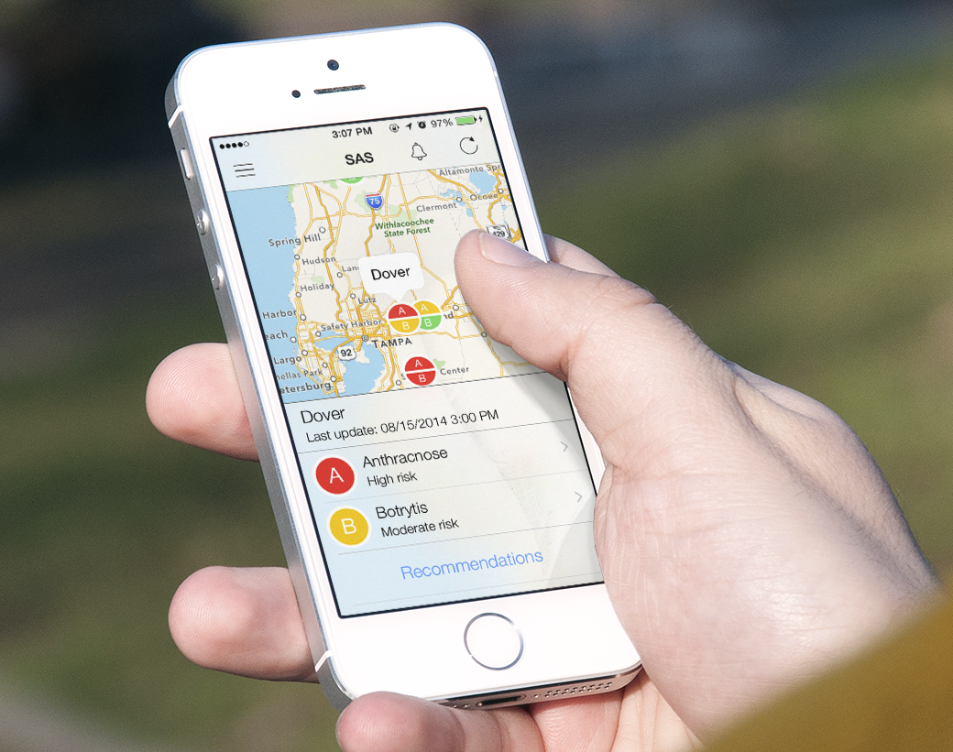
SAS App
Monitors infection risk for Anthracnose and Botrytis fruit rot
Users receive notification messages when the model detects a potential infection risk according to observed weather conditions
Fraisse, Clyde. UF-IFAS

Slide 8
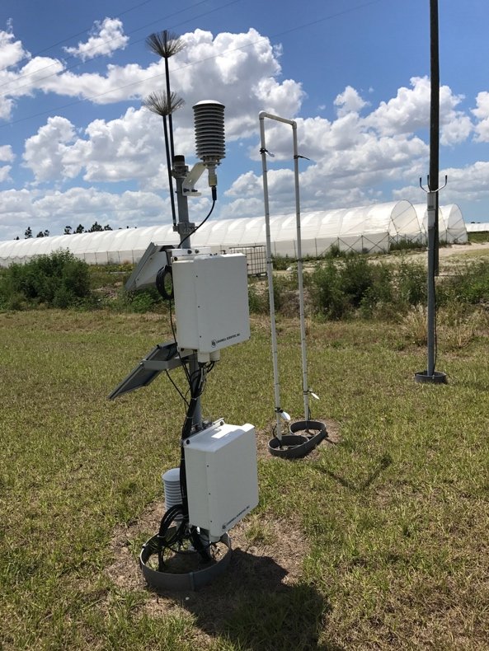
SAS vs SAS Pro
Current SAS relates to a weather station, not to a field
Fraisse, Clyde. UF-IFAS

Slide 9
SAS vs SAS Pro
Current SAS relates to a weather station, not to a field
SASPro focus on the field and requires additional information to improve recommendations and services:
Origin of plant materials
Variety
Spray records
Location, acreage planted
Fraisse, Clyde. UF-IFAS

Slide 10
SAS Pro Objective
Develop an improved mobile app integrating field management information, disease infection models and fungicide resistance management guidelines.
Fraisse, Clyde. UF-IFAS

Slide 11
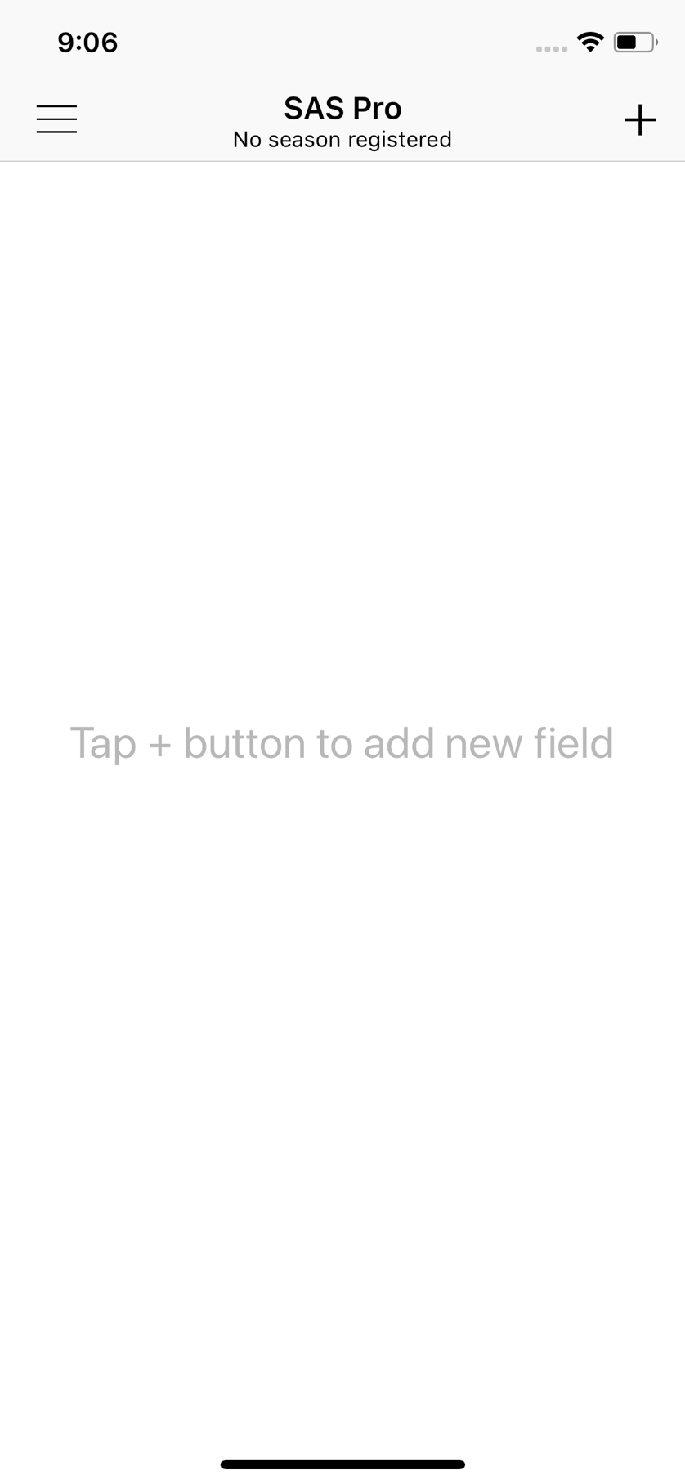
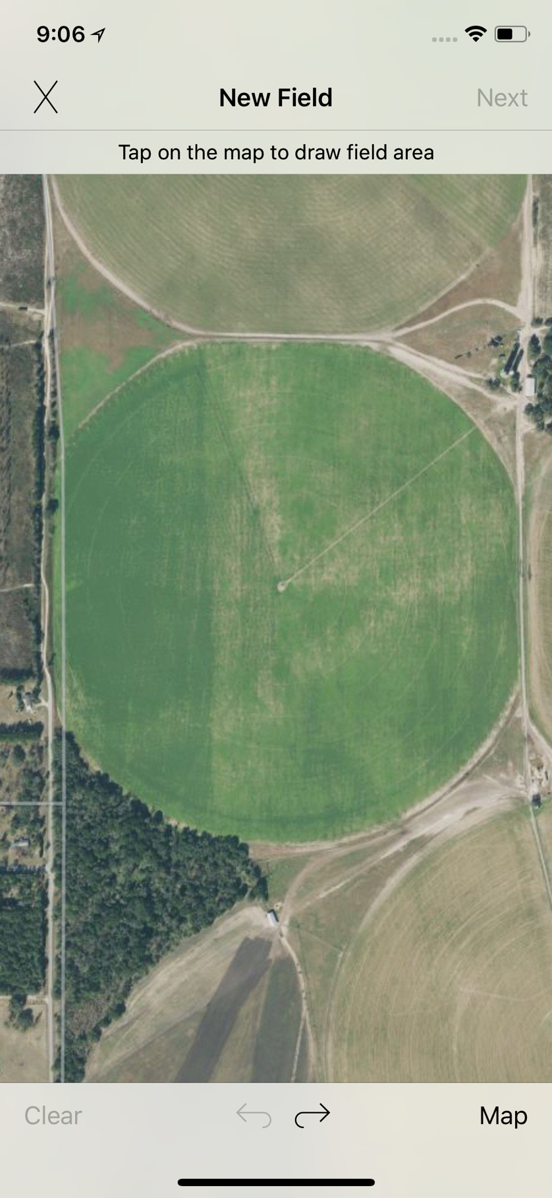
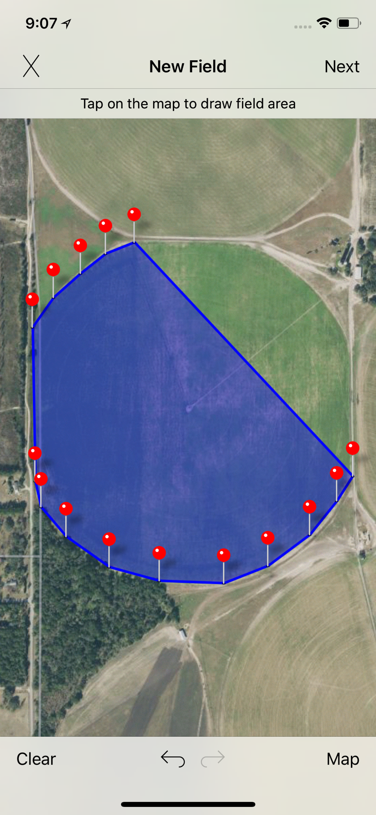
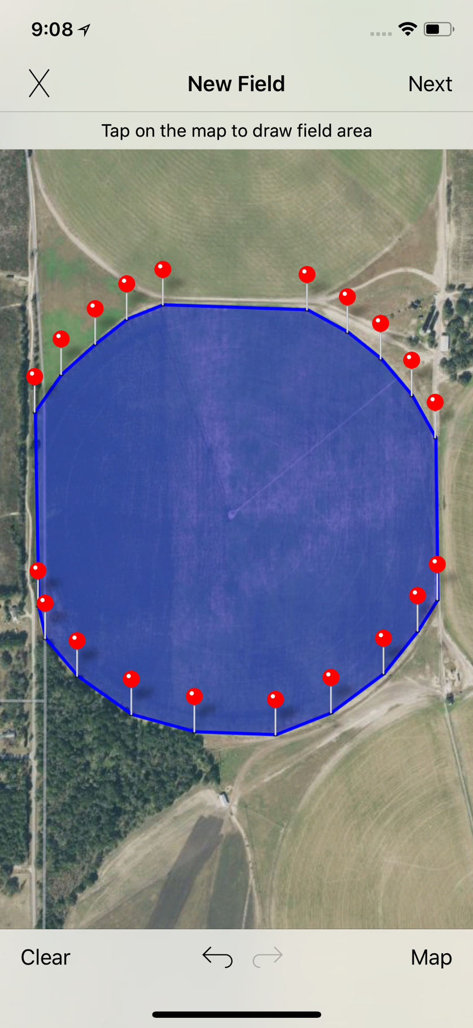
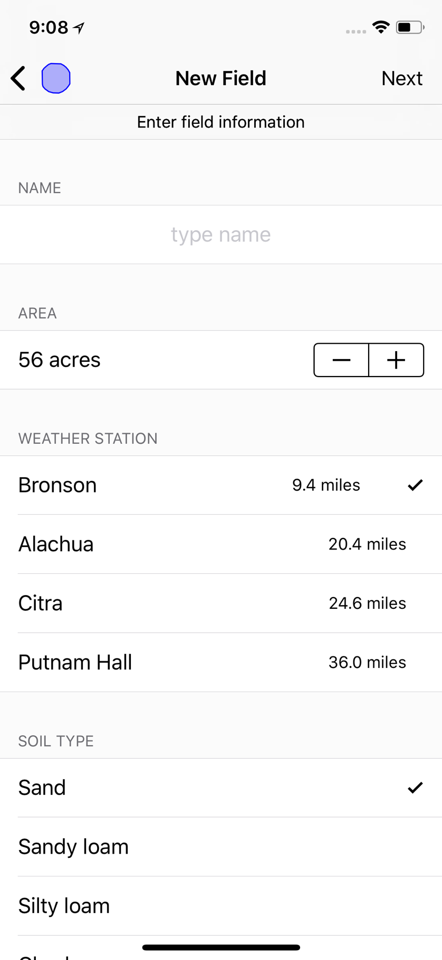
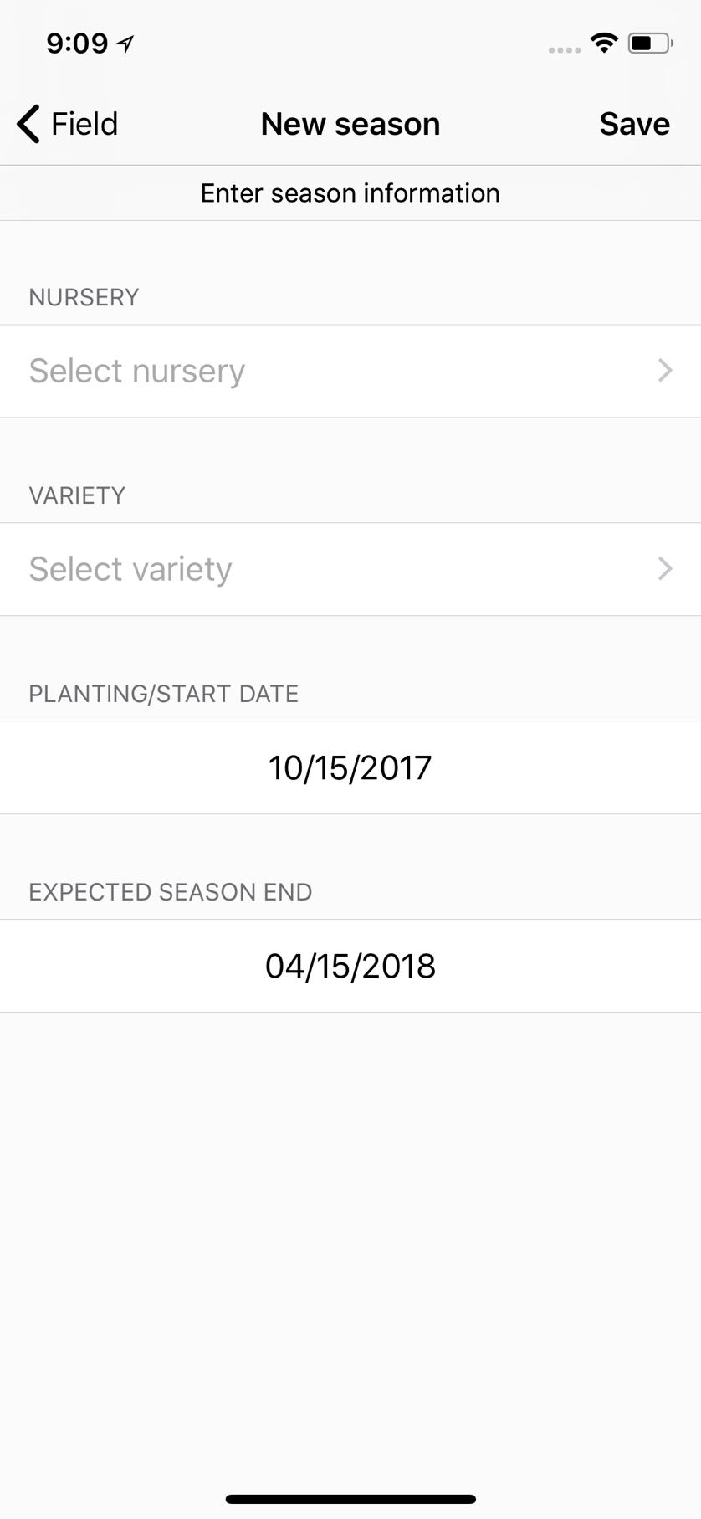
SAS Pro – Fields and Seasons
Adding fields
Zoom to your area of interest (by default it sets the map to your current location)
Plot the field boundaries (you can delete points or clear if making too many mistakes)
Field information
Name
Field area (calculated but it can be adjusted)
Weather station (by default it selects the closest in the system but you can select a different one)
Soil texture
Season information
Nursery
Variety planted
Start planting date
Expected end date
Fraisse, Clyde. UF-IFAS

Slide 12
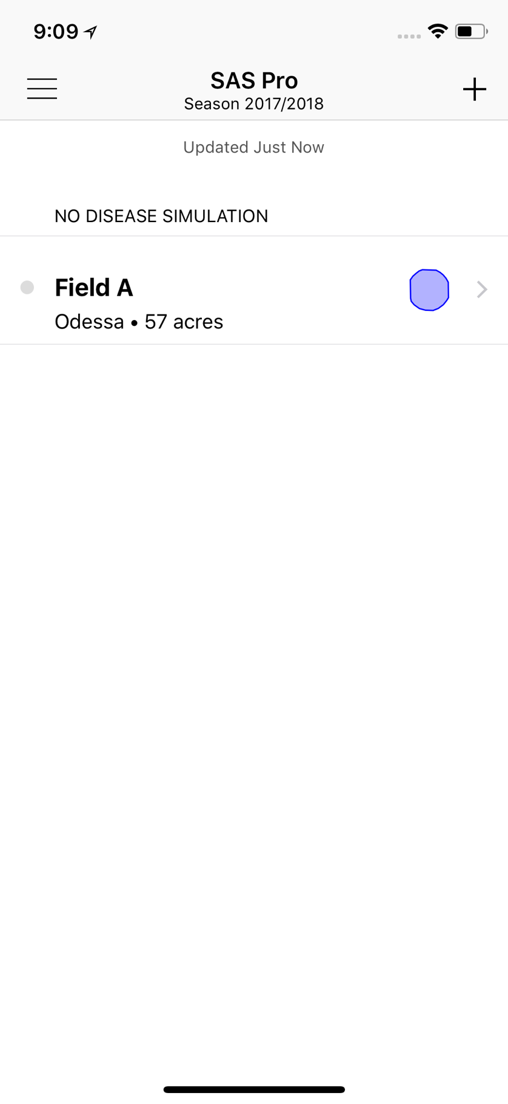
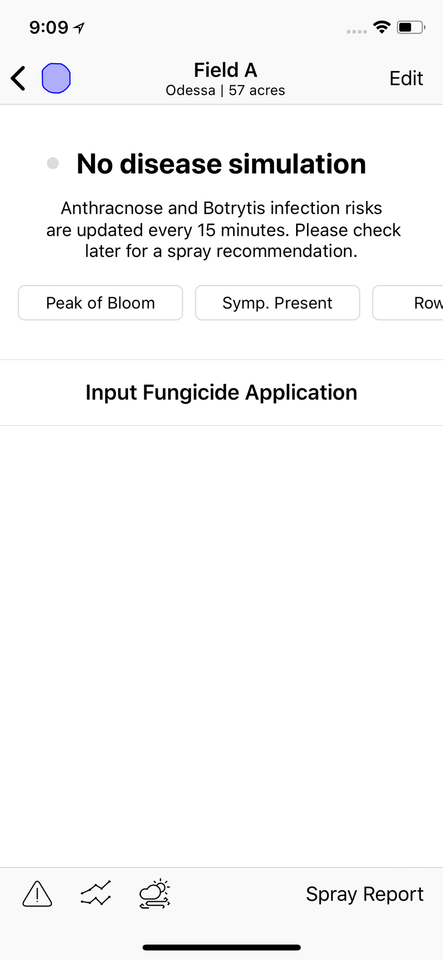
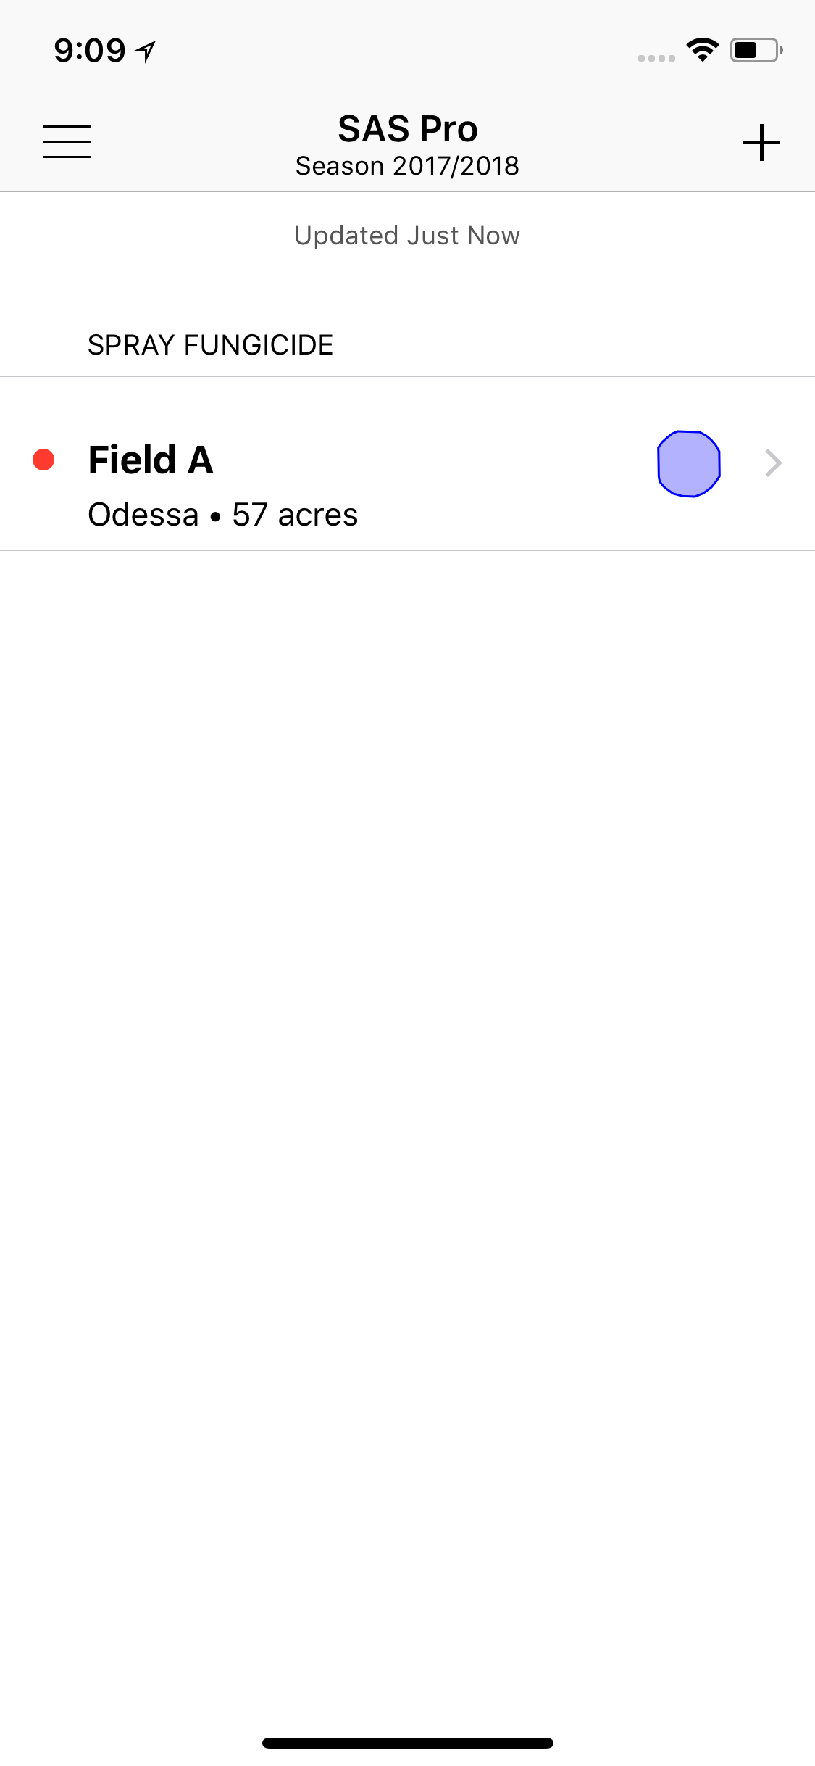
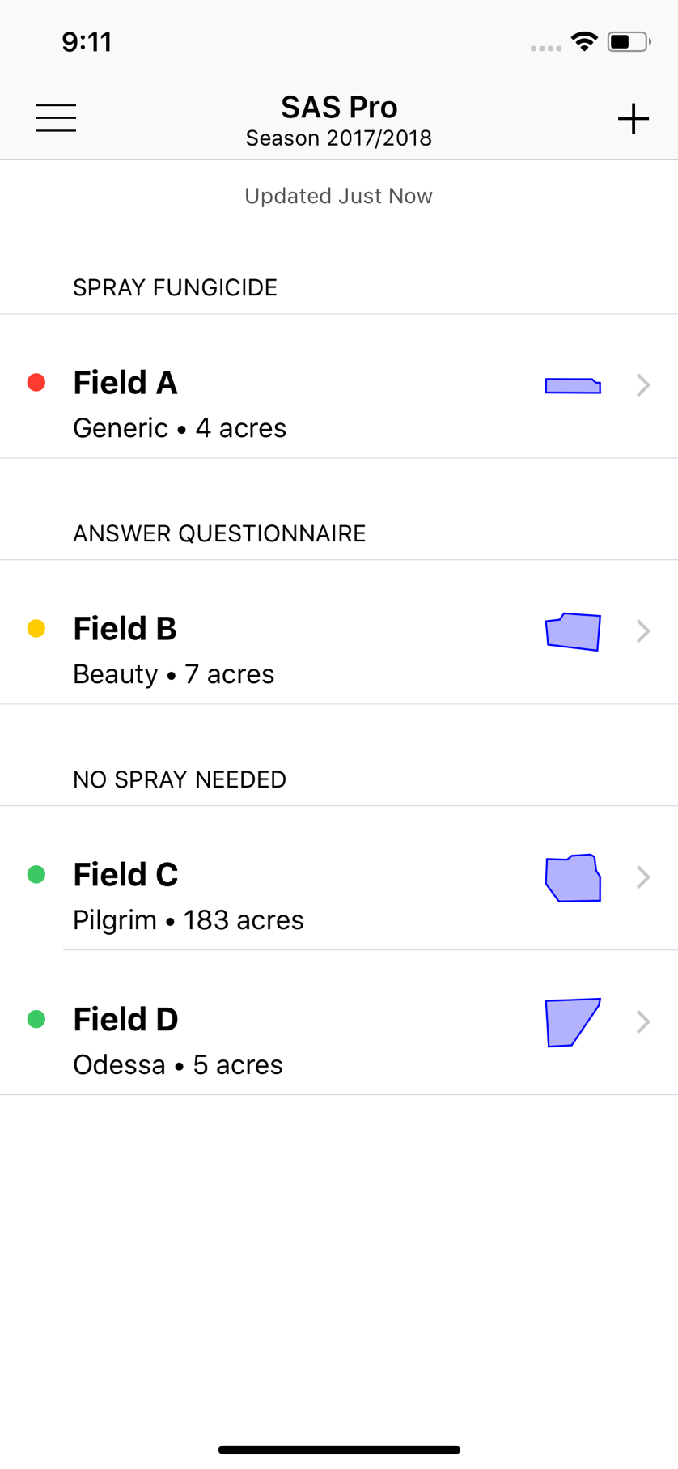
SAS Pro – Fields and tasks
Recommendations are generated every 15 minutes
Fields are grouped by action and priority:
Spray fungicide (red),
Need additional information (yellow),
No spray needed (green).
Fraisse, Clyde. UF-IFAS

Slide 13
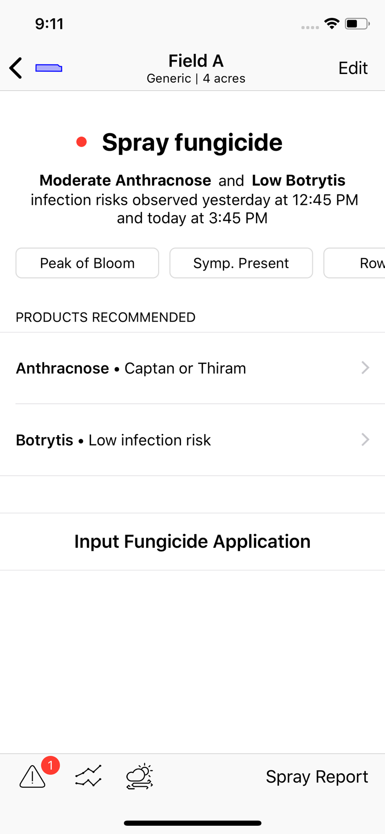
SAS Pro – Recommendations
Spray fungicide
Moderate risk for Anthracnose was observed yesterday at 12:45 PM.
Recommended products
Based on:
Recent sprays;
Observed symptoms;
Peak of bloom or not;
Rotation of fungicide active ingredient
Option to enter spray record
Fraisse, Clyde. UF-IFAS

Slide 14
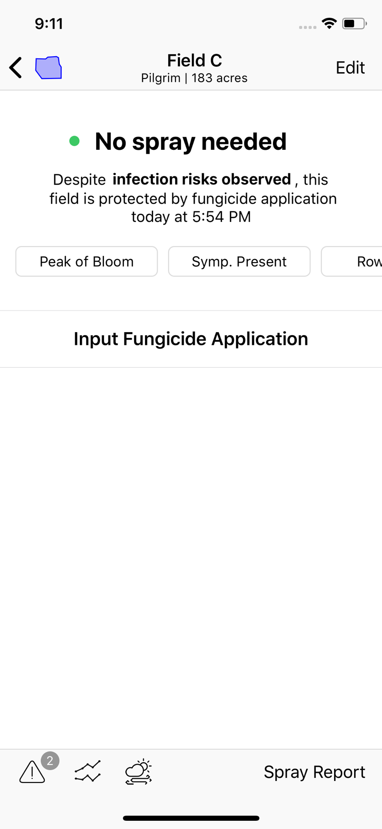
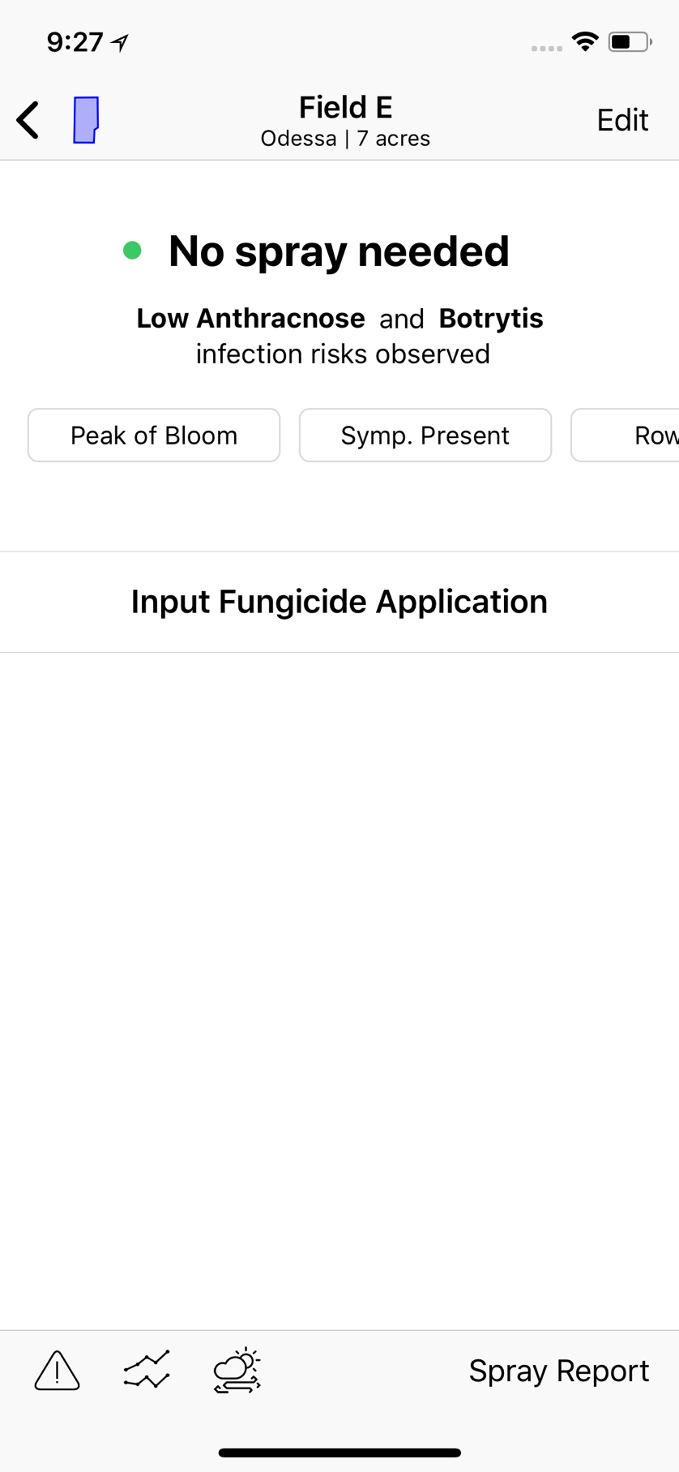
SAS Pro – Recommendations
No spray needed
In spite of the low simulated risk for Anthracnose and Botrytis no spray is recommended for this field due to the fungicide application performed today at 5:54 PM.
Low risk for Anthracnose and Botrytis.
Fraisse, Clyde. UF-IFAS

Slide 15
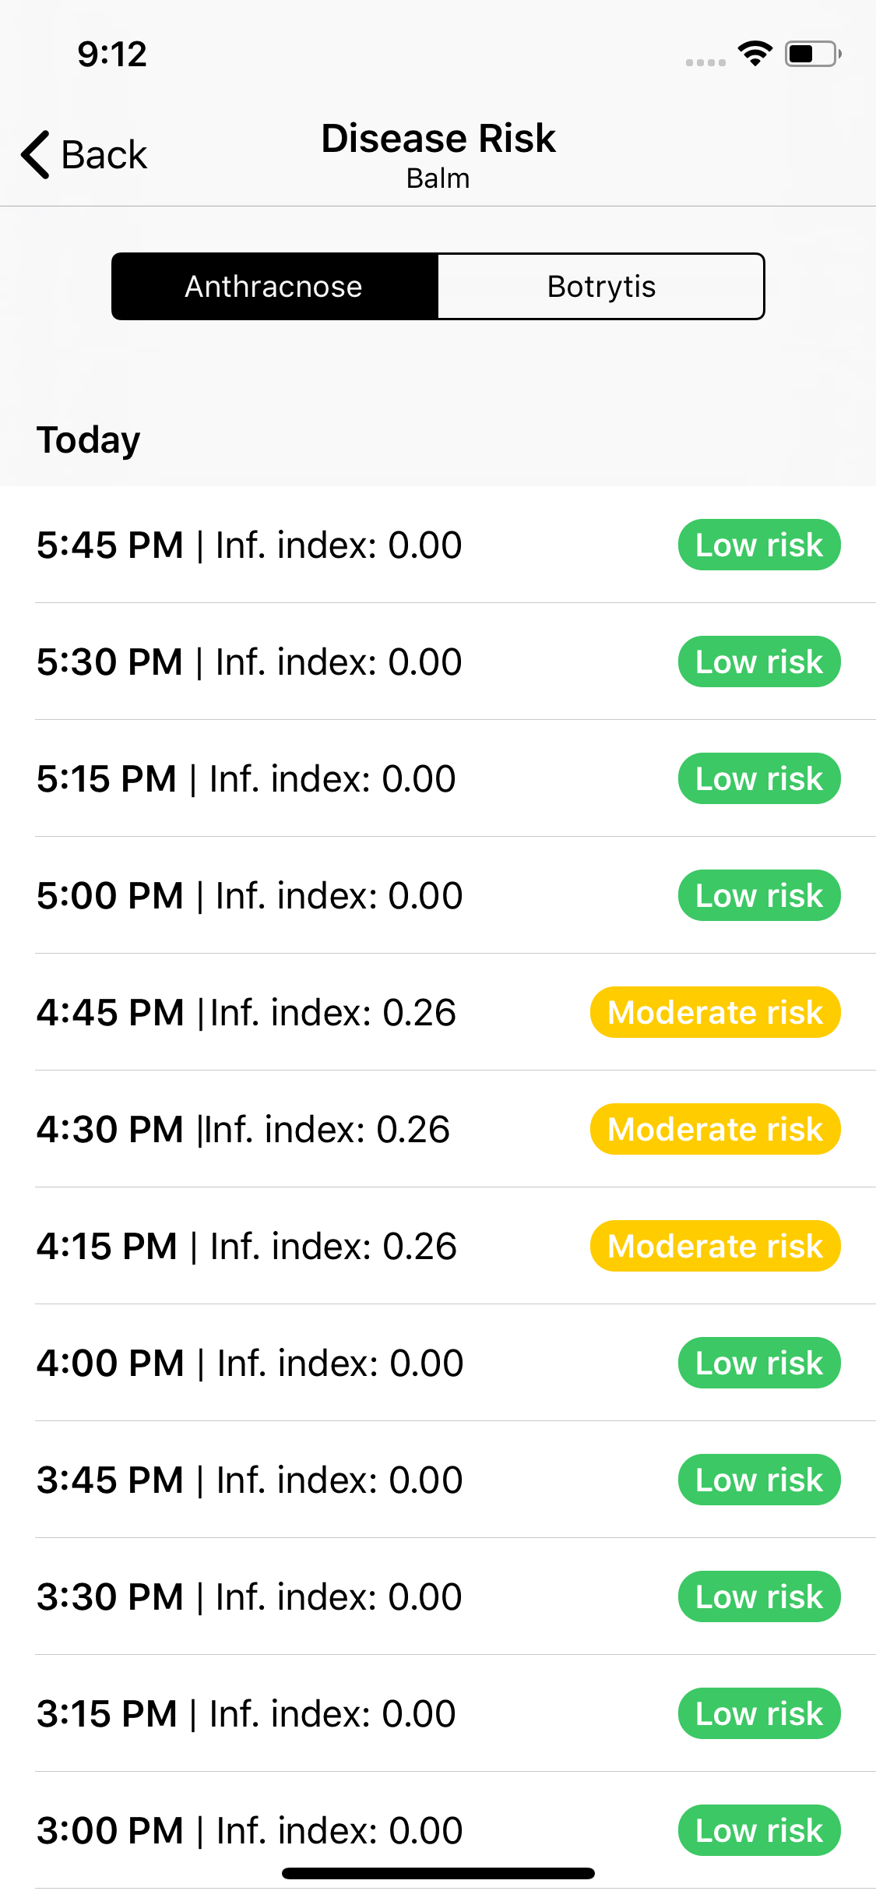
SAS Pro – Disease model simulation
Select supported models: Anthracnose e Botrytis.
All simulations performed during the last 7 days;
Allow the identification of simulated risk levels that triggered a spray recommendation.
>
>
Options for visualizing simulation results
Anthracnose simulation during the last 7 days.
Fraisse, Clyde. UF-IFAS

Slide 16
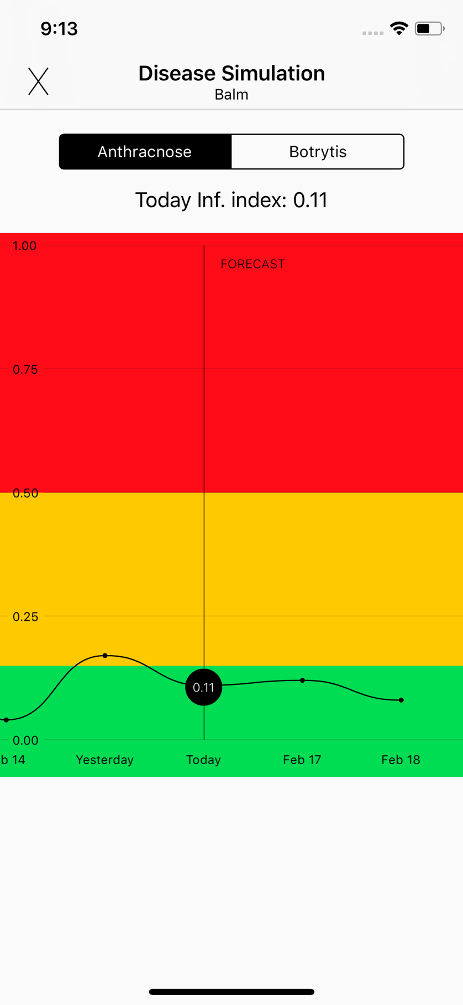
SAS Pro – Simulations
Select supported models: Anthracnose e Botrytis.
Maximum infection index daily values during the last 30 days;
Forecast for the next two days.
Icon for accessing simulation graphs
Simulation for the past 30 days and forecast for the next 2 days.
Fraisse, Clyde. UF-IFAS

Slide 17
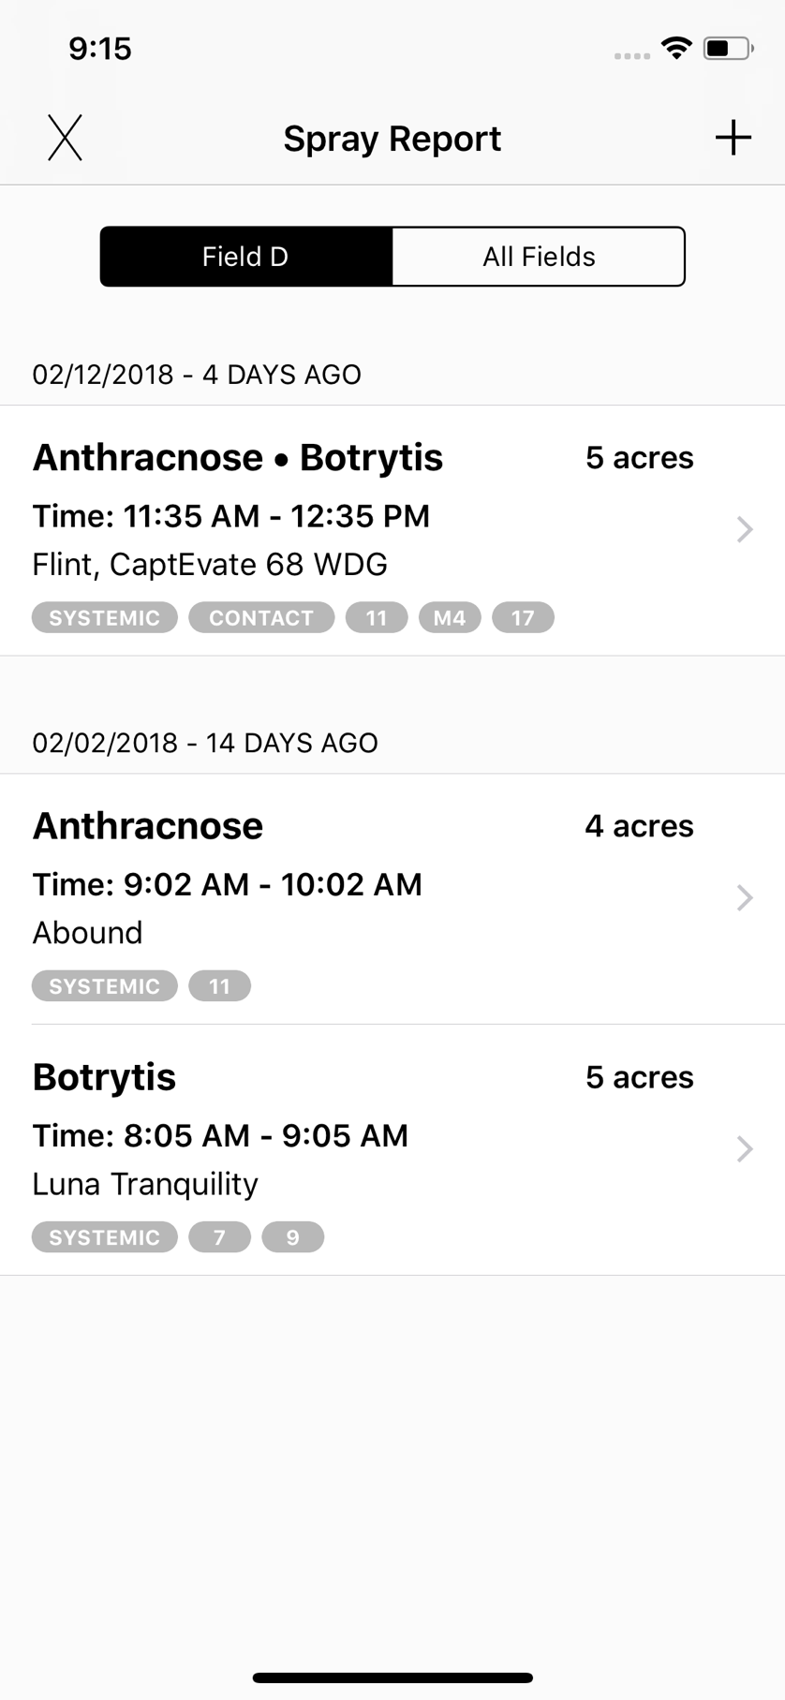
SAS Pro – Spray records
Visualization of spray records during the season (selected field or all fields)
Records are grouped by day ;
Target disease,
Acreage,
Star and end time,
Product used,
Type and FRAC group (Contact, systemic, M4, 11...).
Option to visualize spray records.
Recent sprays.
Fraisse, Clyde. UF-IFAS

Slide 18
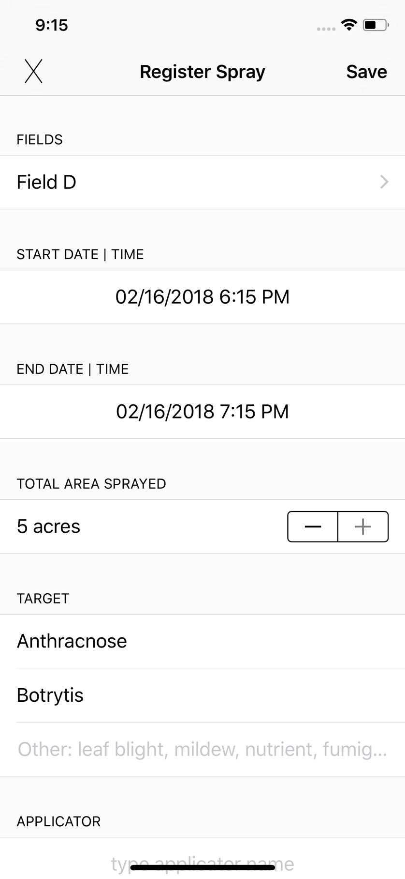
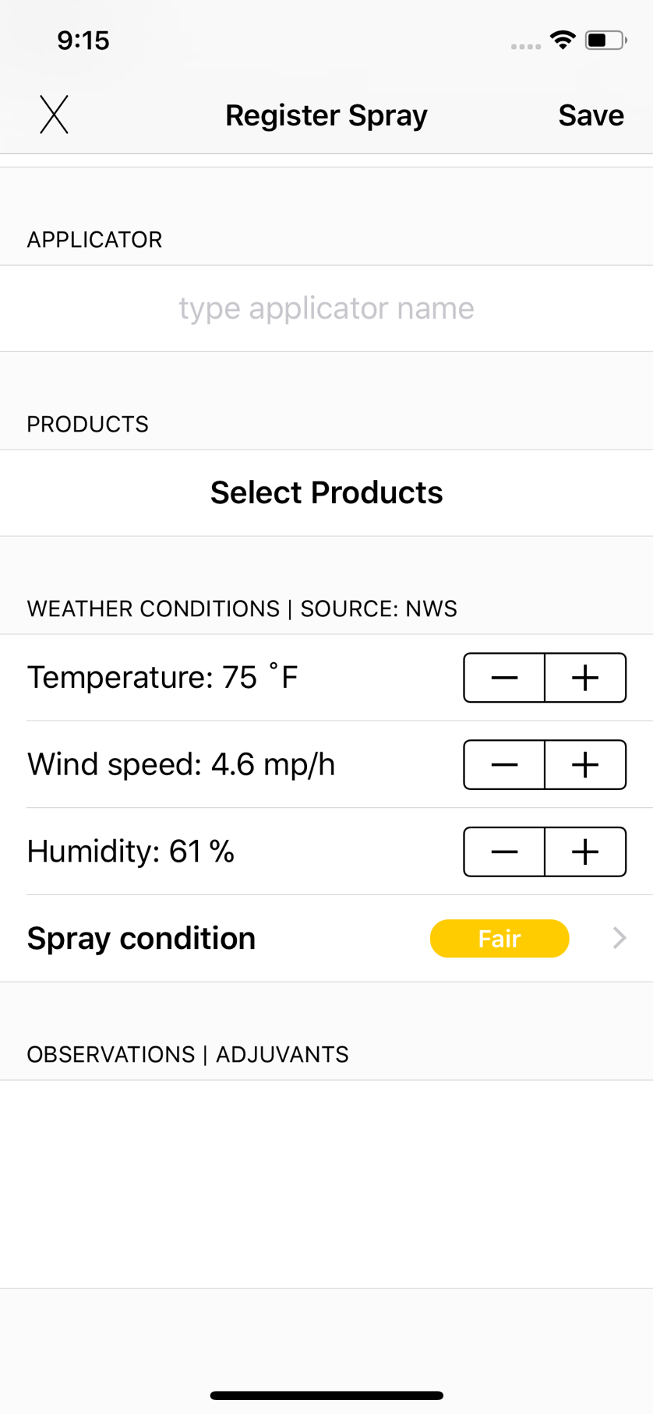
SAS Pro – Spray records
Inputs
Date, start/end time
Acreage,
Target (Anthracnose, Botrytis, others...),
Operator,
Product selection,
Weather conditions (from weather station or manual input)
Observations
Fig. 35 – Opção para registrar uma nova pulverização de fungicida.
Spray record: Operator, products used, weather conditions.
Spray record: Field, date, time, acreage and target.
Fraisse, Clyde. UF-IFAS

Slide 19
Weather conditions during spray
Weather conditions
Weather conditions menu
Fraisse, Clyde. UF-IFAS

Slide 20
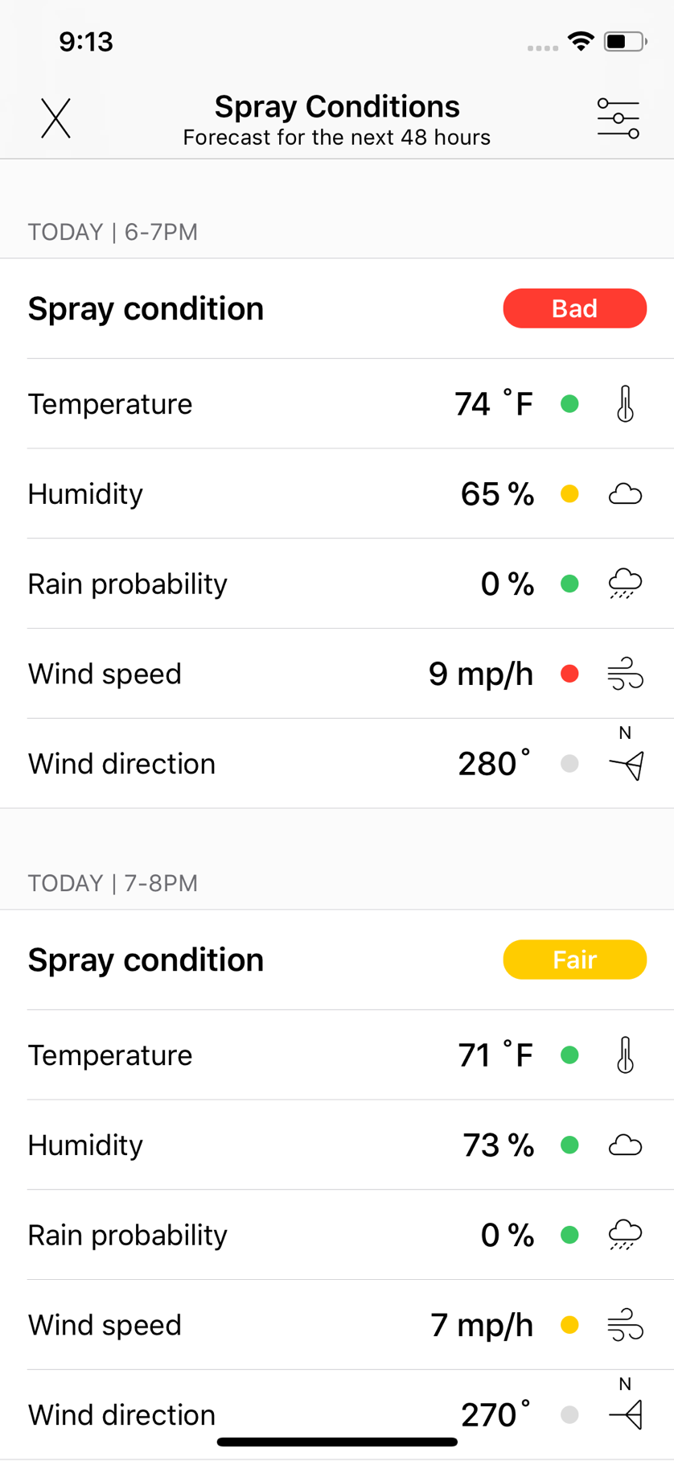
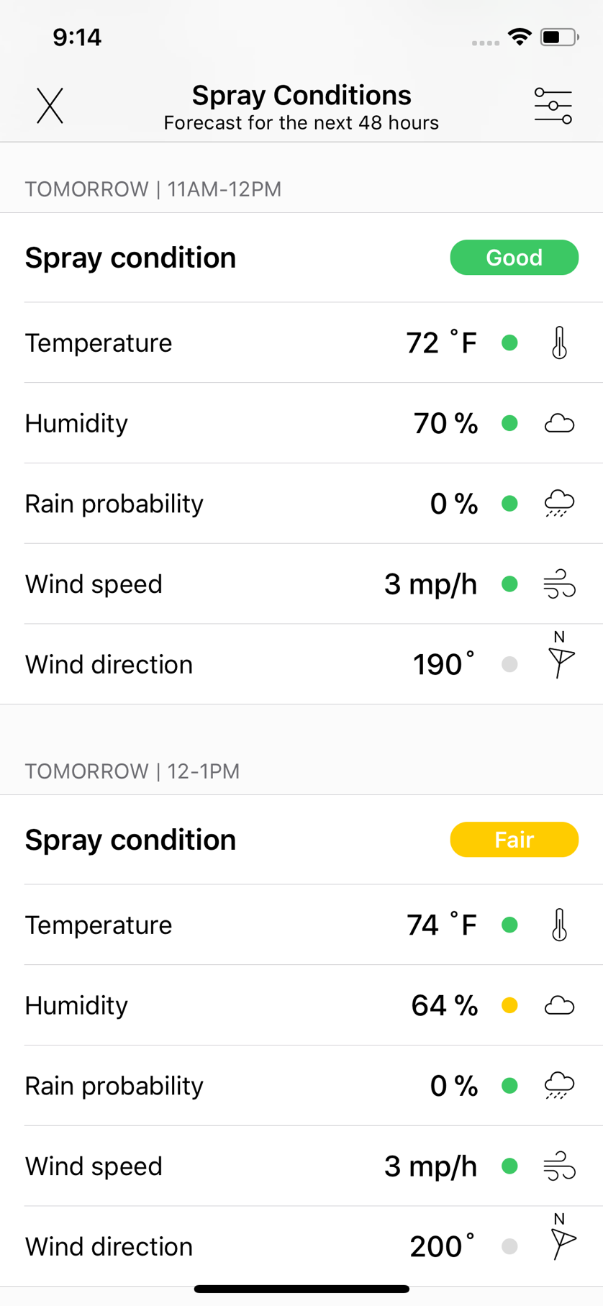
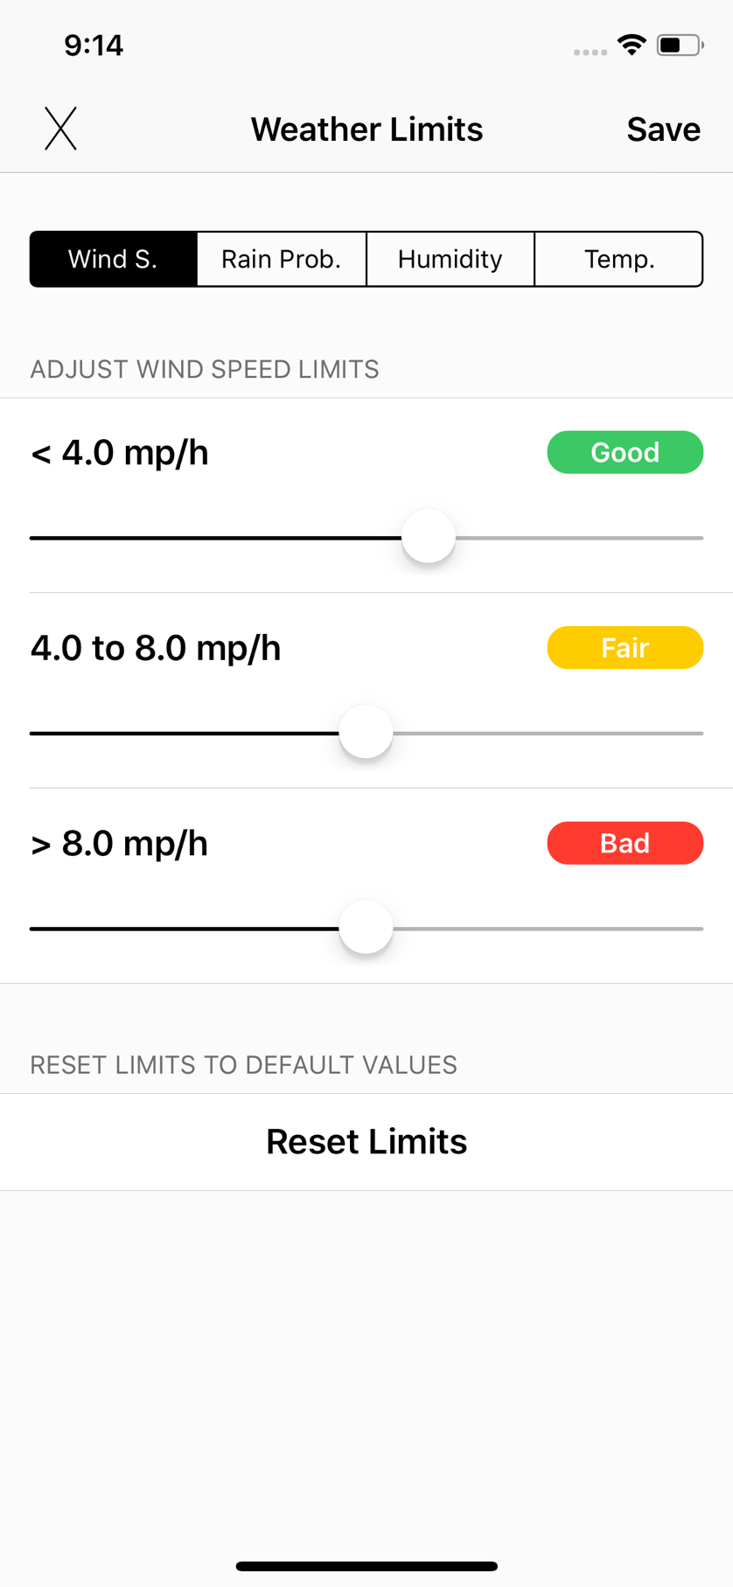
Weather conditions setting
Forecast for the next 48 hours (NWS)
Expected conditions based on:
Temperature,
Wind speed,
Relative humidity,
Rainfall probability;
User can verify current conditions and forecast
Thresholds for bad, fair and good conditions can be modified.
Fig. 40 – Condições ruins e
Settings for wind speed, temperature, relative humidity and rainfall probability
Forecast for the next few hours.
Fraisse, Clyde. UF-IFAS

Slide 21
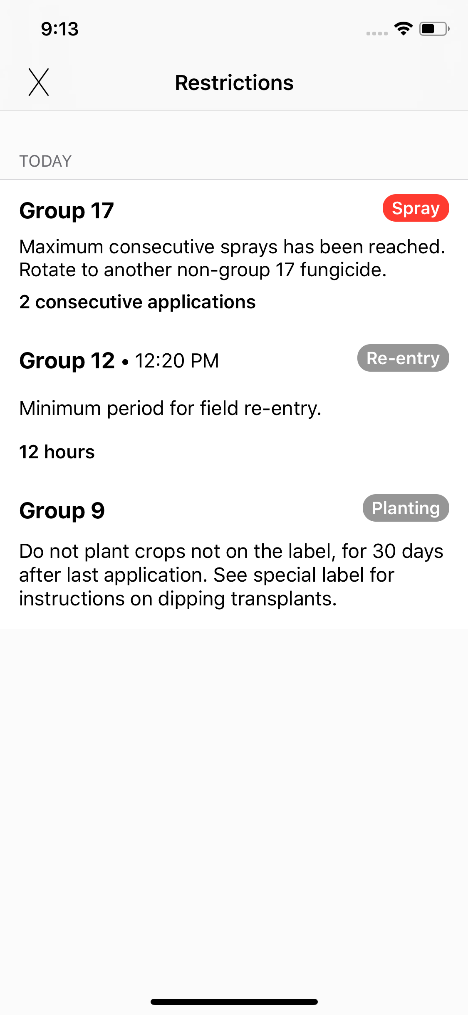
SAS Pro – Spray restrictions
Highlighted according to priority
Restrictions due to the fungicide group are colored red.
Restrictions due to reentry time are colored gray.
Restrictions menu
List of active restrictions.
Fraisse, Clyde. UF-IFAS

Slide 22
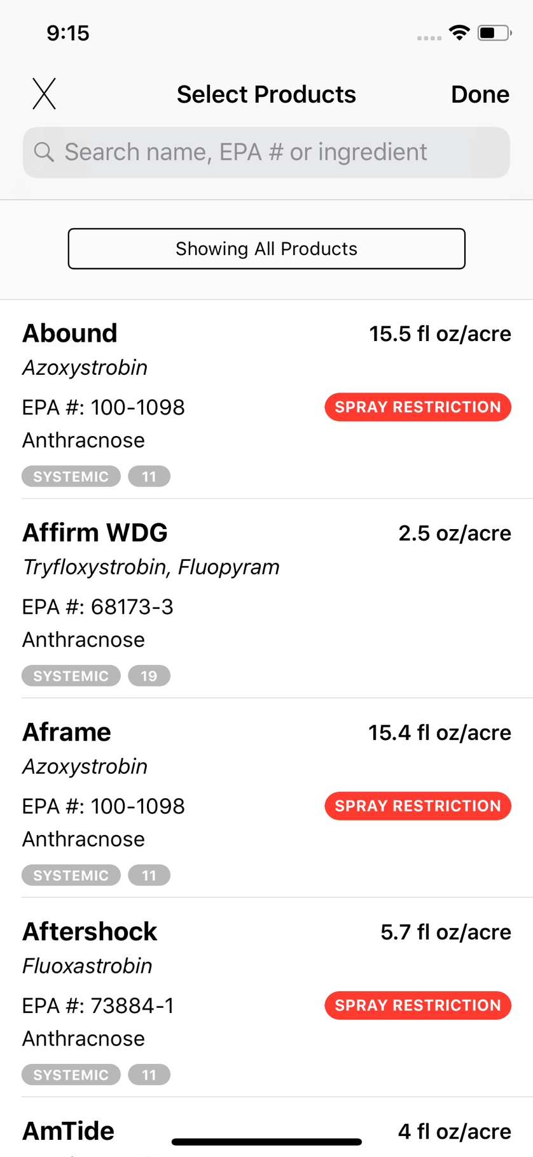
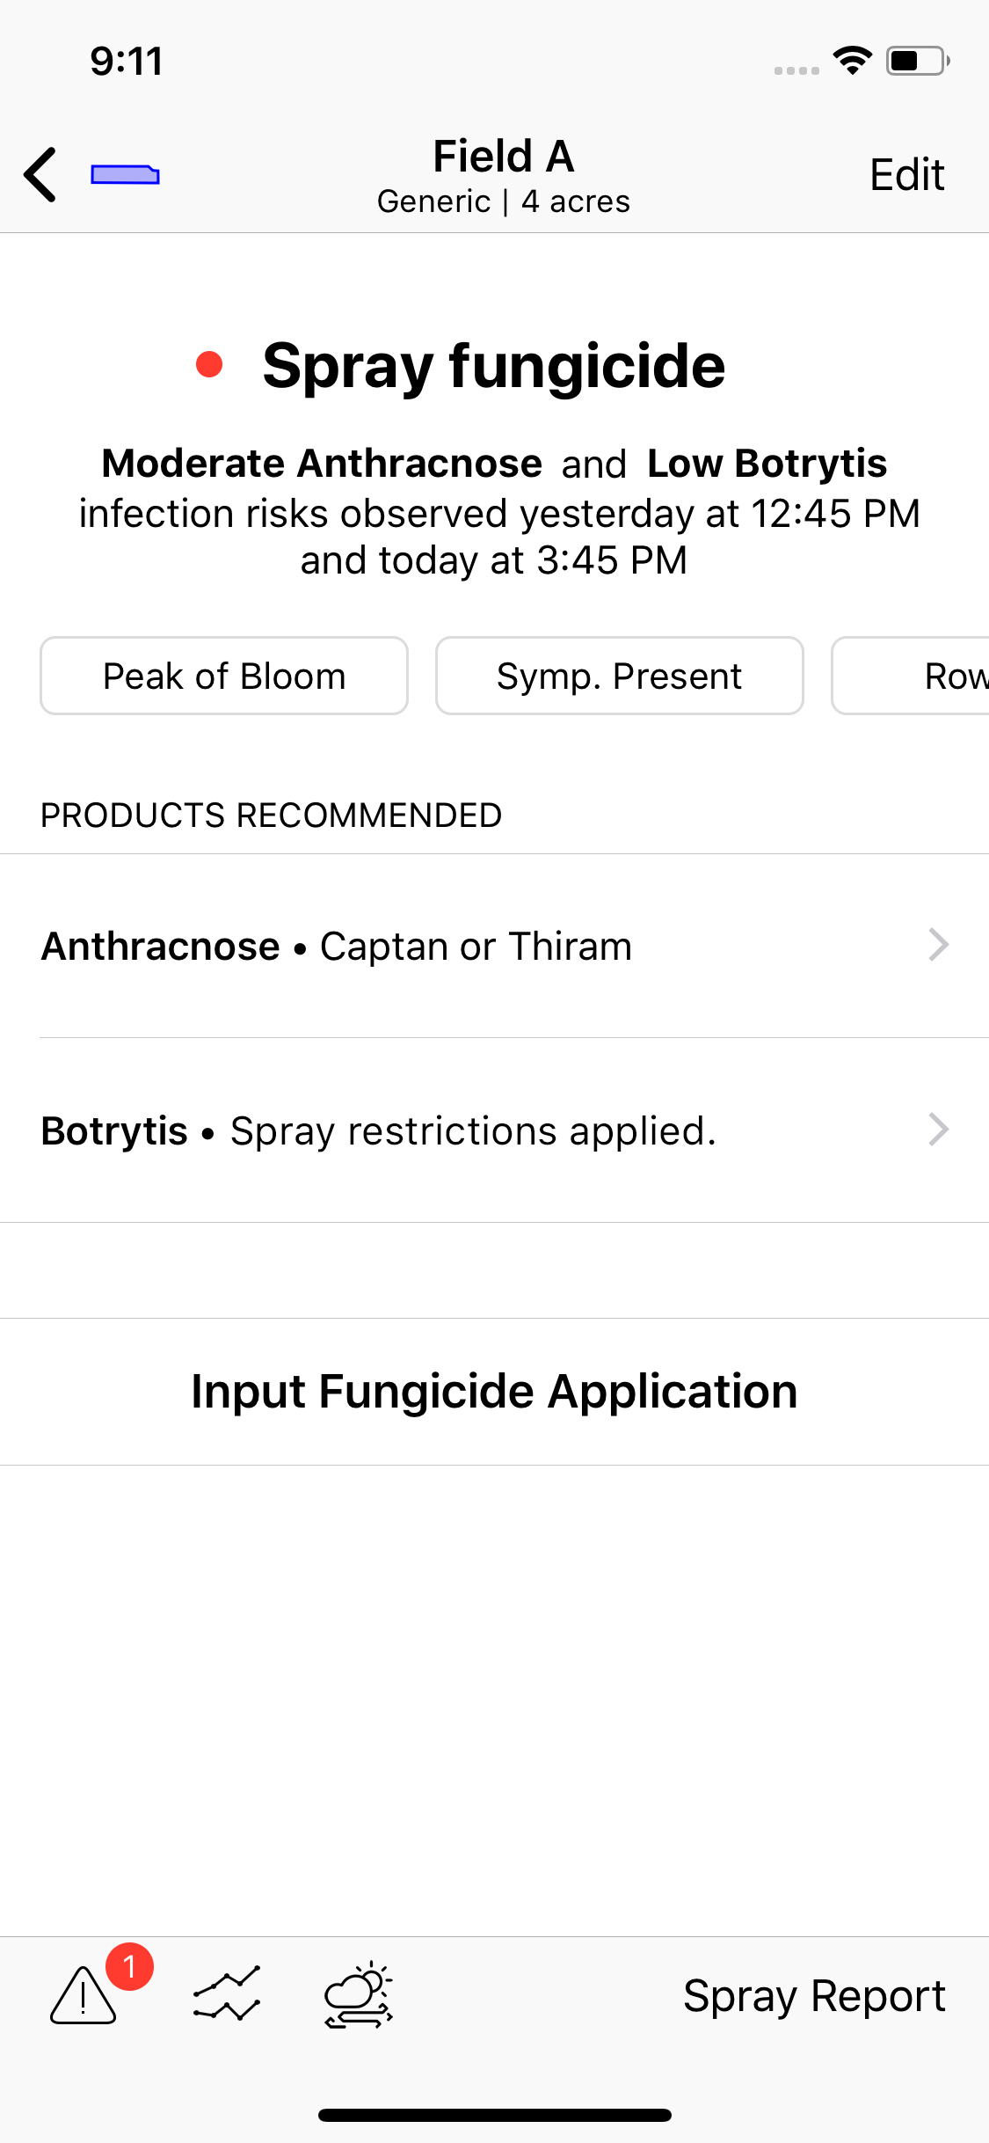
SAS Pro – Spray restrictions
Restriction indicators
A restriction indicator is added to products belonging to restricted groups.
Products belonging to restricted groups are not listed in the recommendations.
Indicators of active restrictions .
No product is recommended due to active restrictions.
Fraisse, Clyde. UF-IFAS

Slide 23
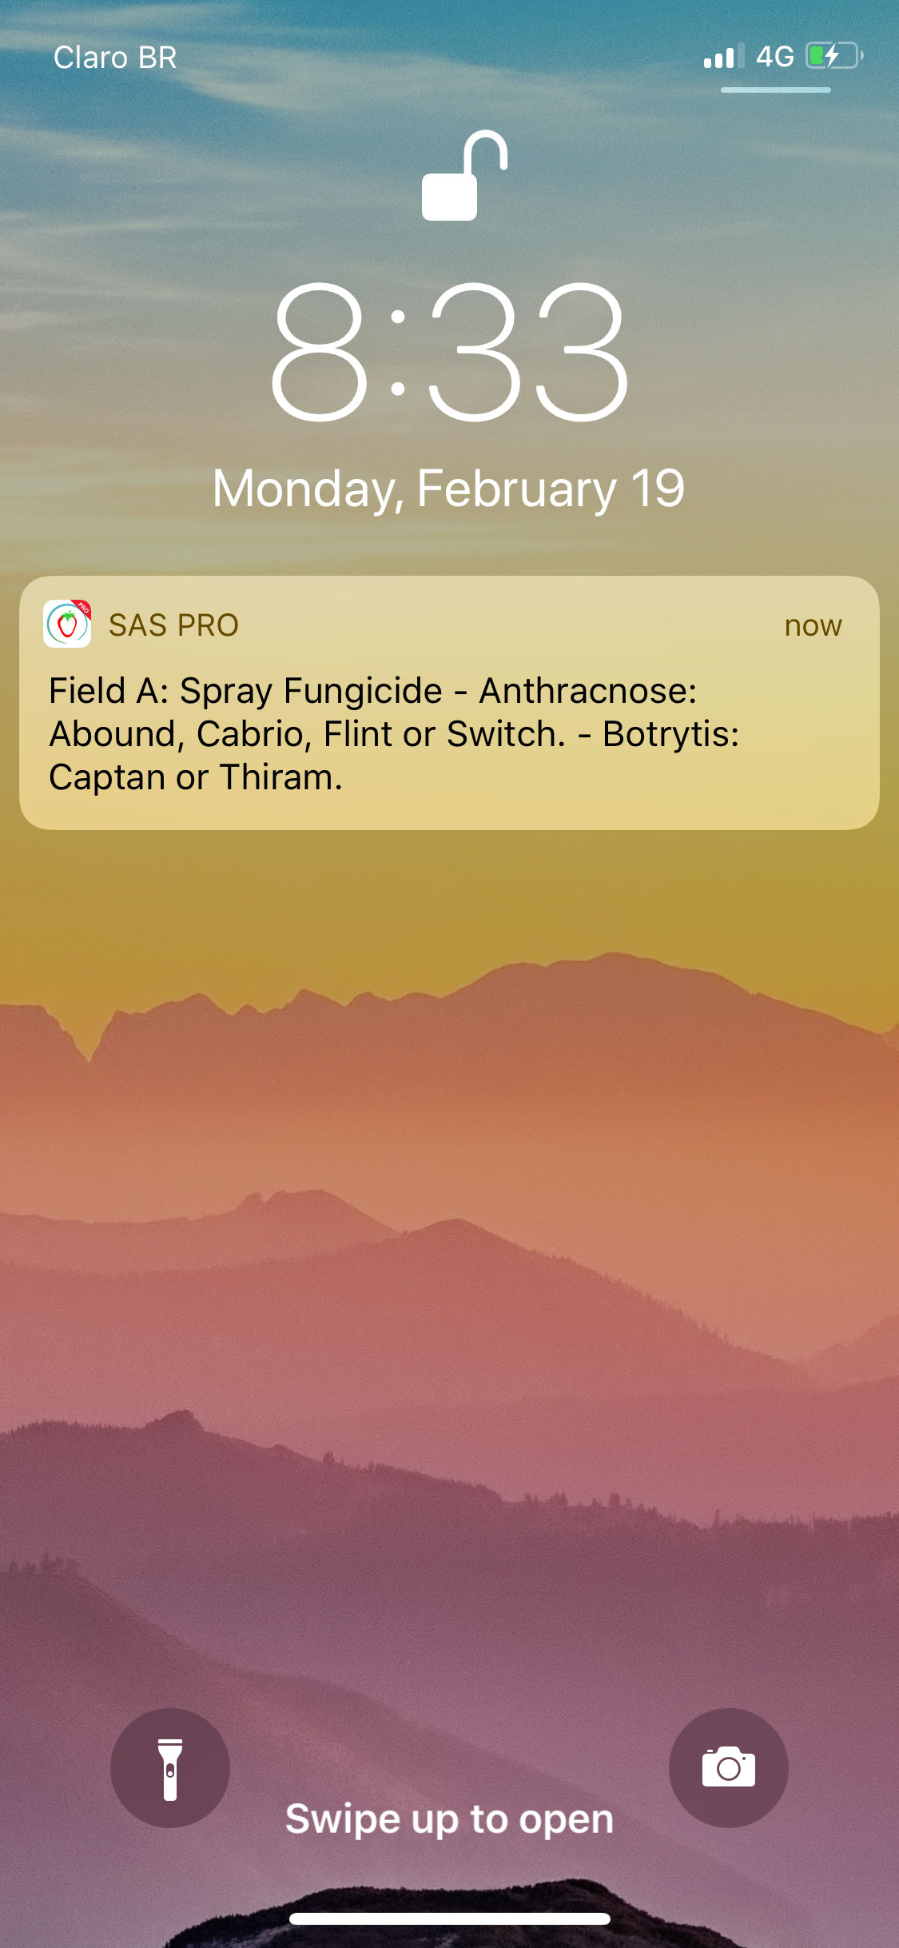
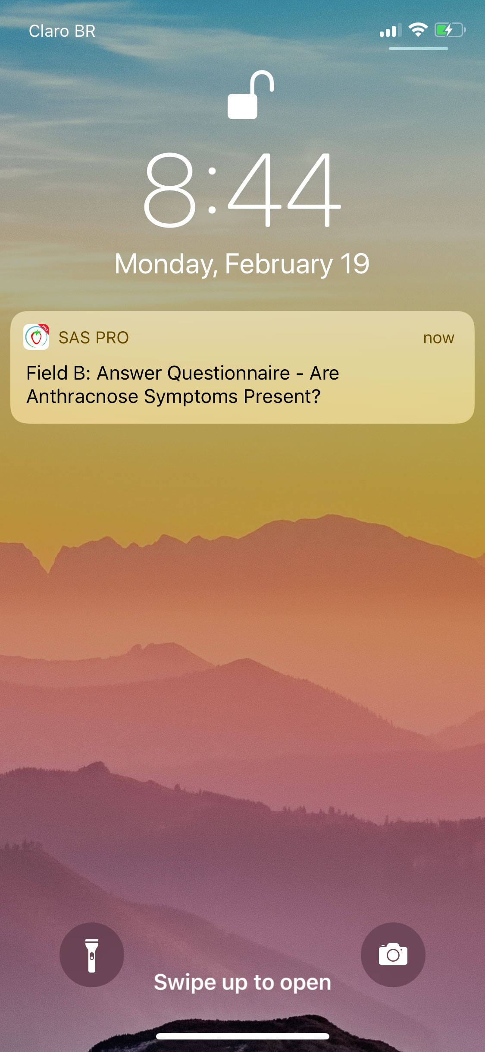
SAS Pro – Notifications
Spray recommendation
Field A: Spray fungicide, Recommended products: Captan or Thiram.
Information request.
Field B: Anthracnose symptoms are present?
Notification that spraying is needed and recommended products.
Notification requesting additional information
Fraisse, Clyde. UF-IFAS

Slide 24
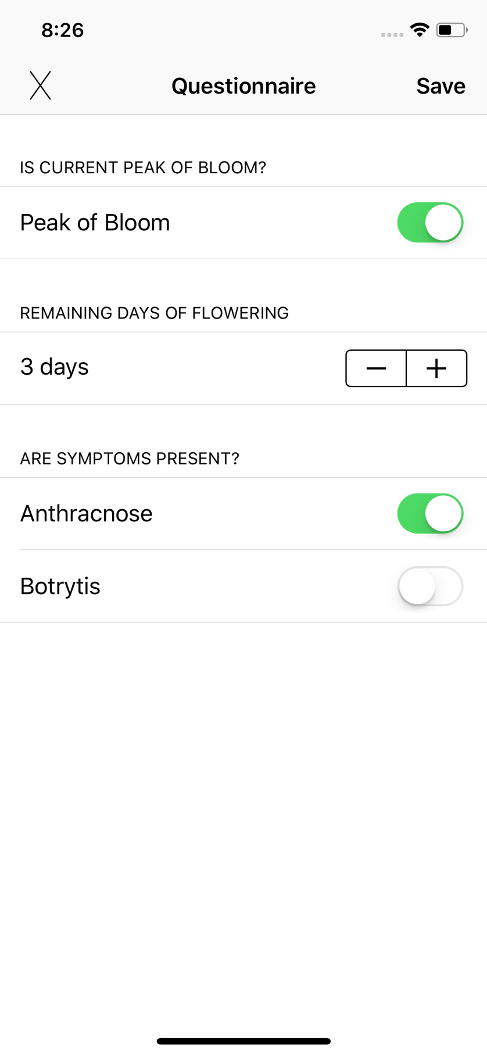
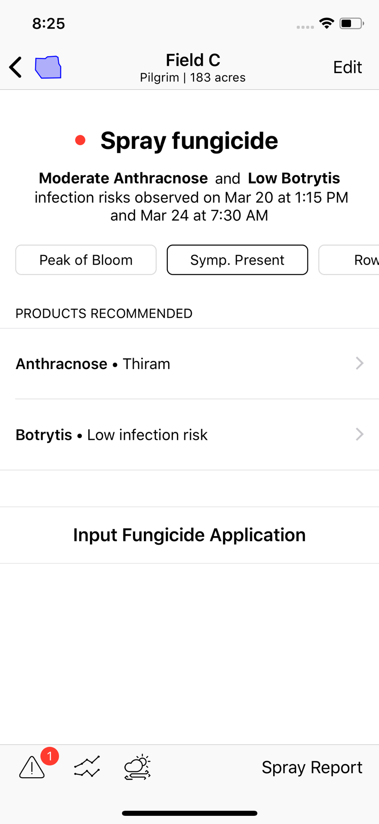
SAS Pro – Additional information
Information request
Peak of bloom and estimated duration
Anthracnose e Botrytis symptoms present
Peak of bloom and expected duration.
Turn symptoms present ON/OFF
Fraisse, Clyde. UF-IFAS

Slide 25
Next steps
The app is ready for iOS (iPhone) devices but not yet released
We would like to meet with a group of growers to explain the app and obtain feedback for improvements/simplifications before releasing it
It will be available at no cost in the App store by the end of July, Android version will follow.
Fraisse, Clyde. UF-IFAS

Slide 26
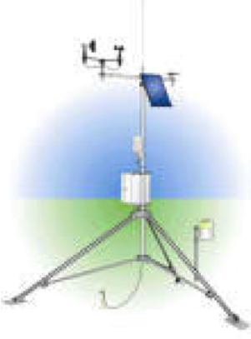
Thanks!
Clyde Fraisse
Agricultural & Biological Engineering
University of Florida – IFAS
cfraisse@ufl.edu
This project is funded by the Florida Strawberry Growers Association

