Slide 1

Managing
‘Florida Beauty’ and ‘Florida Brilliance’
for Optimum Performance
Agritech Conference, Plant City, FL
April 17, 2018
Vance M. Whitaker

Slide 2
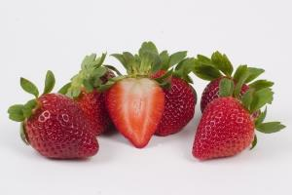
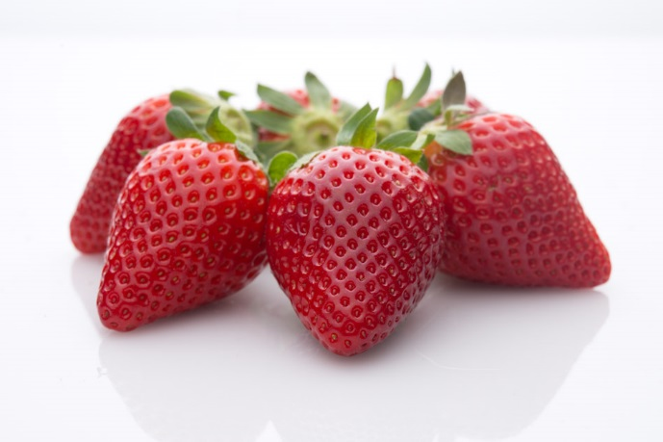
Diminishing Returns with Early Planting
‘Florida Radiance’
Sweet Sensation® ‘Florida127’
Gap in Yield
“Bullet” Fruit
Less efficient to harvest
Gap in Yield
Overgrown Plant
Poor Coloring

Slide 3
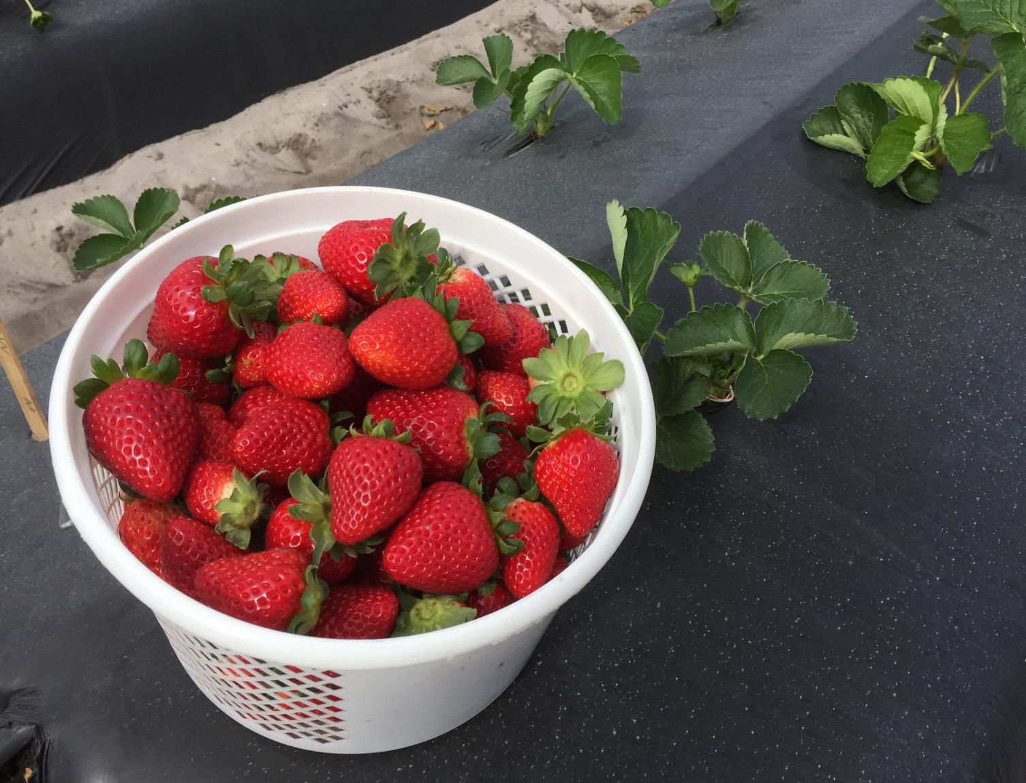
Low-Chill
Day-Neutral
‘Florida Beauty’
Nov 9, 2016 FSGA
(planted Sept 29)

Slide 4
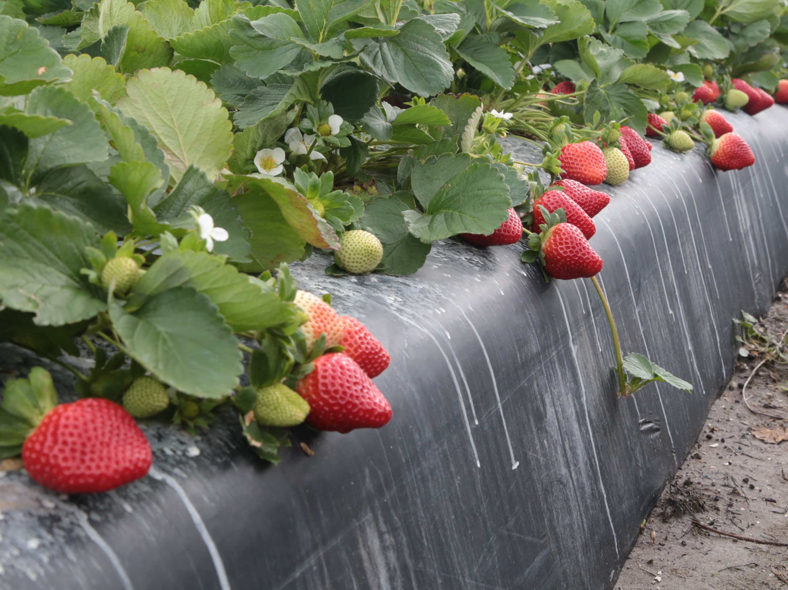
Immediate flowering
Compact plant
Few runners
Quality (shape, color, flavor, rain tolerance)
Biggest Challenge: small fruit at end of first hand

Slide 5
Disease Resistance Overview
Disease | FL Radiance | Sensation® | FL Beauty
Anthracnose fruit rot | R | HR | MS
Angular leaf spot | MS | MS | MS
Botrytis fruit rot | S | S | S
Charcoal rot | MR | MR | MS
Colletotrichum crown rot | MS | MR | MS
Phytophthora root rot | S | S | MR
Powdery mildew | MR | S | S

Slide 6
Ideal Planting Window by Variety
‘FL Beauty’
Sweet Sensation®
‘FL Radiance’
Sept 1
Oct 1
Nov 1

Slide 7
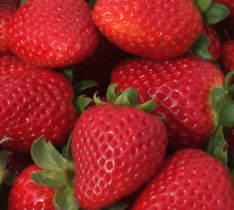
‘Florida Beauty’ Management
Consider bed plastic with white center strip
Trim first blooms after overhead watering
Trim blooms again when trimming leaves
Needs Early Nitrogen
Dr. Peres Disease Recommendations:
  No Ridomil
  Focus on anthracnose and mildew

Slide 8
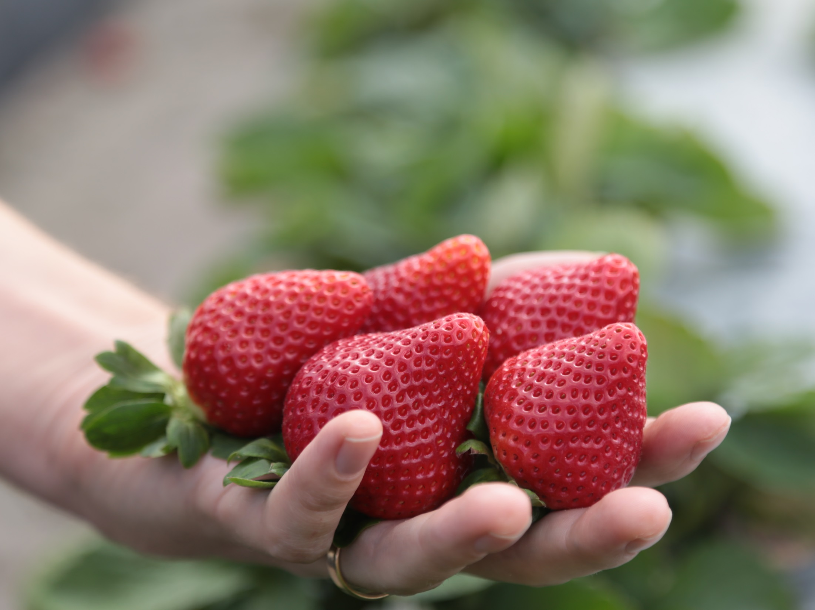
Questions on
‘Florida Beauty’?

Slide 9
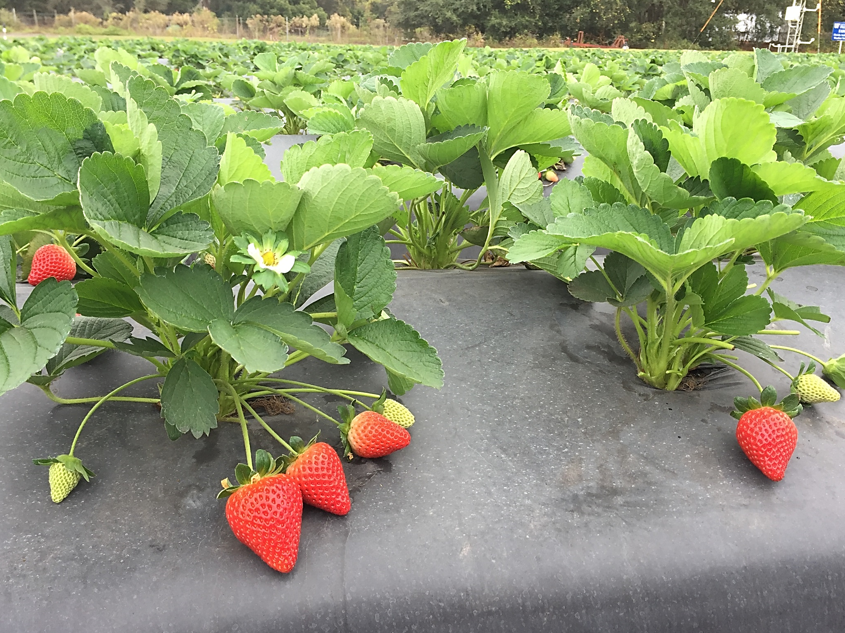
‘Florida Brilliance’ FL 10-153 x FL 11.31-14
Notes:
Trialed as 13.26-134

Slide 10
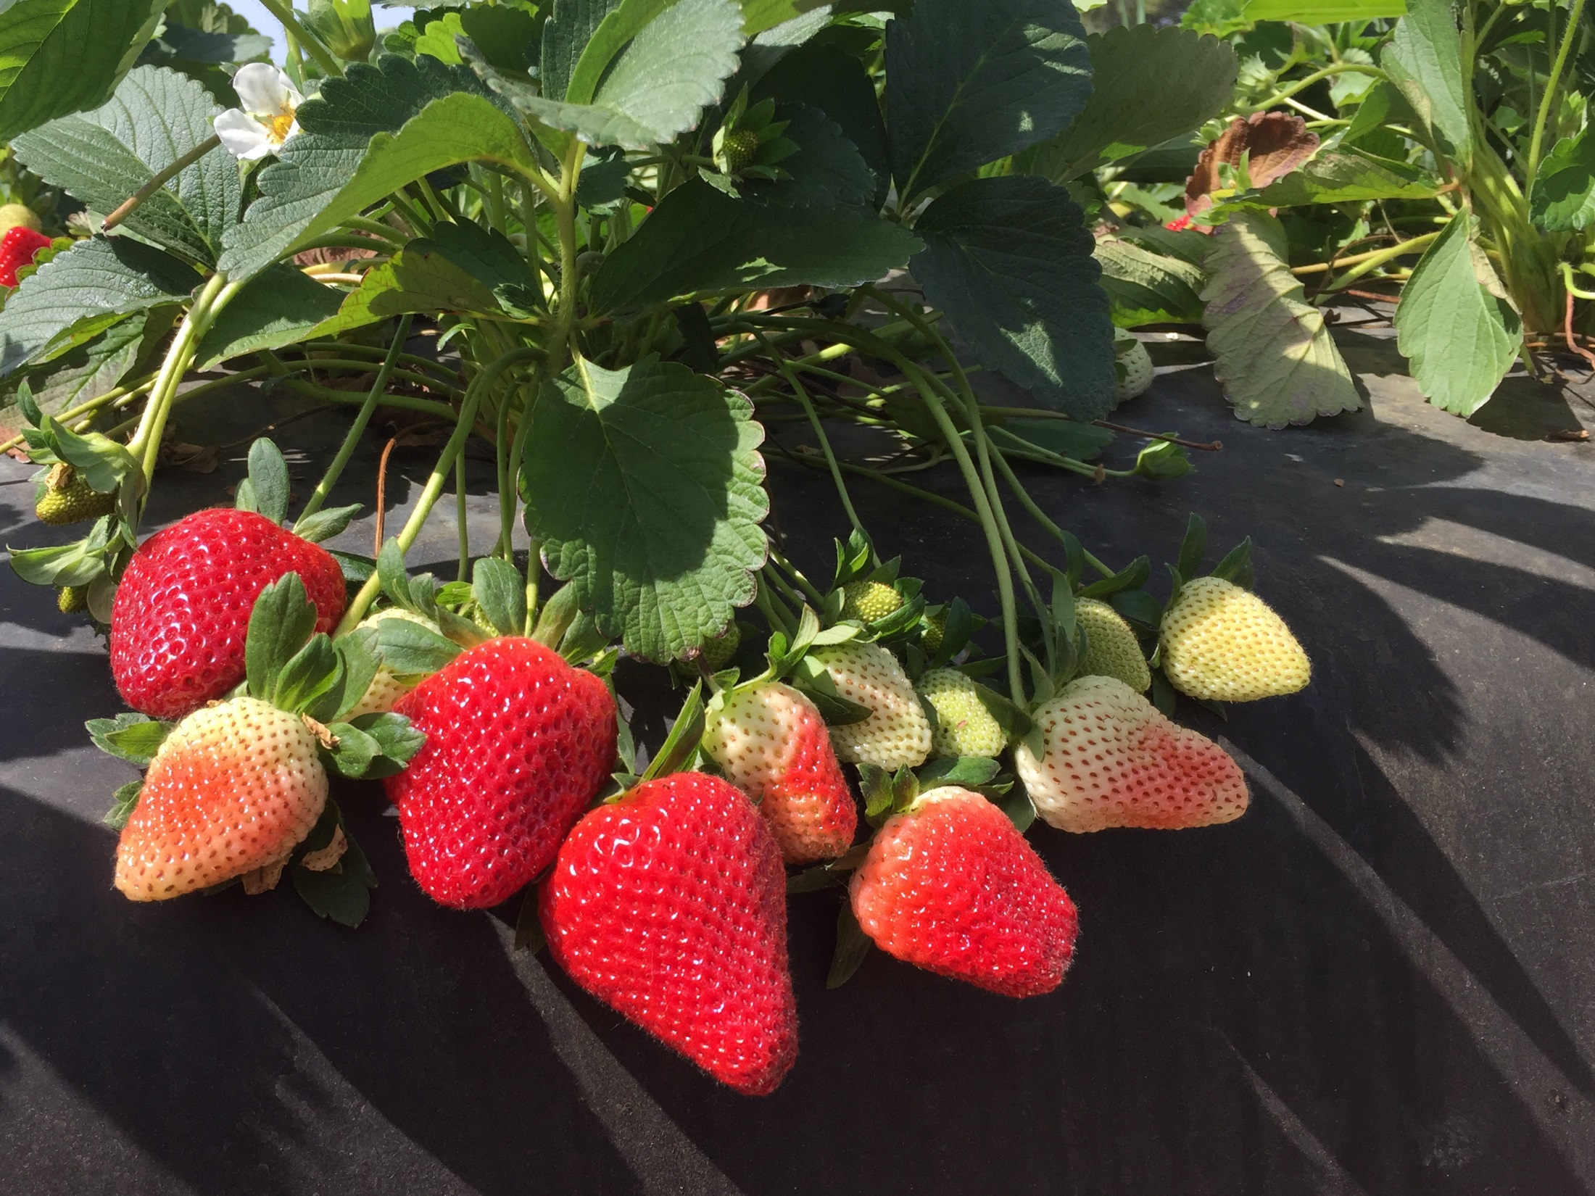
Very early short-day
Easy to harvest
Resilient plant
Shape, firm, gloss and size

Slide 11
‘FL Radiance’
‘FL Brilliance’
Notes:
Dr. Cecilia Nunes: After only 5 days of storage

Slide 12
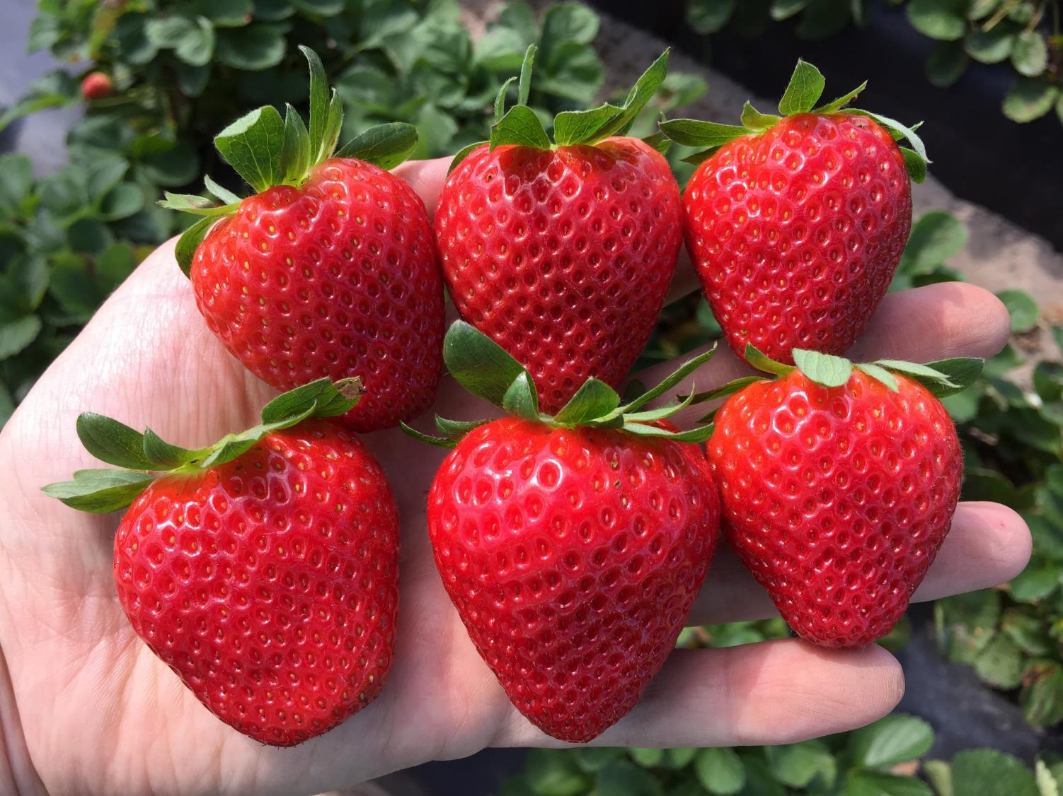
‘Florida Beauty’
Nov 9, 2016
(planted Sept 29 at FSGA)
Notes:
Gloss – never seedy

Slide 13
Notes:
Planted Oct 10

Slide 14
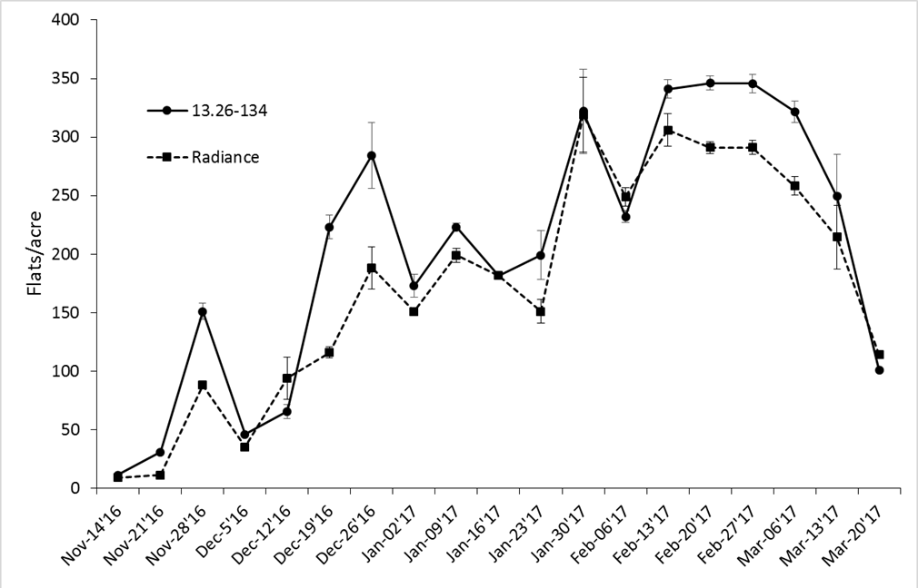
2016-17 Astin Ranch: Planted Sept 25th

Slide 15
Consumer Sensory Data
Cultivar | Overall Acceptability |  | Texture Acceptability |  | Flavor Intensity |  | Sweetness Intensity |  | Sourness Intensity
February 7, 2017
FL 13.26-134 | 31.8 | b^{x} | 32.7 | b | 33.9 | ab | 30.0 | b | 18.1 | ab
Sensation® | 38.4 | a | 38.0 | a | 36.4 | a | 34.3 | a | 14.8 | b
F. Radiance | 30.2 | b | 33.6 | ab | 30.0 | b | 28.5 | b | 18.4 | a
February 14, 2017
FL 13.26-134 | 28.0 | ab | 29.6 | b | 29.6 | ab | 26.9 | a | 15.2 | b
Sensation® | 33.4 | a | 36.6 | a | 32.5 | a | 29.7 | a | 15.3 | ab
F. Radiance | 25.4 | b | 30.9 | b | 27.3 | b | 22.5 | b | 18.6 | a
Notes:
Complement to current varieties in Florida – especially for early planting niche

Slide 16
Disease Resistance Overview
Disease | FL Radiance | Sensation® | FL 13.26-134
Anthracnose fruit rot | MR | R | MR
Botrytis fruit rot | S | S | S
Charcoal rot | MS | MR | MR
Colletotrichum crown rot | S | MR | MR
Phytophthora root rot | HS | S | S
Powdery mildew | MR | S | MR

Slide 17
Ideal Planting Window by Variety
‘FL Beauty’
‘FL Brilliance’
Sweet Sensation®
‘FL Radiance’
Sept 1
Oct 1
Nov 1
Notes:
Only go before Oct 1 on light soils

Slide 18
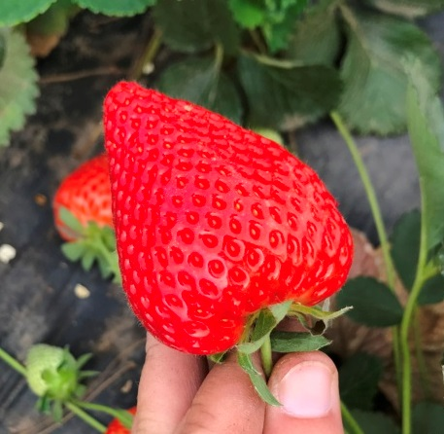
‘Florida Brilliance’ Management
Moderate Early Nitrogen
In Early Season Allow to Ripen
Dr. Peres Disease Recommendations:
  Any mortality likely due to Phytophthora
  Use Ridomil and Phosphites

Slide 19
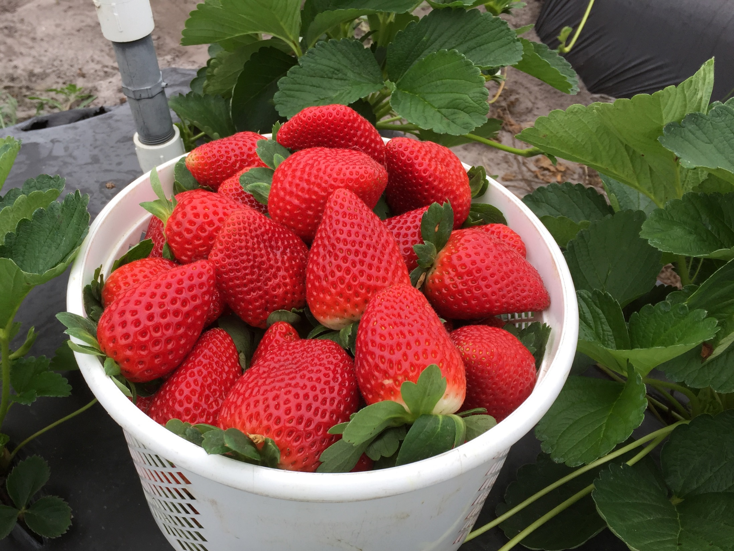
Questions?

Slide 20




Thank You!
Lab Members
  Manuela Rodriguez
  Mariel Gallardo
  Tomas Hasing
  Catalina Moyer
  Luis Osorio
  David Moore
  Israel Cepeda
  Jim Sumler
  Angelita Arredondo
  Kelsey Cearley
  Sujeet Verma
  Zhen Fan
  Wantanee Prescott
Key Collaborators
  Natalia Peres
  Shinsuke Agehara
  Anne Plotto
  Cecilia Nunes
  Charlie Sims
Funding and Support

