Slide 1
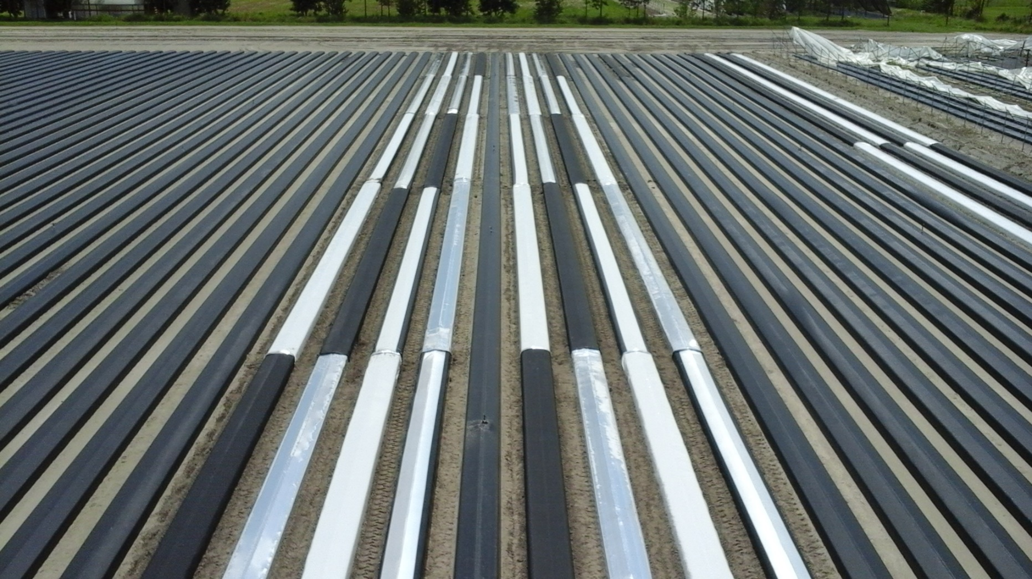
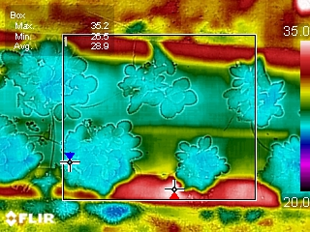
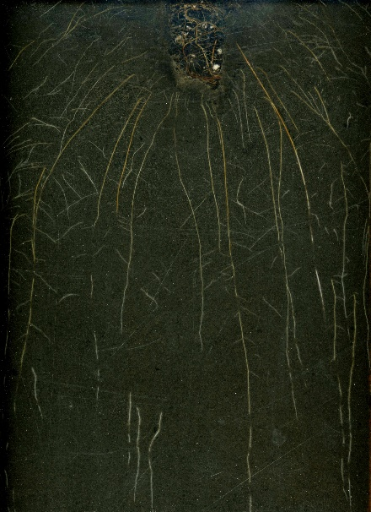
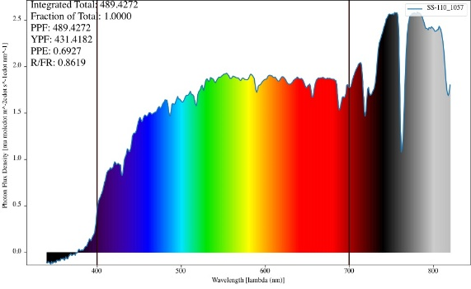


2018 AgriTech (Plant City, FL – Apr 17-18, 2018)
Updates on Strawberry Cultural Practice Study
Shinsuke Agehara
Assistant Professor, Plant Physiology
Gulf Coast Research and Education Center

Slide 2
Strawberry Horticulture Programs
1) Nitrogen fertilization rates and plant spacing
2) Plastic mulch with a white/metalized stripe
Plug transplants
Transplant physiology

Slide 3
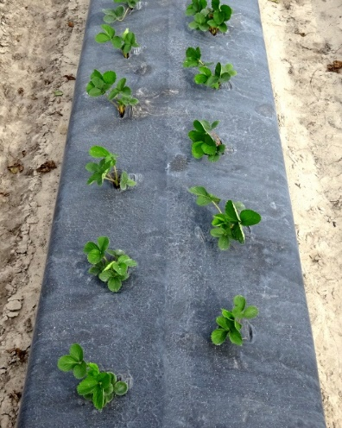
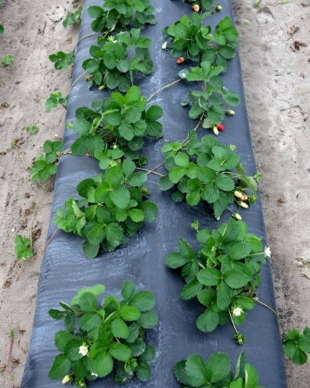
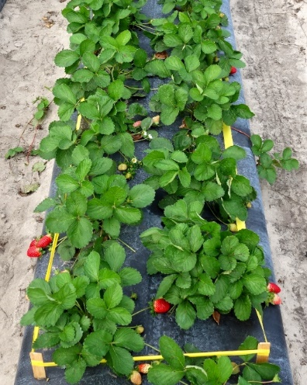
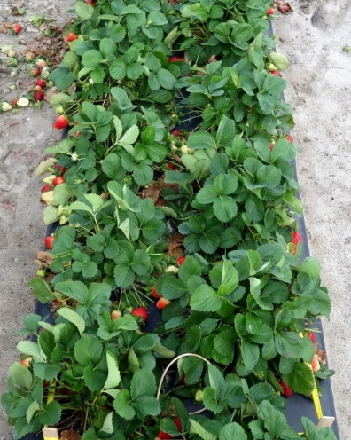
Nitrogen fertilization
 | Preplant | Oct |  | Nov | Dec | Jan | Feb | Mar
Old practice | 0-40 lb/A | 0.3 lb/A/d | 0.6 lb/A/d |  |  |  | 0.75 lb/A/d
New practice | 0 lb/A | 2 lb/A/d | 1.5 lb/A/d |  | 1 lb /A/d |  | 0.75-1 lb/A/d
2017-2018 season trial
Cultivars: Radiance, Beauty, and Brilliance
N treatment (duration of 2 lb/A/d): 0, 3, 6, and 9 weeks (1 lb/A/d thereafter)
Planting date: Sep 28, 2017

Slide 4
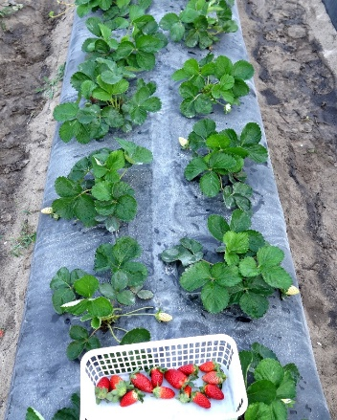
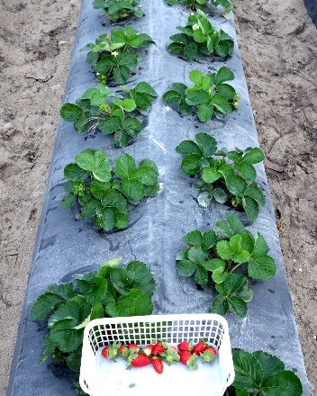
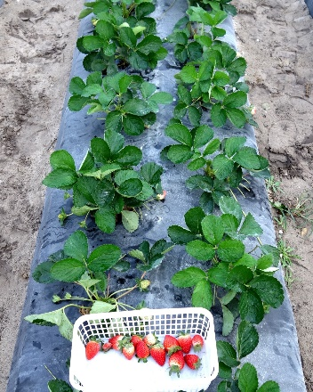
Yield responses
14-27%↗
35-40%↗
17-23%↗

Slide 5
Marketable & unmarketable yields
Low N → Smaller canopy → Thrip damage ↗

Slide 6
Plant spacing – Florida Beauty
23%↗
28%↗

Slide 7
Plastic mulch with a white stripe

Slide 8
1990-1991 season
Early

Slide 9
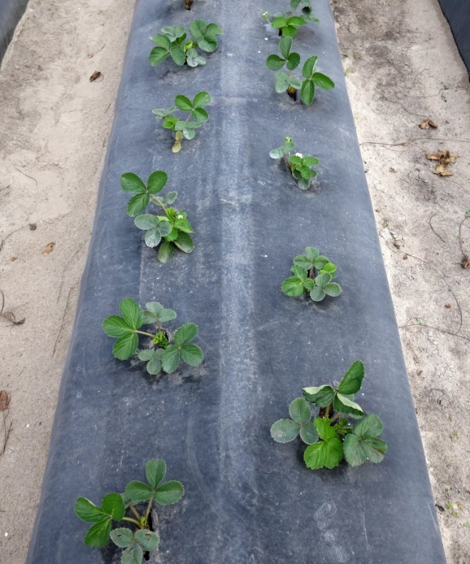
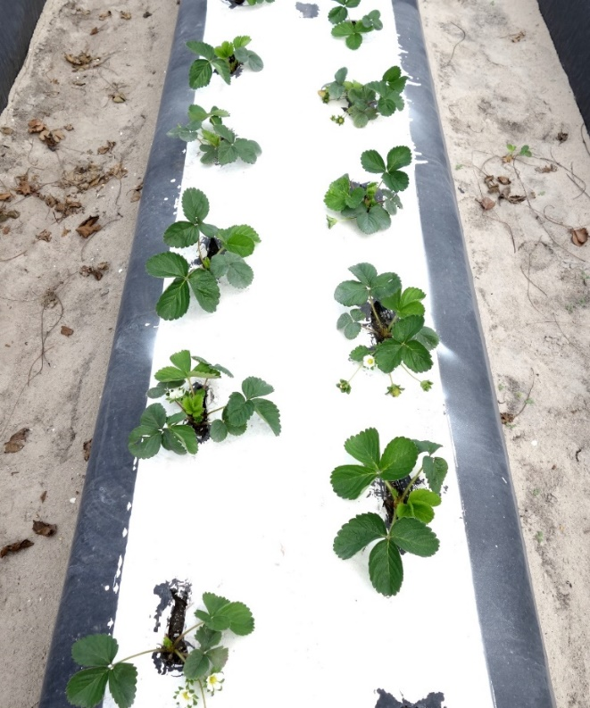
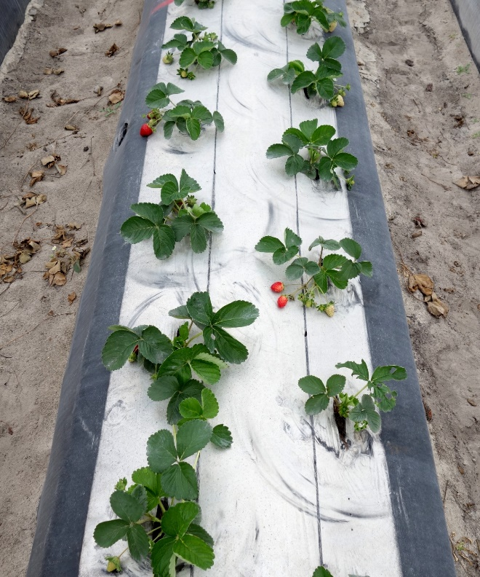
Dual benefits of black and white colors in one plastic mulch?
4”
20”
4”

Slide 10
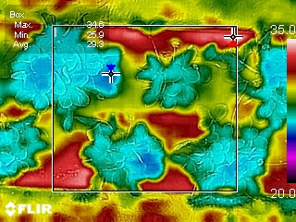
Thermographic image
Black mulch
White-striped mulch
Max: 42.3 °C
Average: 31.0 °C
Max: 33.9 °C
Average: 28.1 °C

Slide 12
Early planting (Sep 28)

Slide 13
Late planting (Oct 12)

Slide 14
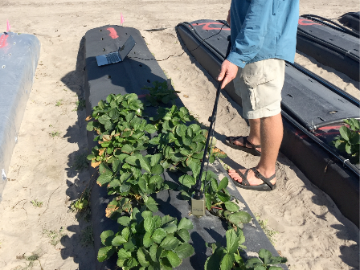
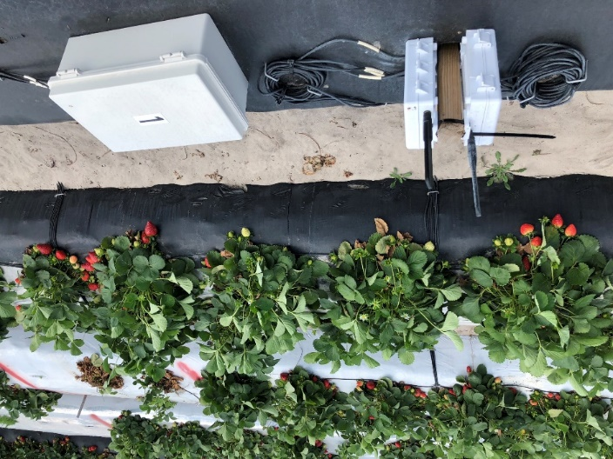
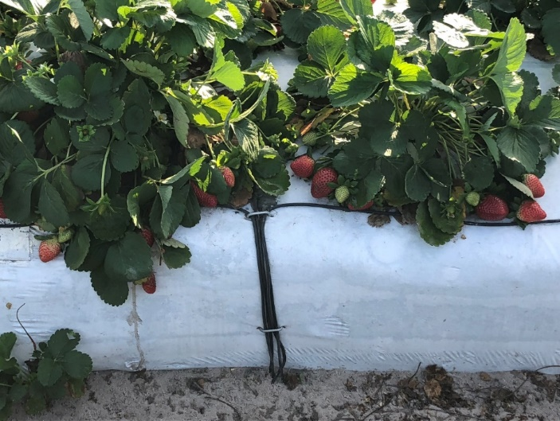
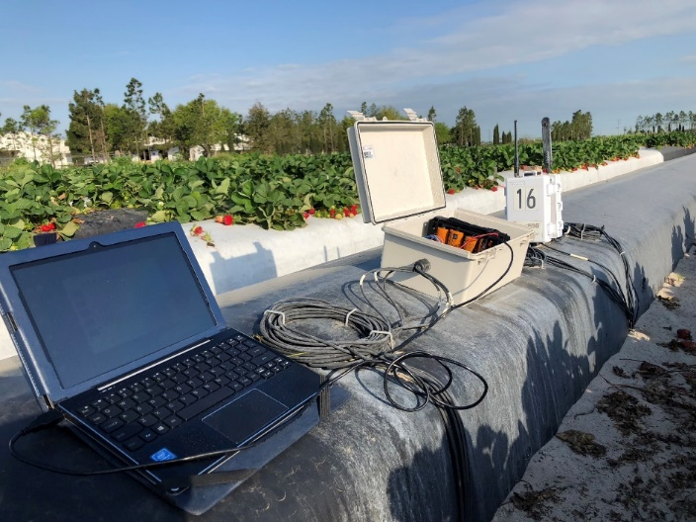
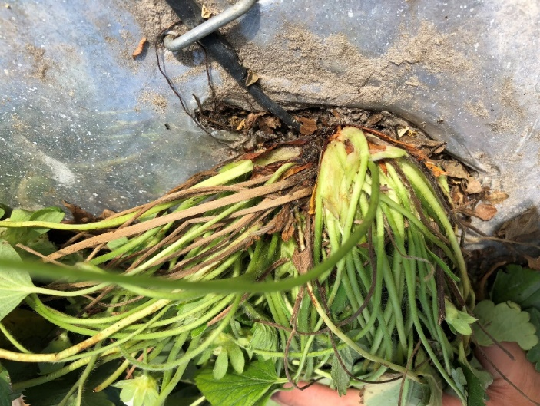
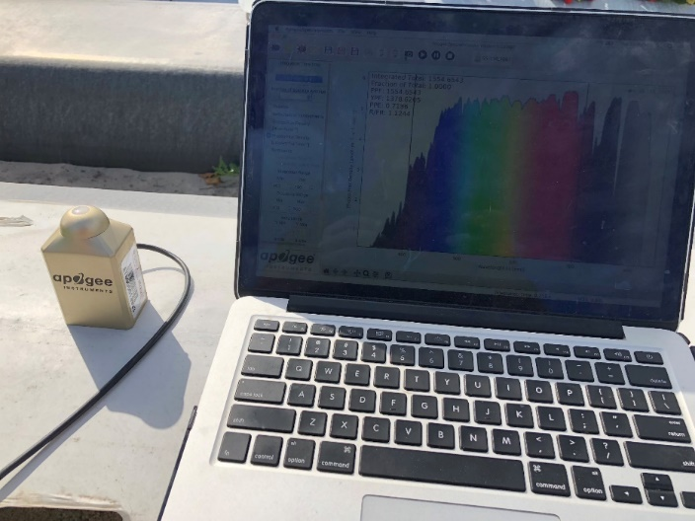
Measuring changes in canopy and soil micro environments

Slide 15
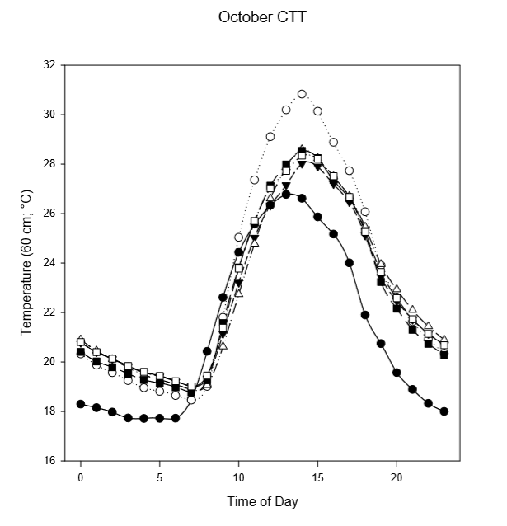
Crown tissue temperature 2.5-3.1°C↘
Black mulch
White & Metalized
Ambient temperature

Slide 16
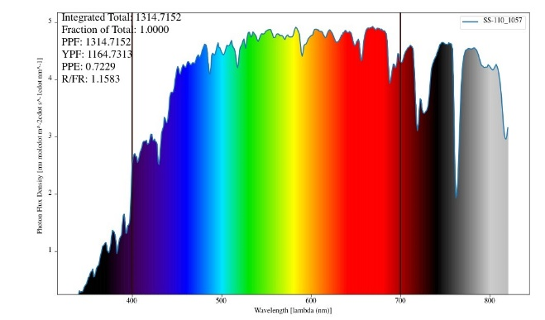
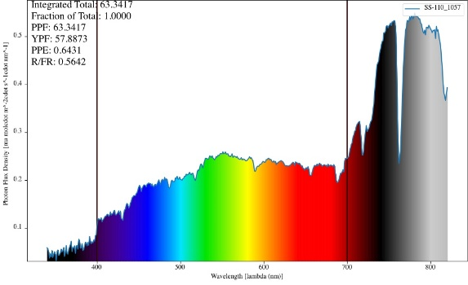
Changing light reflection quantity and quality
Light reflection from
black mulch
Light reflection from
white stripe
Sunlight
Total PPF: 1315
R/FR: 1.158
Total PPF: 63
R/FR: 0.564
Total PPF: 489
R/FR: 0.862
Black vs White-striped mulch
Light reflection ↗ (63 → 489)
R/FR ratio in reflected light ↘ (1.16 → 0.86) → Flowering ↗

Slide 17
Advantages of white/metalized striped mulch vs. black mulch
Early season
Late season
Root-zone temperature during establishment 8.1°F↘
Crown tissue temperature 4.5°F ↘
Same soil warming effects during winter months
Light reflection from mulch ↗
Red/far-red ↘ (light quality to induce flowering)

Slide 18
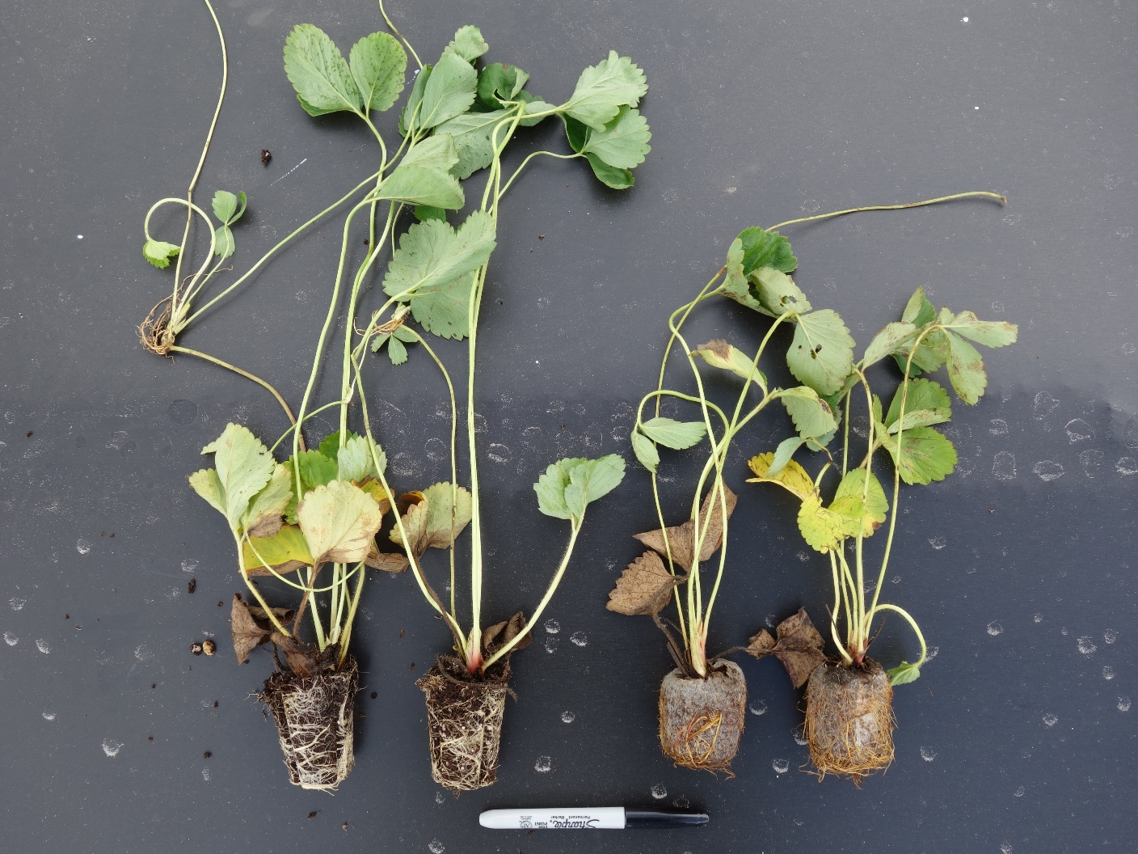
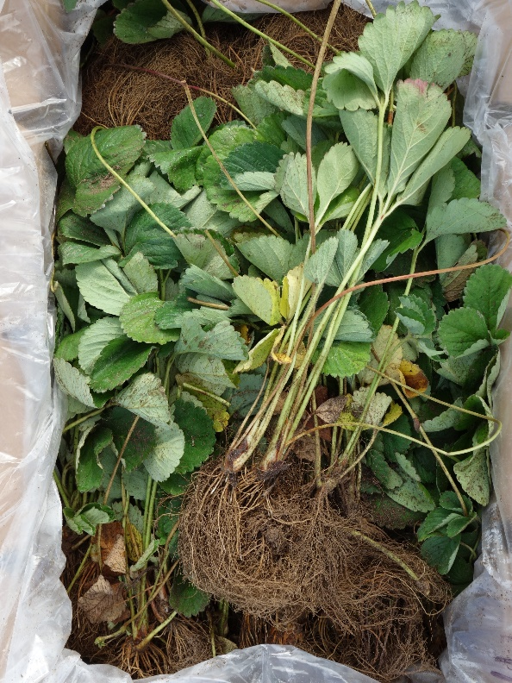
Plug transplants
Tray-plug
Jiffy-plug

Slide 19
Yield data
Planting date = Sep 28, 2017

Slide 20
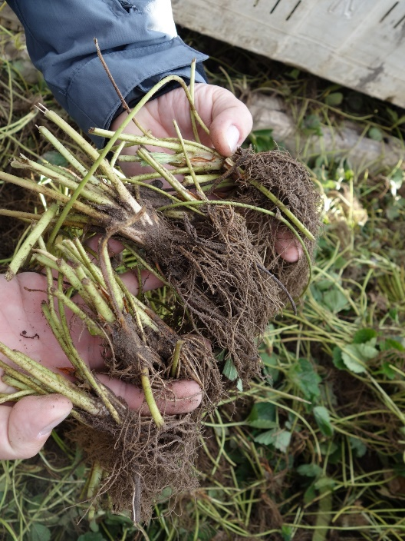

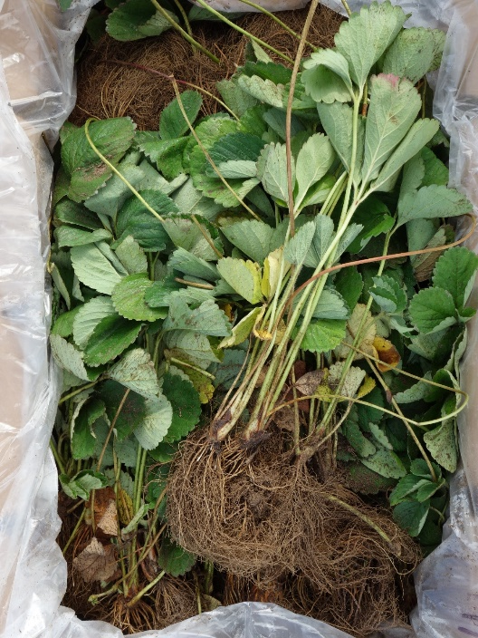
Transplant physiology
Trimmed vs. untrimmed bare-root transplants
Bare-root vs. plug transplants

Slide 21
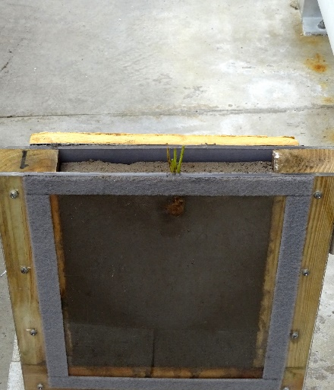
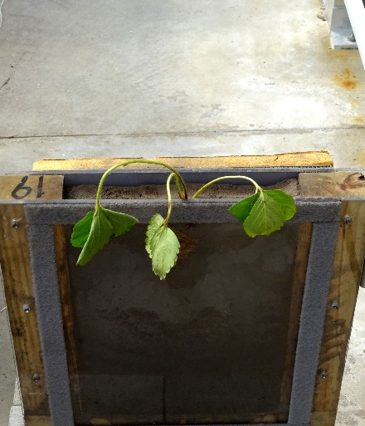
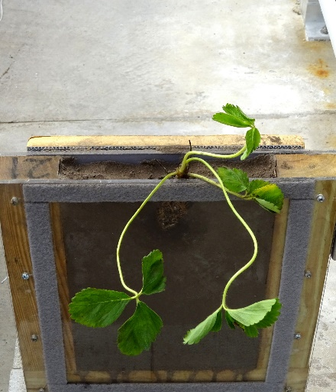
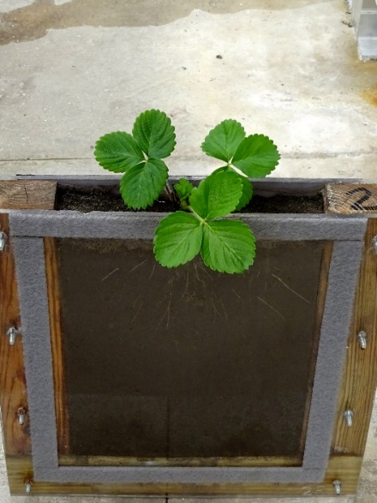
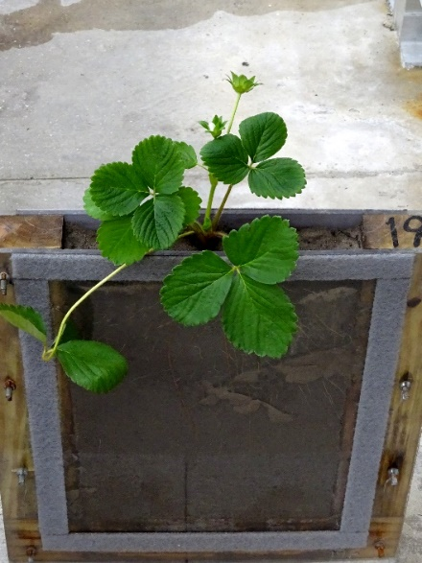
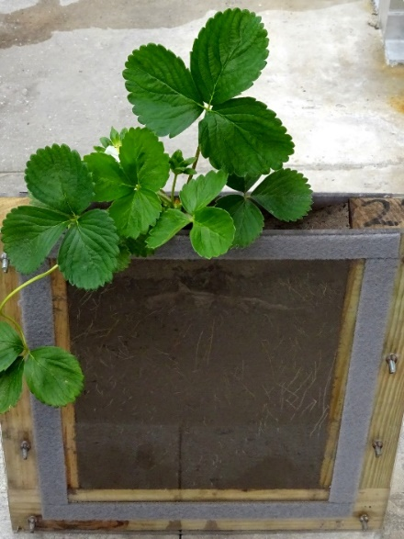
Rhizotron experiment
Bare-root transplant
Trimmed
Untrimmed
Plug transplant
Day 1
Day 35

Slide 22
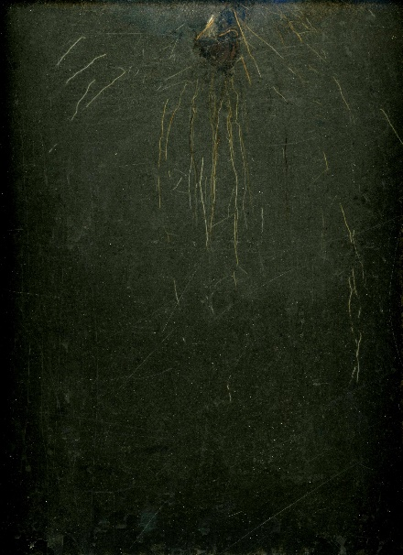
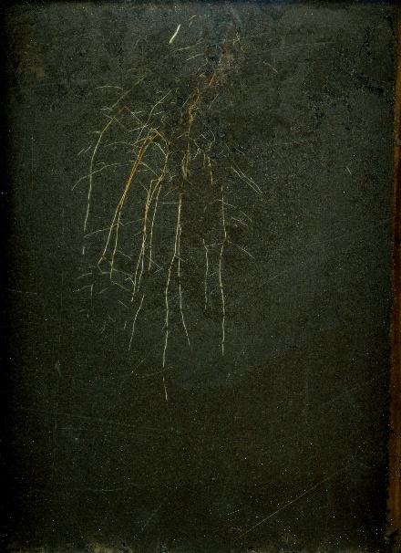
35 days after transplanting
Trimmed
bare-root transplant
Untrimmed
bare-root transplant
Plug transplant
 | Leaf area | Root surface area
Trimmed vs. Untrimmed | 76 → 105 cm² (38%↗) | 7.6 → 11.6 cm² (53%↗)
Untrimmed bare vs. Plug | 105 → 193 cm² (83%↗) | 11.6 → 26.0 cm² (125%↗)

Slide 23
Summary
Initial high N fertilization is beneficial to accelerate the establishment of productive bush
Ideal canopy size depends on many factors – yield, insect damage, fruit exposure, spray penetration, etc.
White/metalized striped mulch can improve early and total season yields by optimizing microenvironments
Plug transplants have very high yield potential – can be combined with other production practices (e.g. white/metalized striped mulch)

Slide 24

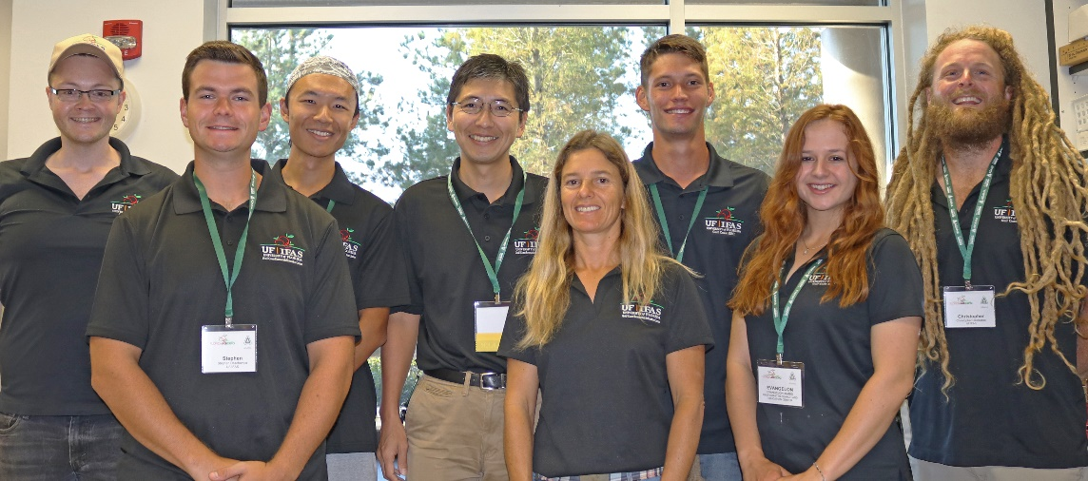
Acknowledgments
Collaborators
Florida Strawberry Grower Association
Chemical Dynamics
Ralf Dujardin, IMAFLEX
Tim Dolan, Intergro
Funding
Florida Strawberry Research and Education Foundation
Plant Physiology Lab
Tia Silvasy (Biological Scientist II)
Syuan-You Lin (PhD)
Stephen Deschamps (MS)
Chris DelCastillo
Anthony Ellis
Evangelon James
Evan McClenthan
Lukas Vallad
Bill Wang
Sana Shahzad

