Slide 1
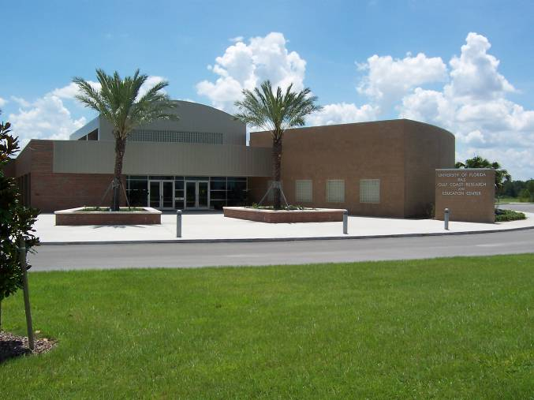
Recent research findings on foliar/fruit diseases: anthracnose, Botrytis and powdery mildew
Natalia Peres
University of Florida
Gulf Coast Research and Education Center

Slide 2
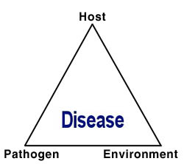
The Disease Triangle
Notes:
Concept
Existence of disease requires the interaction

Slide 3
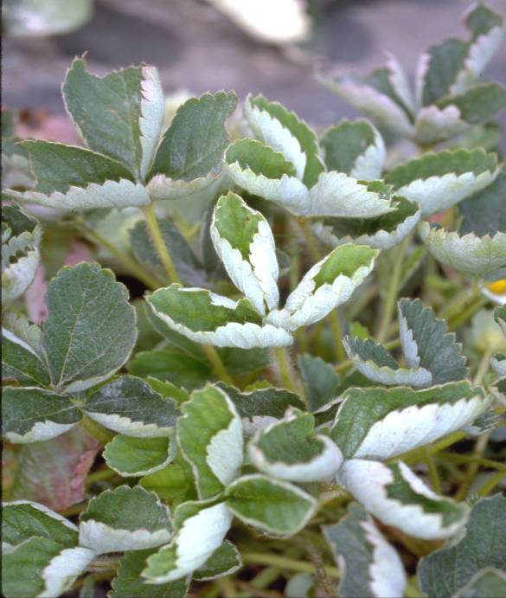
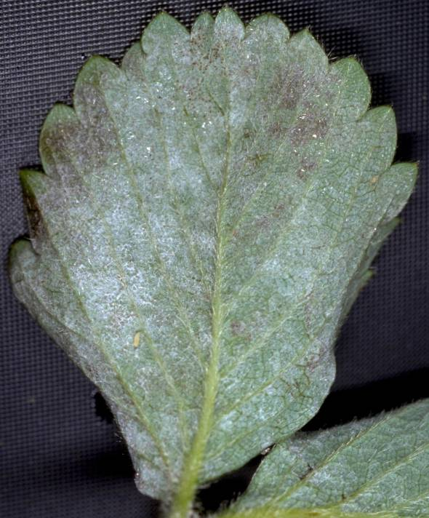
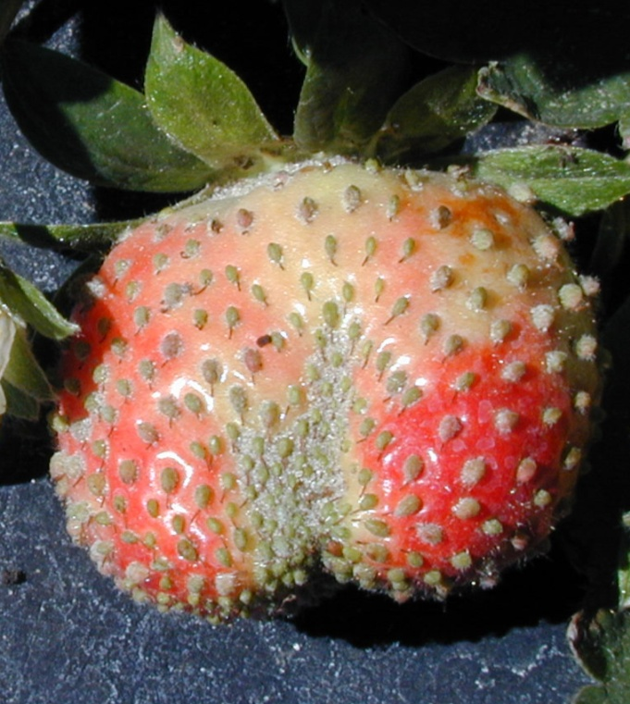

Powdery mildew
(Podosphaerea aphanis)

Slide 4
Powdery mildew
Initial inoculum on infected transplants
Spores are wind dispersed
Favored by humid weather, but not rain
FL-127 (Sensation) highly susceptible

Slide 5

Fungicides currently available
for control of Powdery Mildew in FL
Group M2 - Wettable sulfurs
Group 3 - Procure (triflumizole)
Rally (myclobutanil)
Orbit/Tilt (propiconazole)
Mettle (tetraconazole)
Rhyme (flutriafol)
Group 11 - Abound (azoxystrobin)
Cabrio (pyraclostrobin)
Flint (tryfloxystrobin)
Group 7 - Fontelis (penthiopyrad)
Group 11 + 7 - Merivon (tryfloxystrobin + fluxapyroxad)
Group 13 - Quintec (quinoxyfen) (E1)*
Group U6 - Torino (cyflufenamid)*

Slide 6
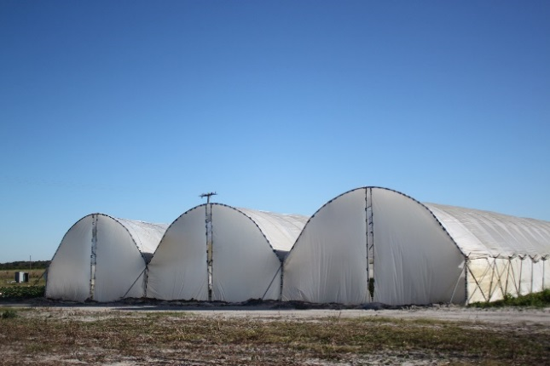
2015-16 PM trial
Notes:
Several years of trials… different products every year… contact me or Jim if you want to know how a certain product worked

Slide 7
2016-17 PM trial

Slide 8
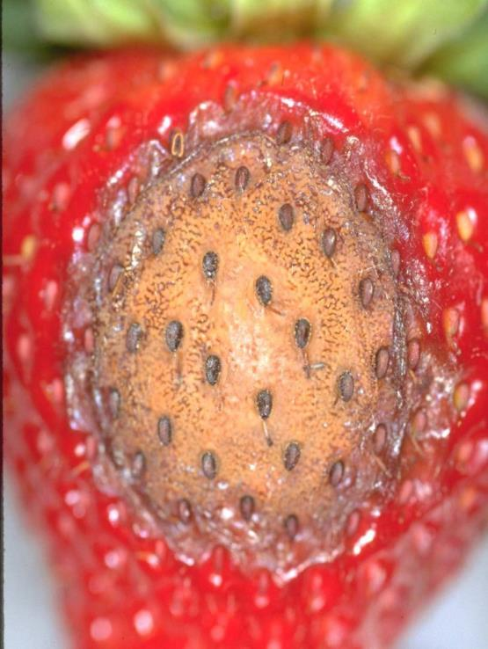
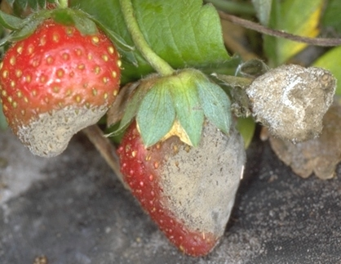
Botrytis and Anthracnose

Slide 9
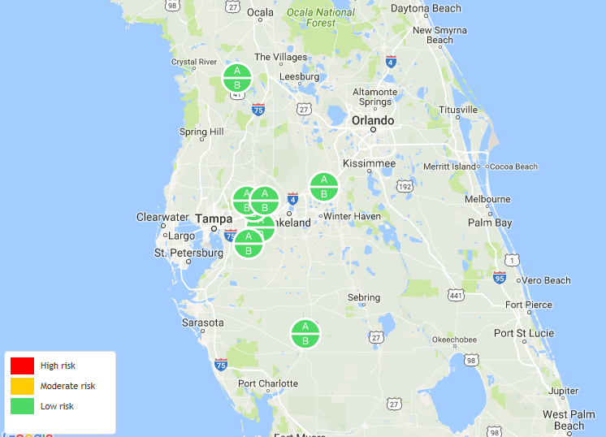

Strawberry Advisory System
A
B
http://agroclimate.org/tools/strawberry/
Notes:
Show new stations

Slide 10
The Disease Triangle

Slide 11
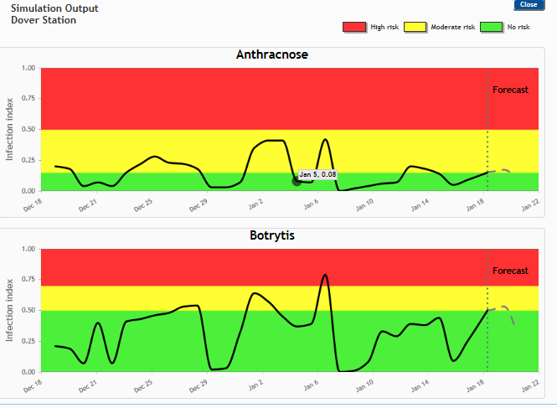
Mid Dec to Mid Jan

Slide 12
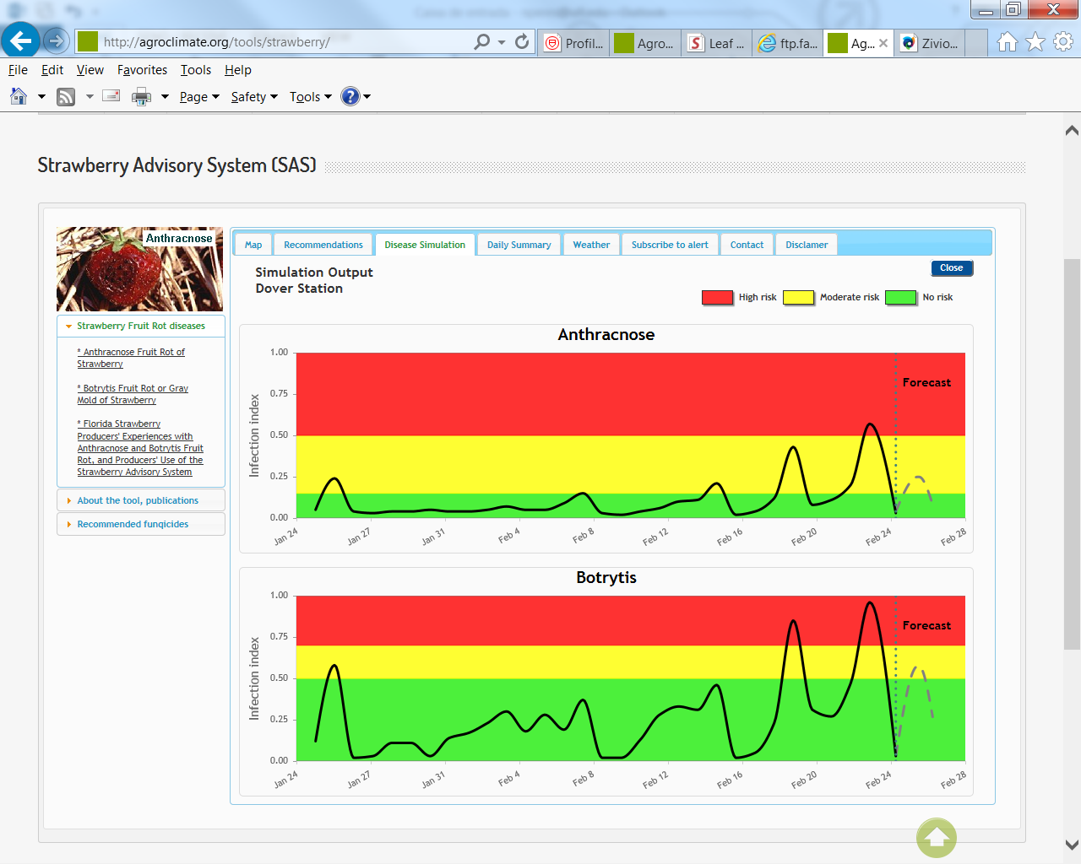
Mid Jan to Mid Feb

Slide 13
Mid Jan to Mid Feb

Slide 14
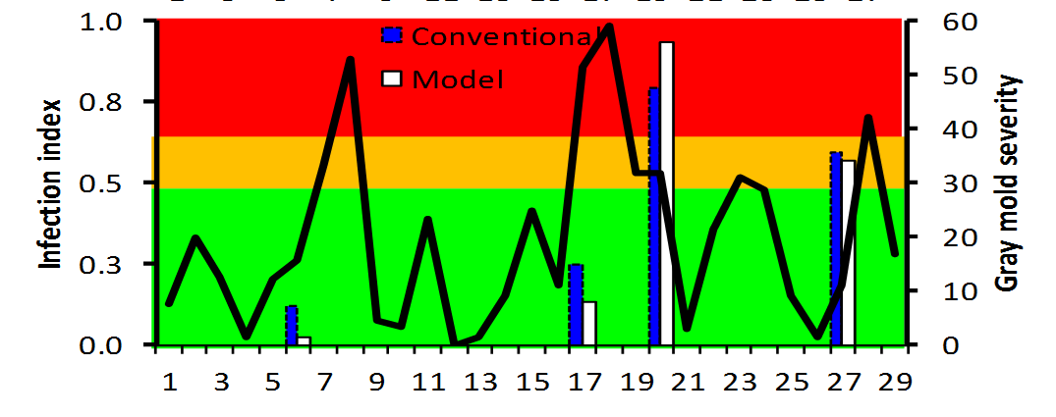
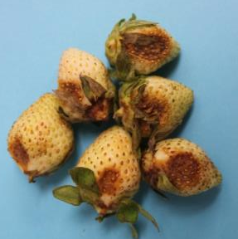
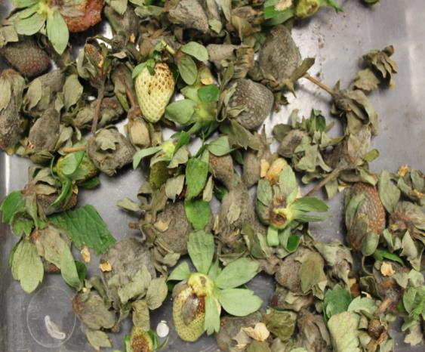
Botrytis outbreak 2012
Peak bloom

Slide 15
Current recommendations for BFR control
Apply only when weather conditions are conducive for BFR development
    Moderately favorable conditions
          Captan (if not bloom), Thiram (if bloom),
          Captevate (captan + fenhexamid),
          Fontelis (penthiopyrad) OR Merivon (fluxapyroxad) – G7
            + thiram or captan
    Highly conducive
          Switch (fludioxonil + cyprodinil)
          Kenja (isofetamid)
          Luna Tranquility (fluopyram + pyrimethanil)
Topsin, Scala, Pristine not recommended

Slide 16
Current recommendations for AFR control
Highly susceptible cultivars + early season infection
  Weekly applications (difficult to control)
    Moderately susceptible cultivars (Radiance, Sensation) – SAS recommendation
    Moderately favorable conditions: Captan
    Highly favorable conditions: Group 11 (strobs) - if no resistance
    If resistance confirmed: Captan, captan, captan….
    Highly conducive for AFR + BFR
          Switch (cyprodinil + fludioxonil)
(test)

Slide 17
2016-17 AFR trial

Slide 18
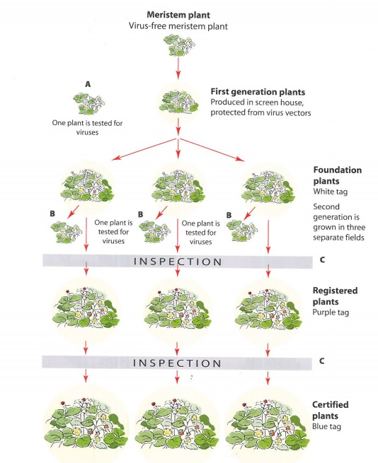
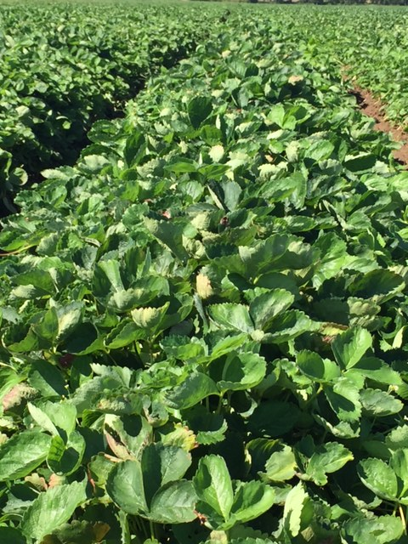
FSGA funded project
Current nursery IPM practices and incidence surveys for soil and foliar pests associated with strawberry transplants in FL production fields
Group 11 (strobs);
Group 7 (SDHIs)
CA
NC,
Canada
FL

Slide 19
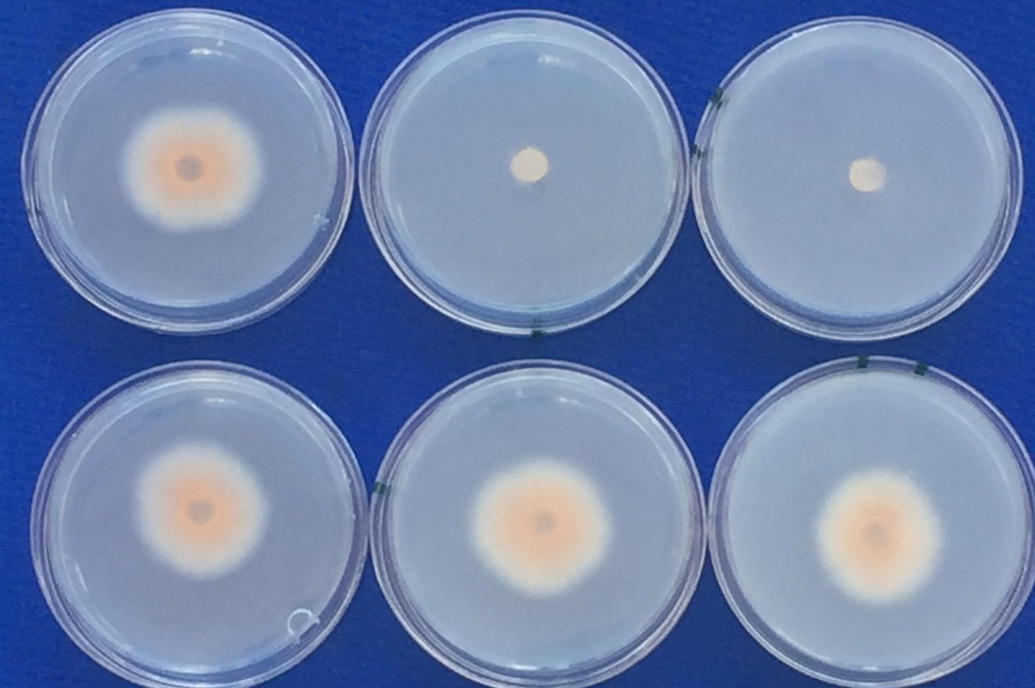
Nursery disease management survey
(Triazoles)
(Strobirulins)
(Group 7)
(Quintec)

Slide 20
Strobirulin resistance distribution
(2013-16)
(n=55) (5)
(n=115) (10)
(n=15)

Slide 21
Nursery recommendations for disease control
Multi-site fungicides:
  C. acutatum and C. gloeosporioides – Captan and Chlorothalonil (Omega)
  Botrytis – Thiram and Chlorothalonil (Omega)
  Powdery mildew – Sulfur
  Phytophthora - Phosphites

Slide 22
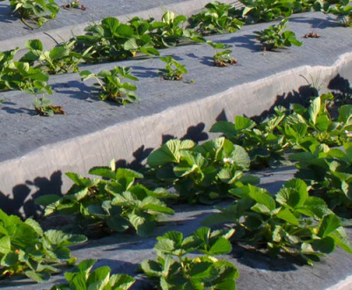
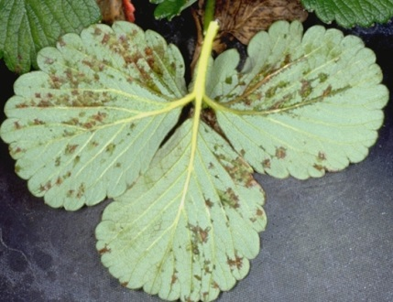
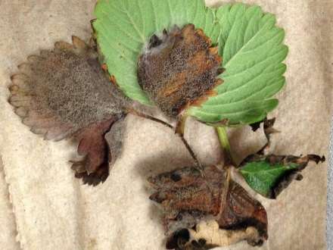
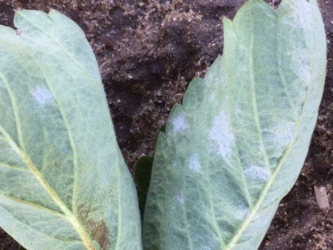
USDA-SCRI funded project
To integrate strawberry disease management across the nursery and fruit production system (2014-2019)
Anthracnose
(Colletotrichum acutatum)
Angular leaf spot
(Xanthomonas fragariae)
Gray mold
(Botrytis cinerea)
Powdery Mildew
(Podosphaera aphanis)

Slide 23
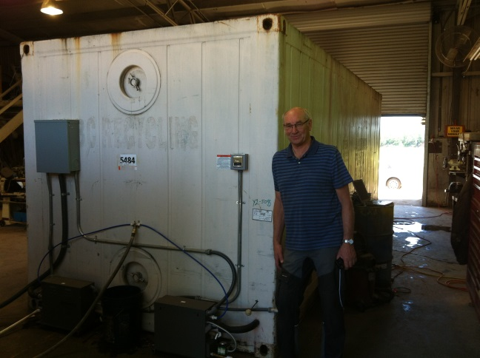
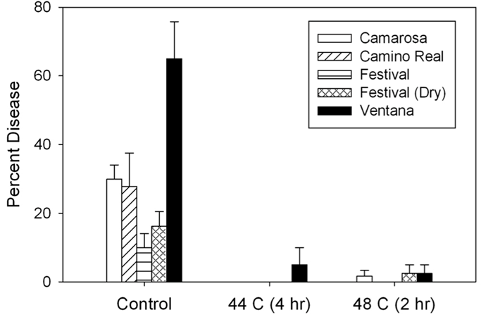
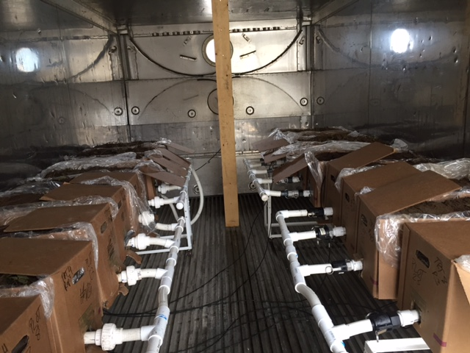
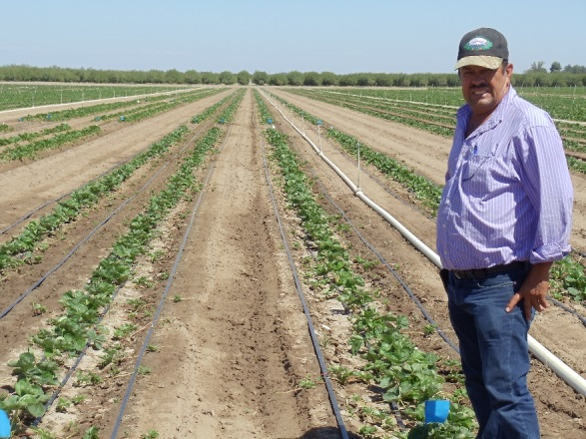
Develop non-chemical suppressive methods for strawberry diseases for use by nurseries and fruit production fields
Bill Turechek
Heat treatment (“Plant sauna”)
Ole Myhrene
Lassen Canyon

Slide 24
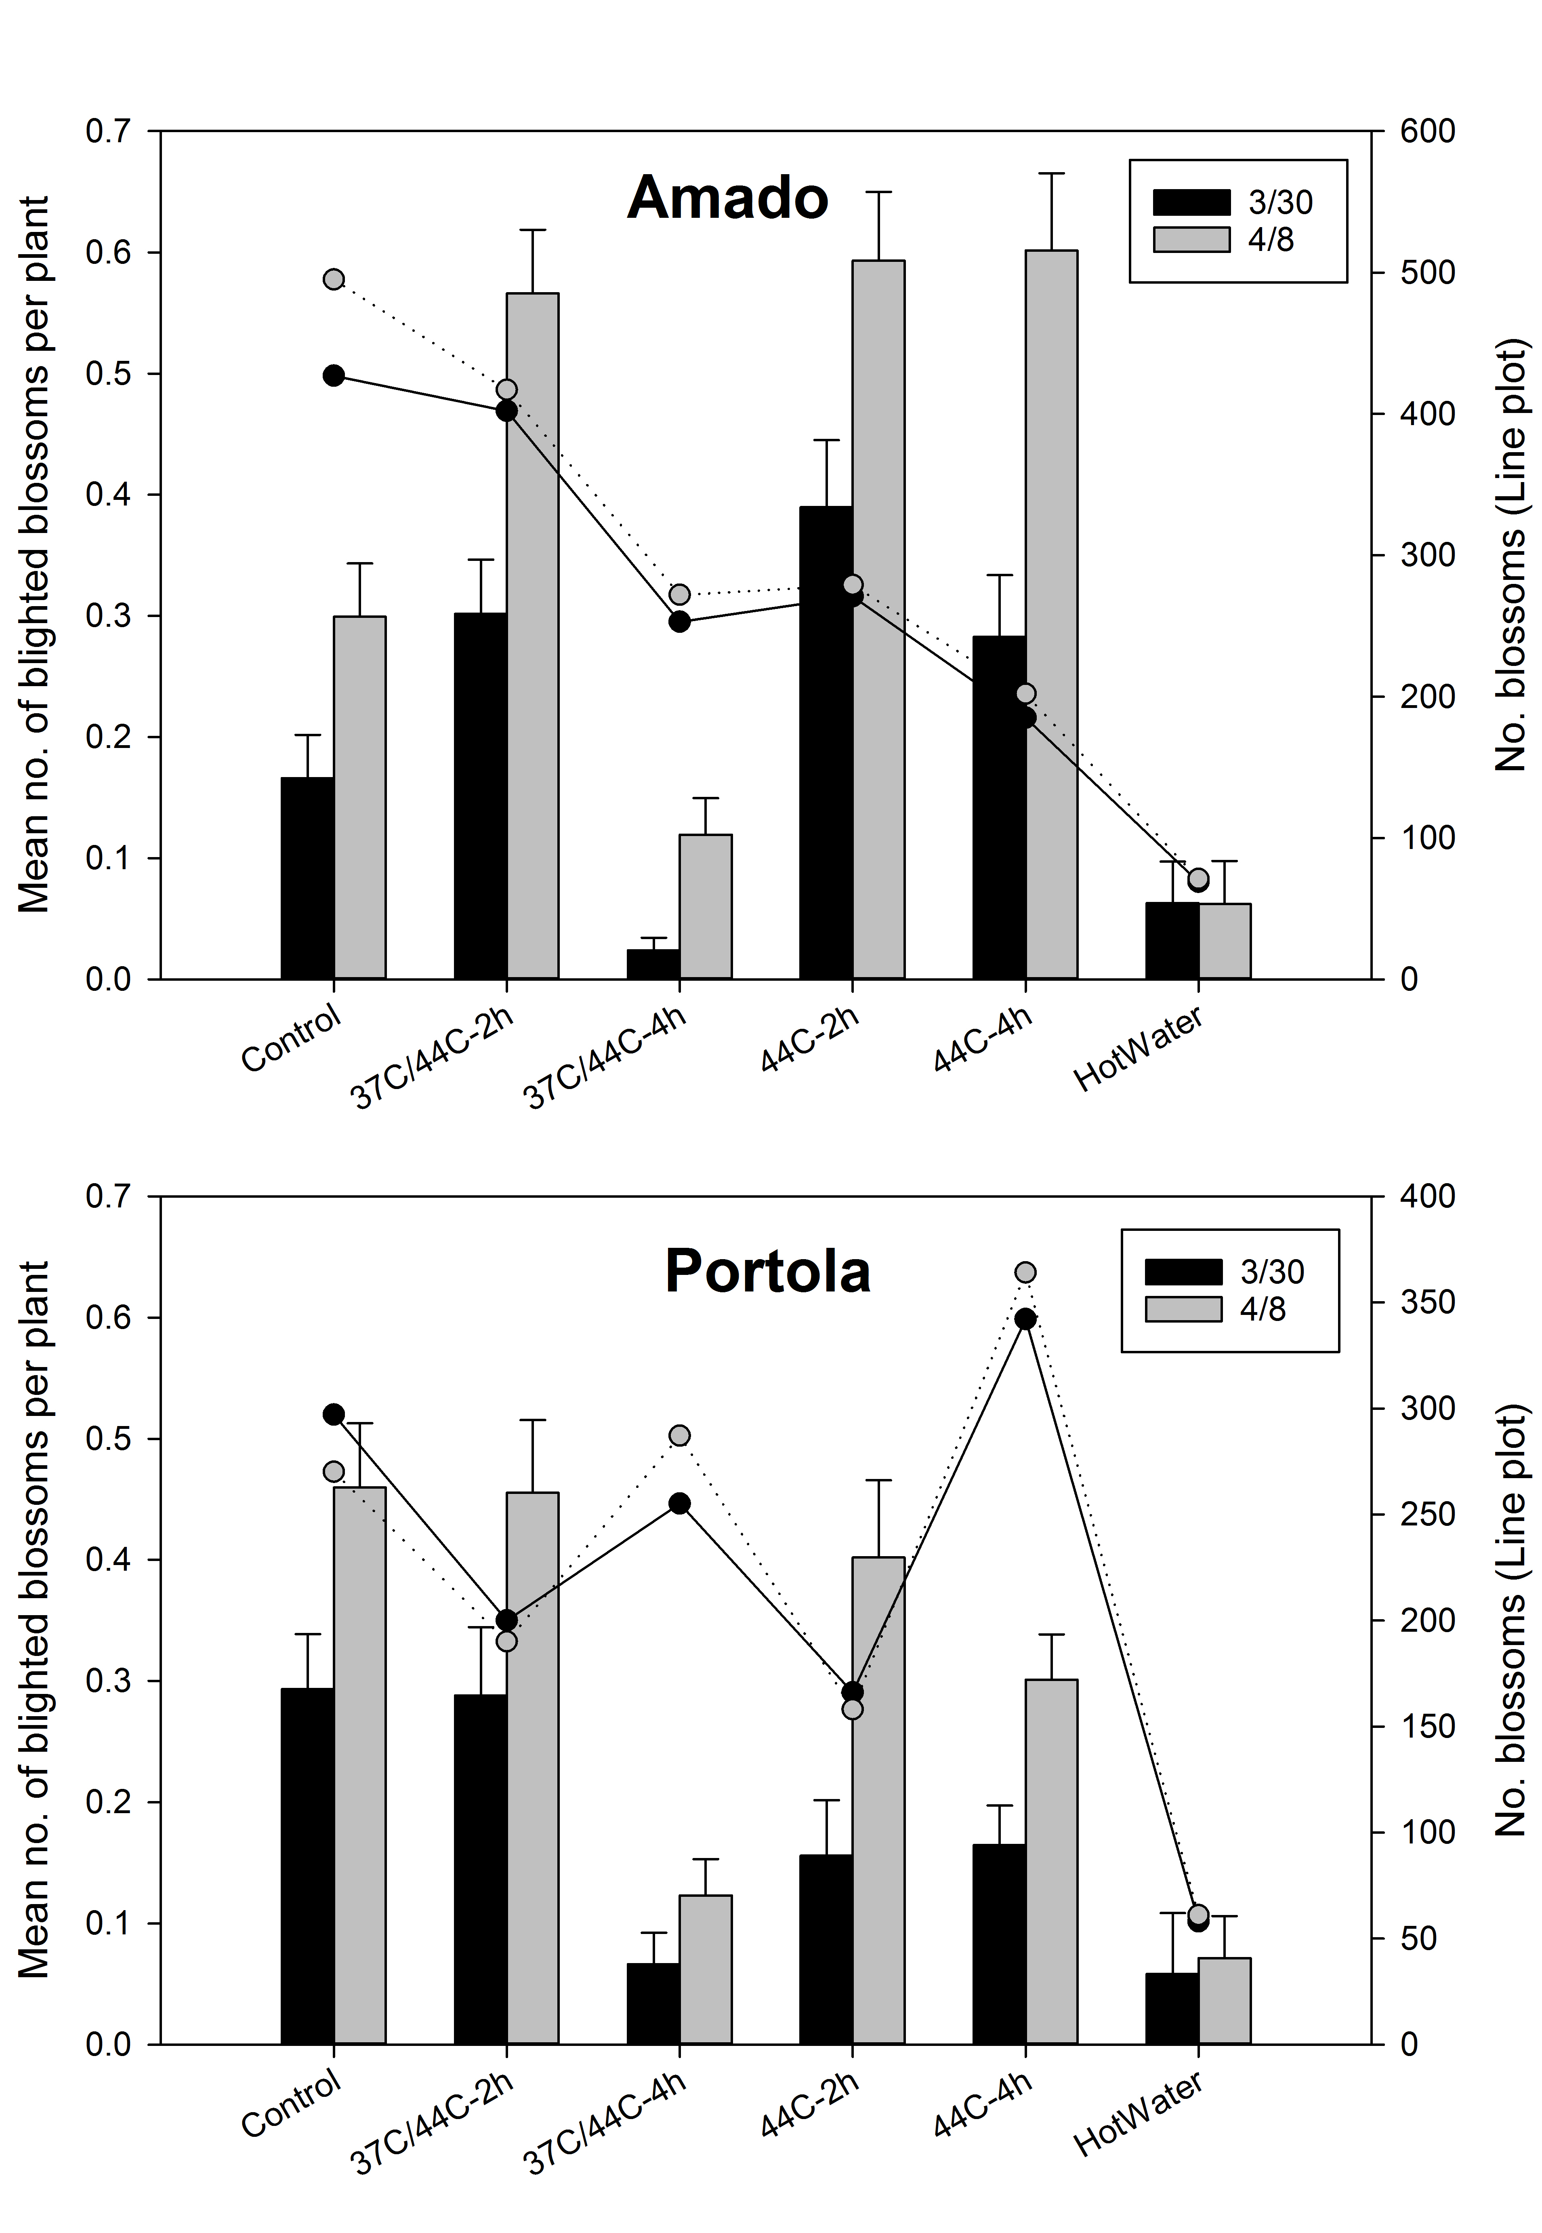
2015-16 Plant Sauna Trials
C. acutatum

Slide 25
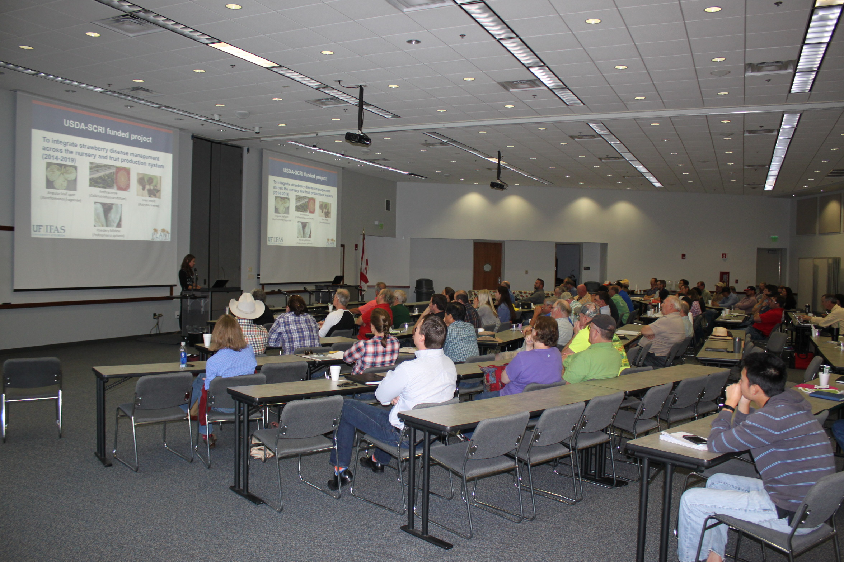
Nursery meeting
Balm, January 2017

Slide 26
Final considerations
Reduce number applications of single-site fungicides
Screening/label of materials for nursery usage only
Integrated management with non-chemical alternatives (cultivar resistance, plant sauna, UV)
Improved communication among fruit producers, nursery, researchers, etc..

Slide 27
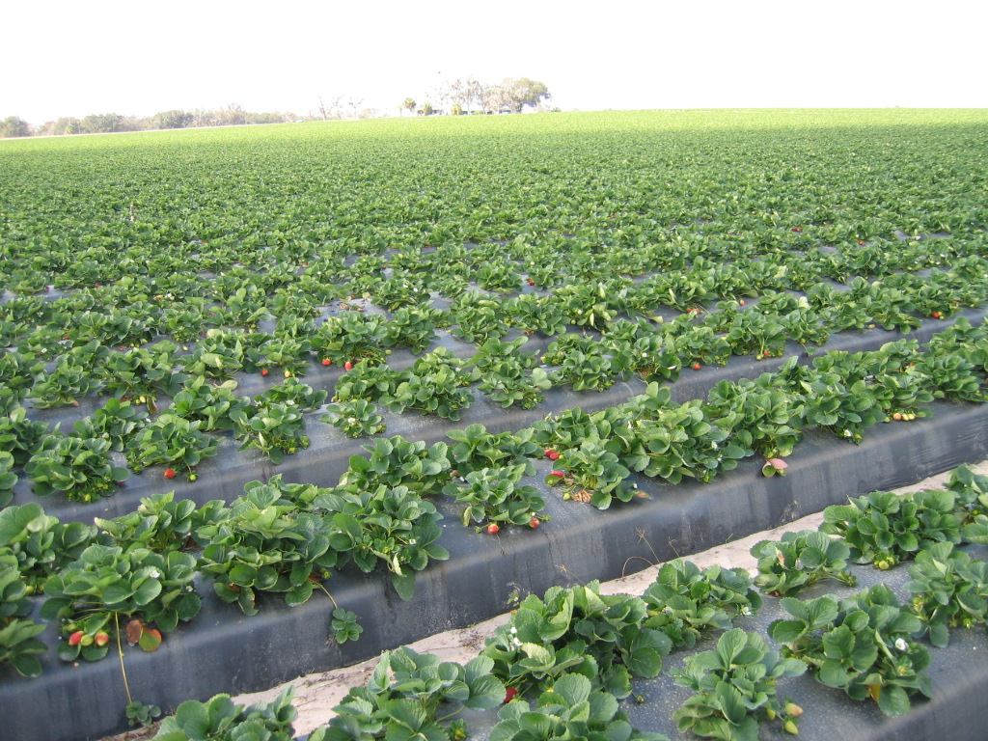


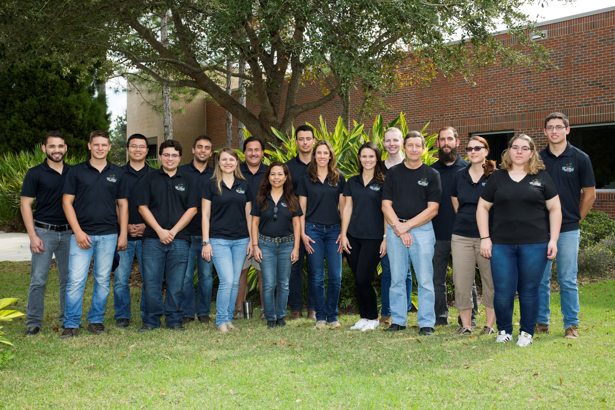
Thank you!!
nperes@ufl.edu
813-633-4133

