Slide 1
FARMS Program
Chris Zajac, FARMS Program Manager
Agritech April 19, 2017
Notes:
Introduction
Brief presentation on the District’s FARMS Program
Provide overview of the program including:
a short background
share with you the (5) FARMS Program Goals,
identify some FARMS BMP Examples we’ve cost shared,
FARMS Program Stats, Project coverage, and Funding levels.

Slide 2
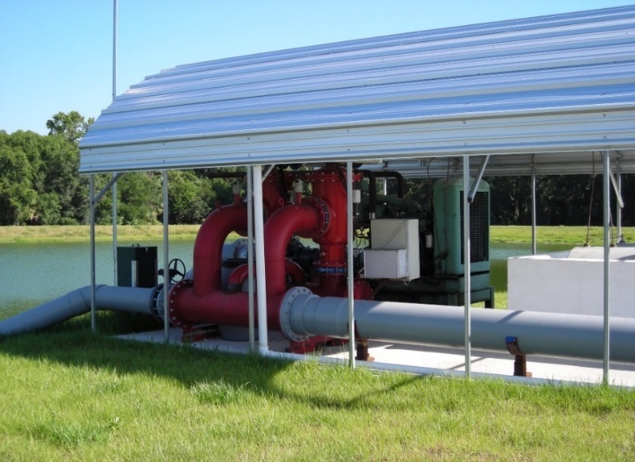
FARMS Program
FARMS is a Best Management Practice (BMP) cost-share reimbursement program for agricultural projects
Created in 2003
Five Program Goals
Shell, Prairie, and Joshua Creek
Upper Myakka River Watershed
Southern Water Use Caution Area
Dover/Plant City WUCA
Northern District/Springs Coast
Notes:
FARMS is a cost-share reimbursement program with agricultural producers.
The program was created in 2003 and works closely with the Florida Department of Agriculture
The Program has 5 goals.

Slide 3
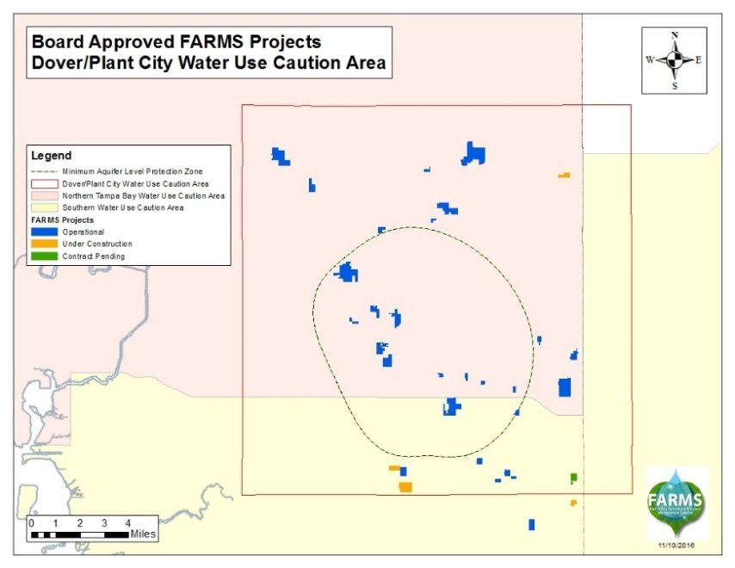
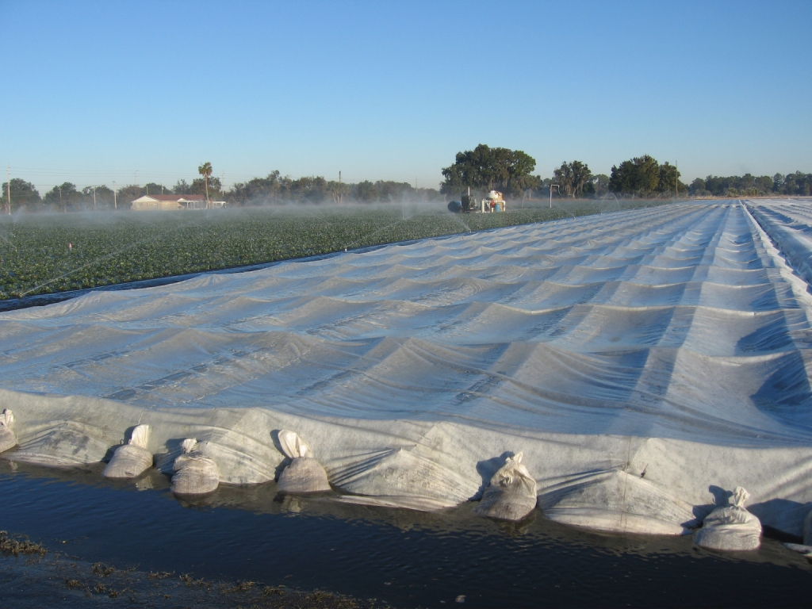
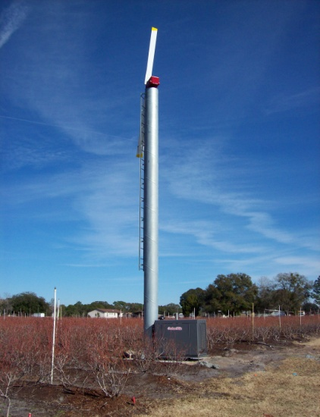
FARMS Program
Reduce cold protection groundwater quantities in the DPCWUCA by 20% by 2020
Funding to reduce frost/freeze protection withdrawals
- 22 Frost-freeze protection projects Board approved
- ~ 41.19 MGD per freeze event offset projected
Notes:
In the Dover/Plant City area the goal of the FARMS Program is to reduce the amount of groundwater used for cold protection.
The DPCWUCA was established in 2011 as a result of an extended freeze event in 2010.
That freeze event resulted in numerous dry well complaints as a result of agricultural related freeze protection.
The FARMS Goal is to reduce the amount of groundwater used for freeze protection by 20% by 2020.
To date the Board has approved 22 Frost/Freeze protection projects with an estimated offset of 41.19 MGD per freeze event.

Slide 4
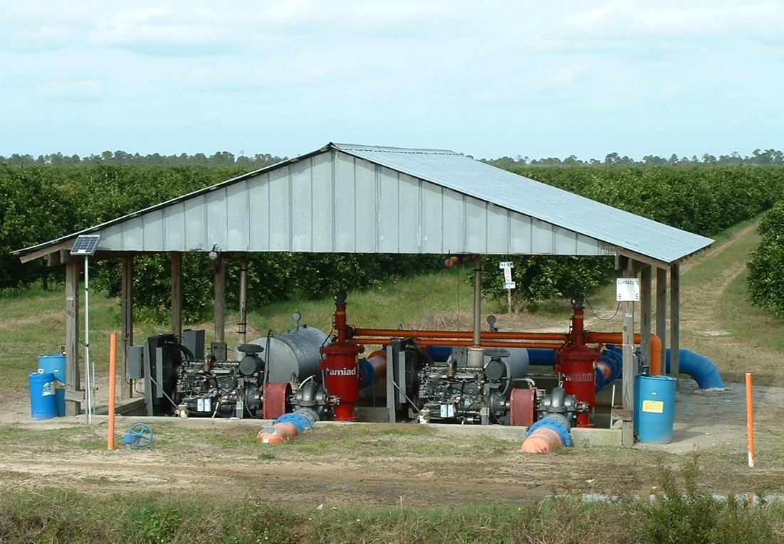
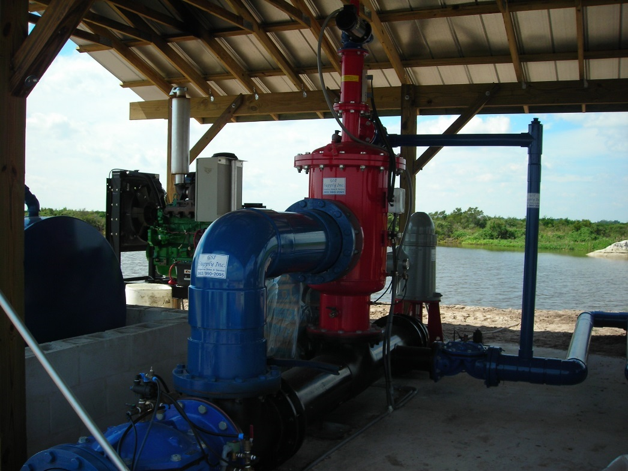
FARMS Program
Typical Cost Share BMPs
Tailwater Recovery
Pumps
Filters
Mainline
Notes:
Tailwater recovery is the most common BMP that we cost share. We will reimburse growers up to 50% of FARMS eligible costs that typically include pumps, filters and mainline necessary to hook the tailwater pond up to the existing irrigation system. The grower is required to pay for at least 25% of the total project cost. We do not reimburse for excavation costs so that is usually considered part of the growers matching dollars. During construction and before the project is operational the grower is also required to modify their Water Use Permit. Any groundwater offset by the tailwater recovery system is placed on standby on their permit. The grower does not lose groundwater quantities from their permit. Again those quantities are put on standby in the vent that the surface water is not available.

Slide 5
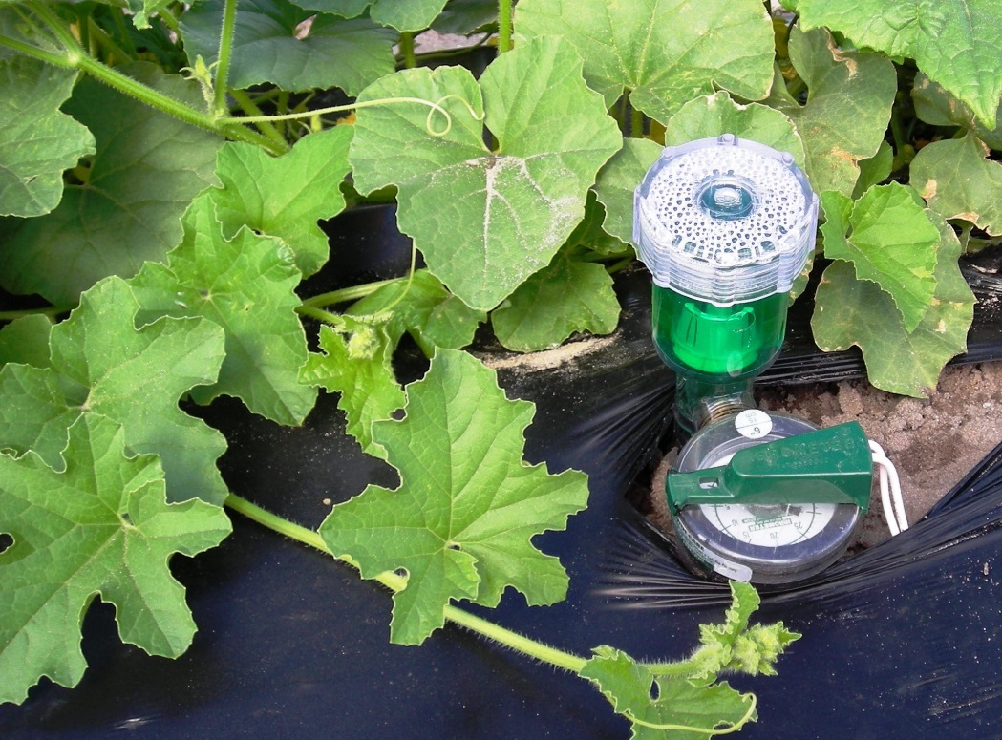
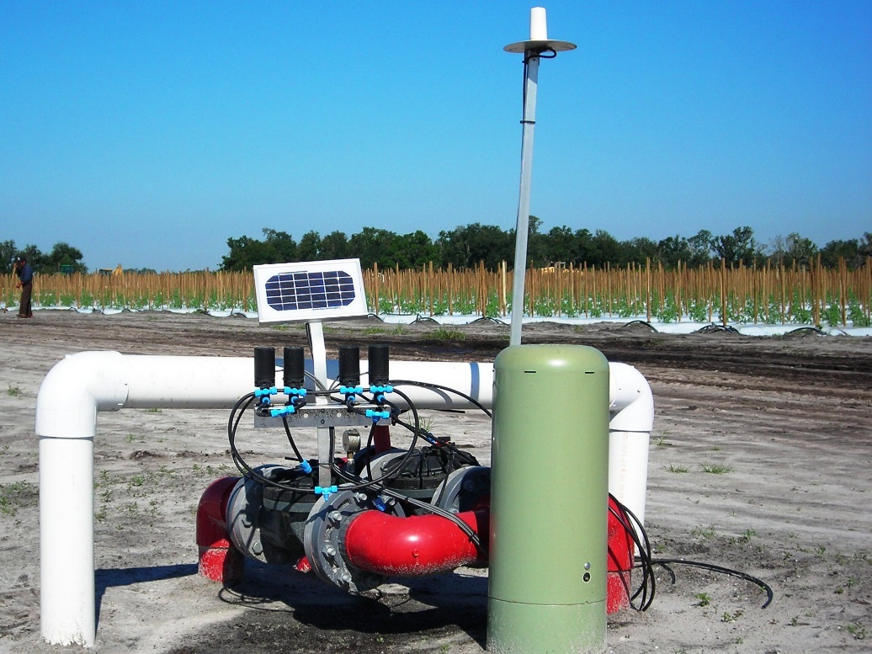
FARMS Program
Typical Cost Share BMPs
Irrigation System Automation
Auto Start/Stop
Weather Stations
Soil Moisture Sensors and Salinity Probes
Notes:
If your farm is too small or if you don’t have space on the farm for tailwater recovery, we can cost share some other BMPs to help growers conserve water. Typical water conservation BMPs include automating your irrigation system and incorporating soil moisture probes and weather stations into your decision support systems. These allow growers to make irrigation decisions based on site specific criteria and conditions. Again, we will reimburse up to 50% for many of these BMPs.

Slide 6
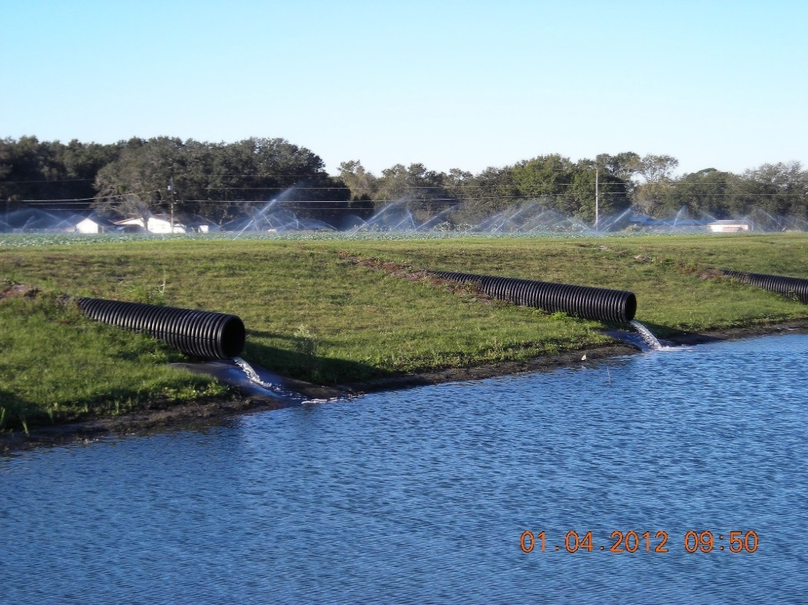
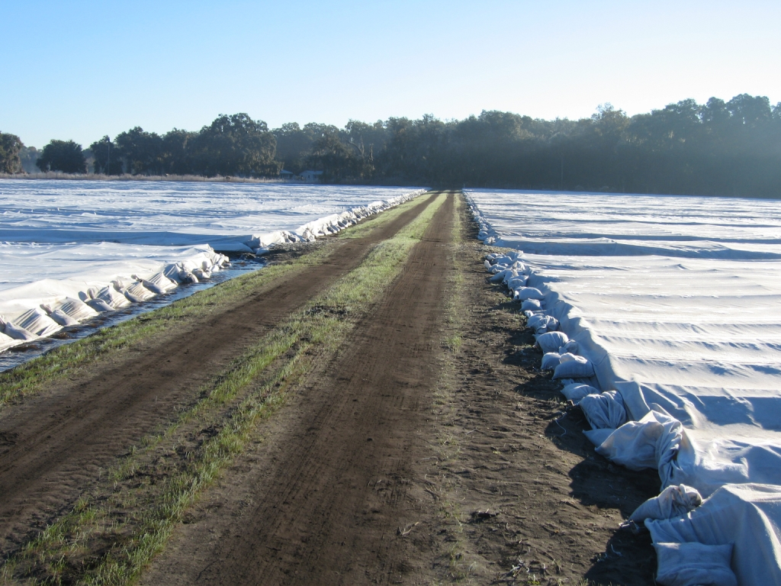
FARMS Program
Typical Cost Share BMPs
Frost/Freeze Protection BMPs
Alternative Water Supply
Chemical Protectants (DPCWUCA)
Row Covers (DPCWUCA)
Wind Machines
Notes:
The previous BMPs mentioned will help growers save groundwater for daily irrigation. We can really open the wallet and increase the reimbursement rate if your project reduces groundwater used for frost/freeze protection. The Dover/Plant City area has been included in a rule revision that allows the District to reimburse growers up to 75% if their project qualifies. This means that not only do you save water for daily irrigation but also for frost/freeze protection. This is typically limited to tailwater recovery systems. We also fund frost freeze BMPs like chemical protectants and row covers at a 75% rate for qualifying projects.

Slide 7
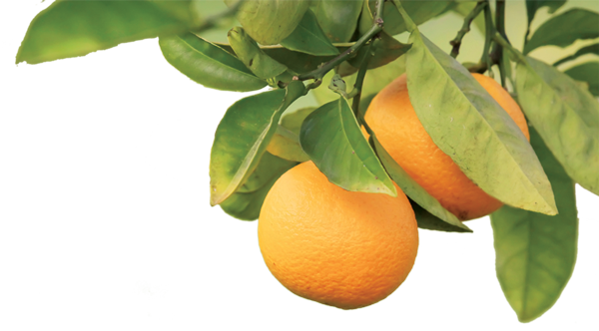
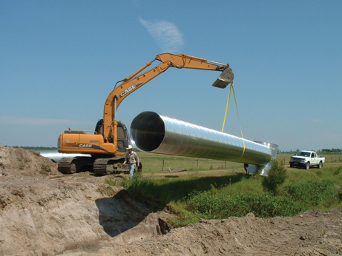
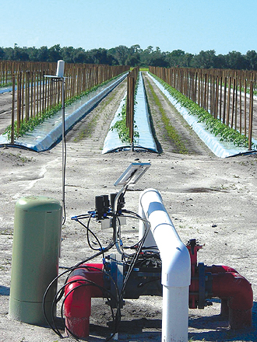
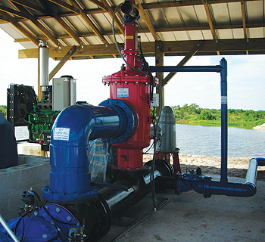
FARMS Accomplishments
182 Board-approved projects
27 MGD projected groundwater offset
DPCWUCA 25% progress toward goal
Total invested: ~$65.7M since 2003
District 44%/Farmer 44%
$3.00/1,000 gallons saved
Notes:
The Governing Board has approved 182 projects with a projected offset of 27 MGD.
District Reimbursement $28.7 – 44%
State Appropriation $7.3 – 11%
FDACS $0.8 – 1%
Grower $28.8 – 44%
Total Project Cost: $65.7 – 100%

Slide 8
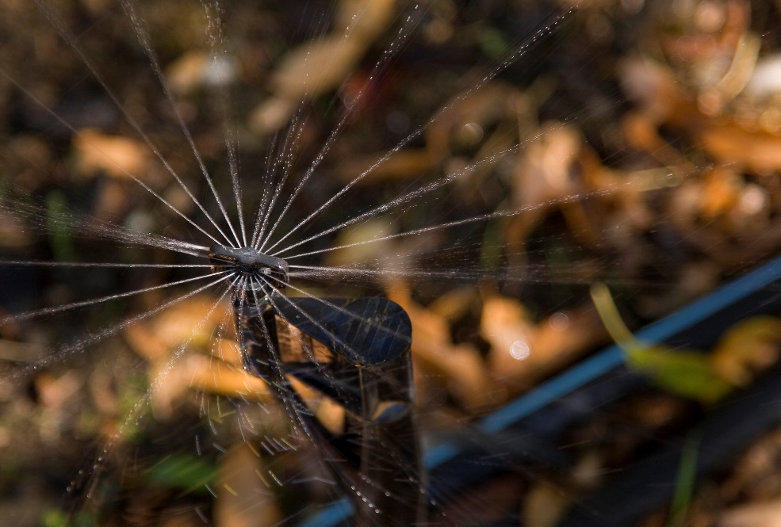
Other Programs Overseen by FARMS
UF-IFAS Research
Agricultural Commodities = 39
Blueberries
Citrus
Nursery Trees and Plants
Peaches
Peppers
Potatoes
Strawberries
Tomatoes
UF-IFAS Research
Notes:
IFAS: Projects applicable to both production agriculture and urban landscapes include FAWN, BMP implementation, soil moisture sensors, comparing different techniques to estimating ET.
Status: 8 ongoing (2 new in FY17)

Slide 9
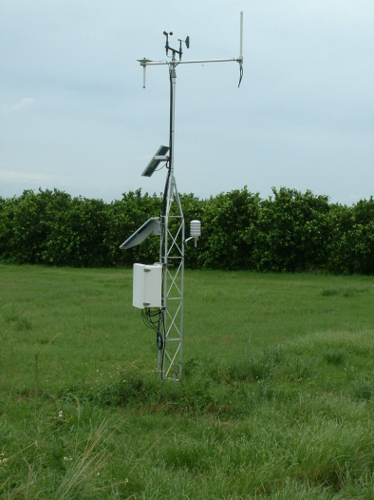
Other Programs Overseen by FARMS
Mini-FARMS Program
Partnership with FDACS
Scaled-down version of FARMS
$5,000 cap, 75% reimbursement
Total Funding last 5 years ($374,633)
158 projects over 4,570 acres serviced
FAWN Program
Partnership with IFAS
Collect and distribute real-time data
44 weather stations statewide (13 in the District)

Slide 10
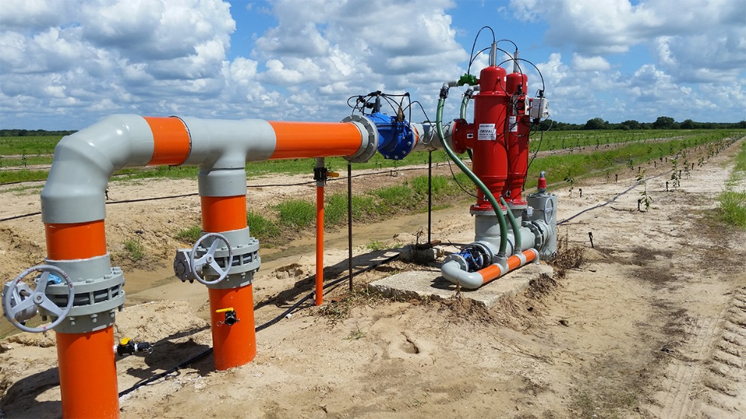
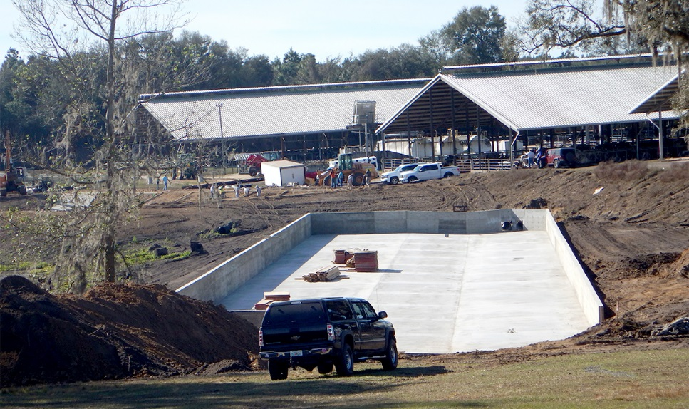
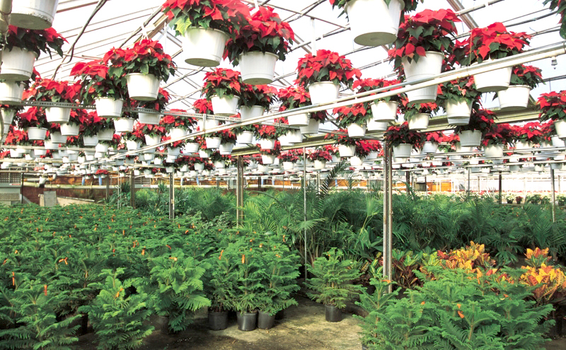
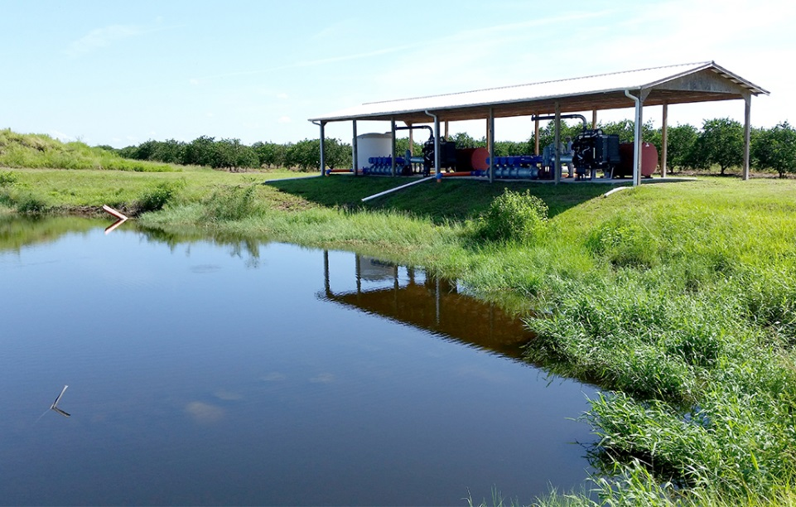
Notes:
FARMS operates as a reimbursement program.
The Agricultural community has shown strong support over the years for the FARMS Program
The District aims to continue it’s support of the FARMS program and other agricultural programs as is evident in the District’s strong financial support, while continuing with FARMS Program projects in the future.

Slide 12
FARMS Program Project Totals by Fiscal Year

