Slide 1

Recent research findings on crown diseases: Macrophomina, Colletotrichum and Phytophthora
Natalia A. Peres, Jim Mertely, and Juliana Baggio
UF, Gulf Coast REC
Joe Noling
UF, Citrus REC

Slide 2
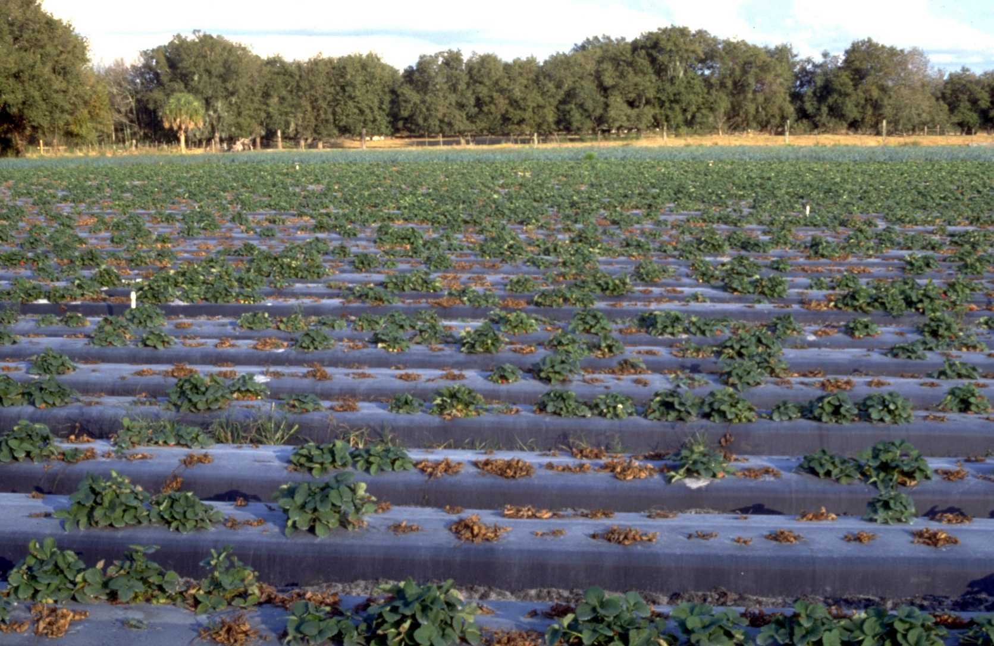
A crown rot… is a crown rot
Notes:
So… this was the season of the crown rots… I have seen a few fields like this, with high % mortality… but the majority was not as severe but just had a steady mortality throughout the season… Mostly with crown rots… and a crown rot is crown rot, right?

Slide 3
Well, not really…

Slide 4
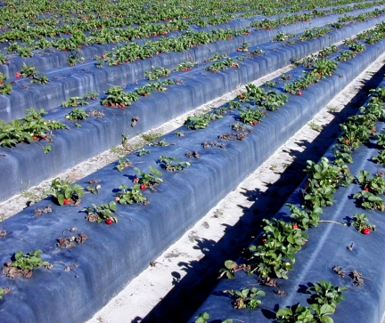
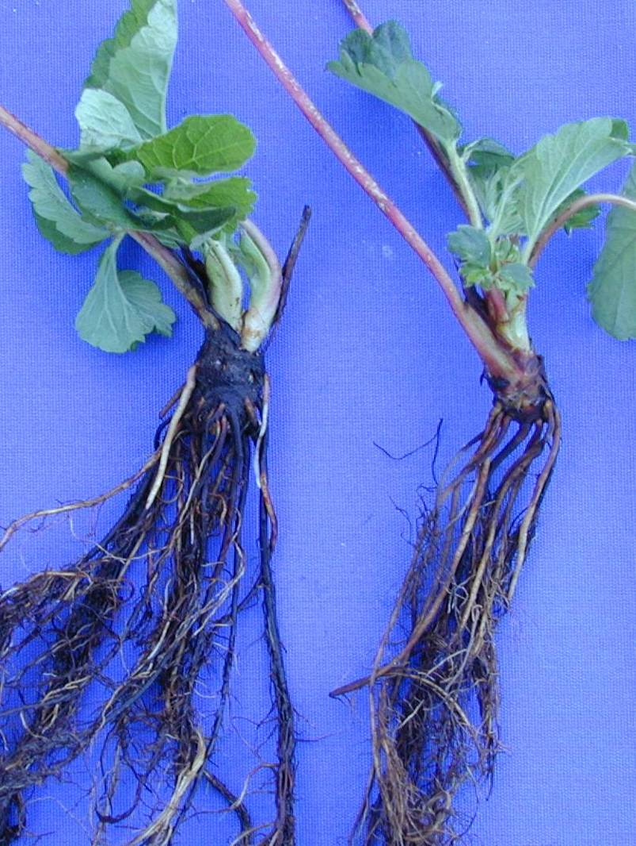
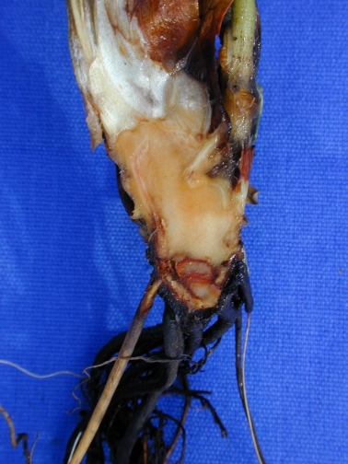
Root Necrosis/Crown Rot
(Colletotrichum acutatum)

Slide 5

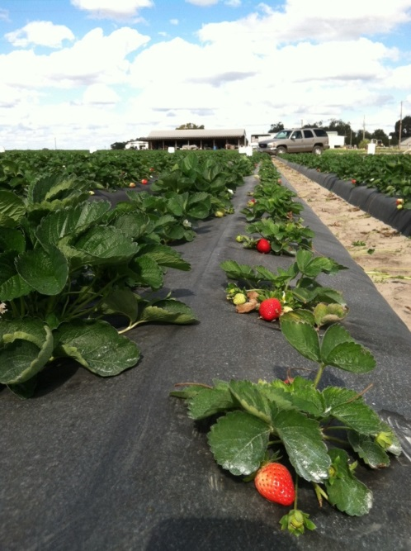
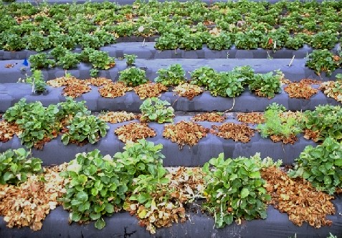
Early season disease problems in FL
2016-17: C. acutatum
2015-16: C. acutatum
2014-15: C. acutatum
2013-14: C. acutatum
2012-13: C. acutatum
(SMYEV and SMoV)
2007-08: C. gloeosporioides
2004-05: C. acutatum

Slide 6
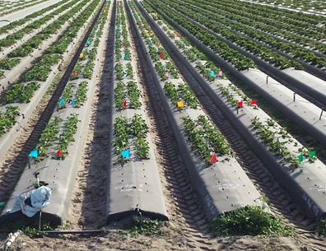
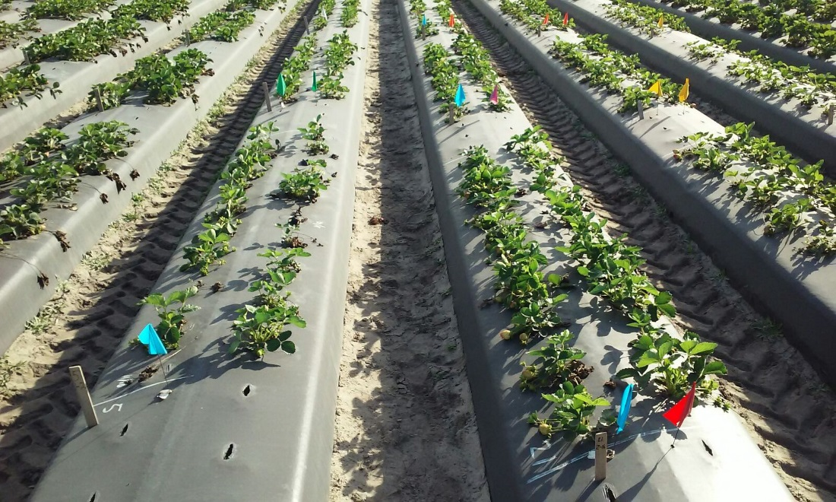
2016-17 Fungicide dip trials
GCREC - Balm
Plants root-inoculated with C. acutatum

Slide 7
C. acutatum plant dip trial
2016-17

Slide 8
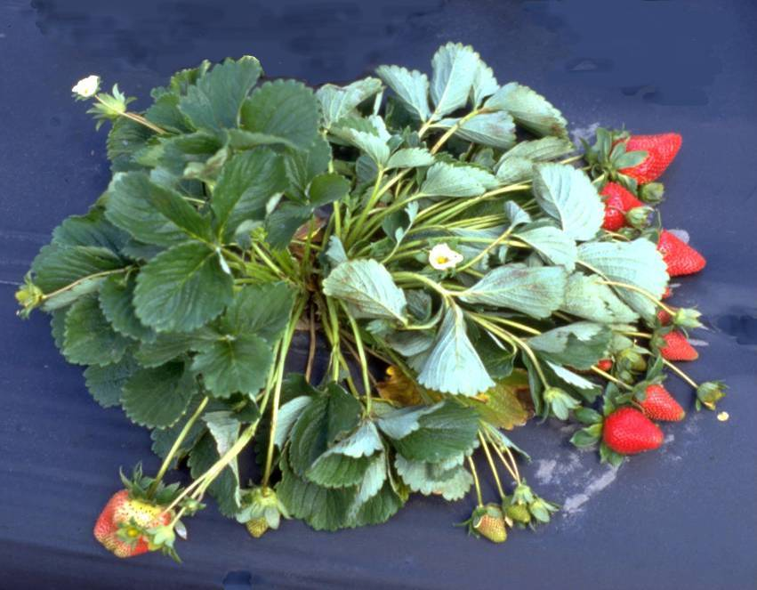
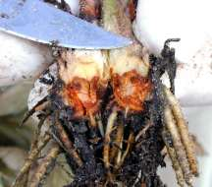

Colletotrichum Crown Rot and Phytophthora Crown Rot
Symptoms nearly identical and similar to charcoal rot caused by Macrophomina phaseolina

Slide 9
Colletotrichum / Phytophthora crown rots
Both favored by warm weather
Colletotrichum: high incidence in local summer nurseries
  Production of transplants in northern states greatly reduced disease
  Low incidence (1-5%) still observed: inoculum from other hosts
Phytophthora: nursery infected transplants

Slide 10
Current recommendations for
Colletotrichum / Phytophthora control
Correct diagnosis!
Colletotrichum
  Preventative captan applications (susceptible cv)
Phytophthora
  one or two applications of Ridomil after plant establishment
  regular applications of phosphorous acid or phosphite materials throughout the season
Notes:
xx

Slide 11
Fungicides recommended
for Colletotrichum Crown Rot control
Captan (captan) – Group M4
Abound (azoxystrobin) – Group 11
Cabrio (pyraclostrobin) – Group 11
Flint (tryfloxistrobin) – Group 11
Evito (fluoxastrobin) – Group 11
Topsin (thiophanate-methyl – Group 1
Switch (cyprodinil + fludioxonil) – 9 + 12

Slide 12
Screening of C.gloeosporioides isolates for sensitivity to strobilurin fungicides*
*Abound, Cabrio, Flint, etc…
*All isolates resistant to strobilurin fungicides were also resistant to Topsin

Slide 13
Phytophthora drip trial
2016-17

Slide 14
Emergence of Ridomil resistance
2016-17 FL season
n=47
Notes:
xx

Slide 15
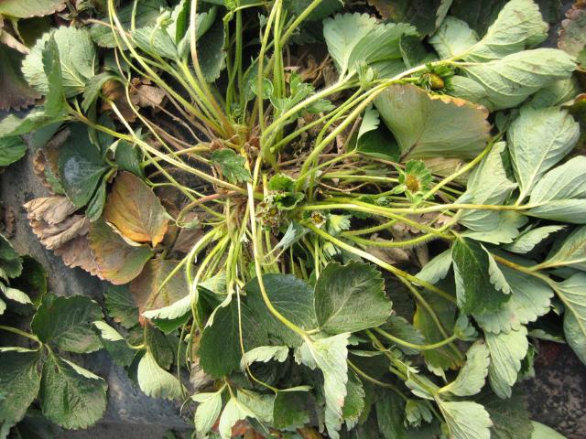
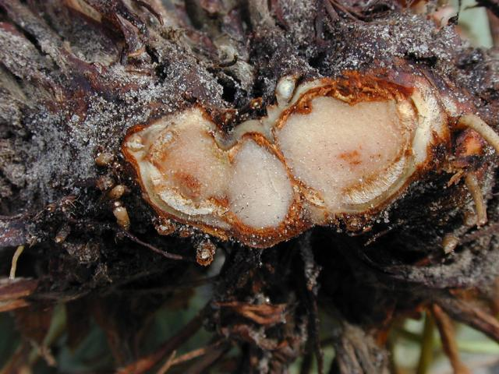
Charcoal Rot caused by
Macrophomina phaseolina
* Similar to symptoms caused by Colletotrichum and Phytophthora
Notes:
Symptoms consist of wilting of foliage, plant stunting, and drying and death of older leaves, though the central youngest leaves often remain green and alive. Plants can eventually collapse and die. When plant crowns are cut open, internal vascular and cortex tissues are dark brown to orange brown. We do not see fungus fruiting bodies or other structures directly on plant tissues. Disease is often most severe if the infected plant is subject to stresses such as weather extremes, water stress, poor soil conditions, or heavy fruit loads.

Slide 16
Charcoal Rot
First diagnosed in Florida in 2001; in CA in 2005
Optimum conditions – high temperatures (>78ºF)* and high O₂ concentration in the soil
Survives in the soil as microsclerotia – viable for up to 3 years Fumigation

Slide 17
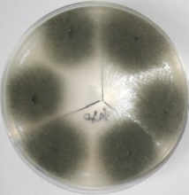
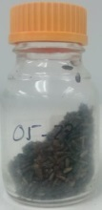
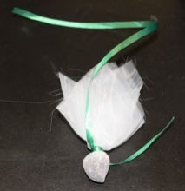
Dover fumigation trial 2016-17
Macrophomina evaluation
Treatment (rate) | Plastic/Method | Number of Macrophomina colonies/ 3ml kaykob bundle
 |  | Center of Bed | Side of Bed
1. MeBr50 | Shank + VIF | 0.0 d | 0.0 d
2. Telone C35 (30 gpta) | Shank + VIF | 0.1 d | 0.0 d
3. PicClor60 (300 lb/ta) | Shank + VIF | 122.1 b | 76.5 bc
4. Pic80 (23 gpta) | Shank + VIF | 0 d | 0 d
5. Pic100 (21.6 gpta) | Shank + VIF | 10.9 c | 23.6 bc
6. Kpam (62 gpta) | Drip + VIF | 0.3 d | 0.6 cd
7. DMDS + Pic (30 gpta) | Shank + TIF | 247.9 a | 374.1 a
8. DMDS EC + Pic EC (30 gpta) | Drip + TIF | 0.1 d | 76.0 bc
9. Dominus (30 gpta) | Drip + VIF | 0.4 d | 137.5 b
10. Untreated control | -- | 529.4 a | 483.8 a

Slide 18
Macrophomina Chemigation trial
2016-17

Slide 19
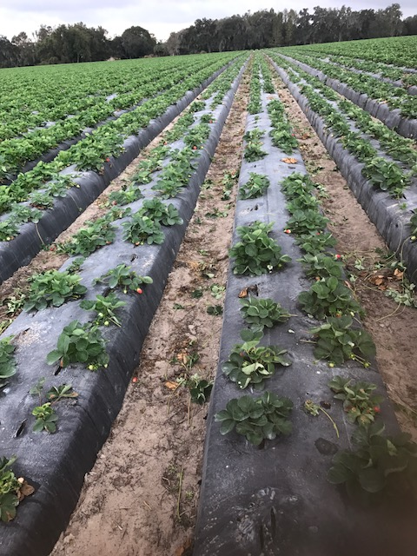
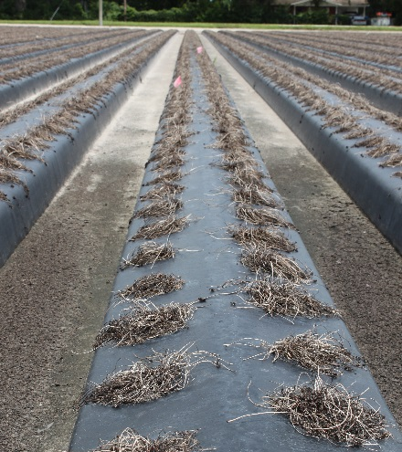
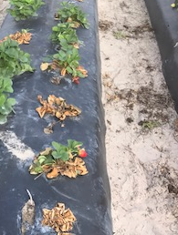
Crop destruction trial
60% mortality at end of
2015-16 season
Field previously fumigated
with Telone
Planted with highly susceptible
cultivar Albion
2016-17 season

Slide 20
Integrated approach for Macrophomina management
  Crop destruction
  Pre-plant fumigation
  Cultivar selection
  Crop residue removal when
  re-using plastic

Slide 21
Cultivar evaluations for crown rot diseases
Disease | Causal agent | Festival | Radiance | Winterstar | FL-127 (Sensation)
Colletotrichum crown rot | Colletotrichum gloeosporioides | S (52%) | S (50%) | MS (40%) | MR (27%)
Phytophthora crown rot | Phytophthora cactorum | R (5%) | HS (50%) | S (36%) | HS (67%)
Charcoal rot | Macrophomina phaseolina | S (95%) | MS (52%) | MR (12%) | MR (20%)
* Knowing your cultivar susceptibility helps with diagnosis!!

Slide 22
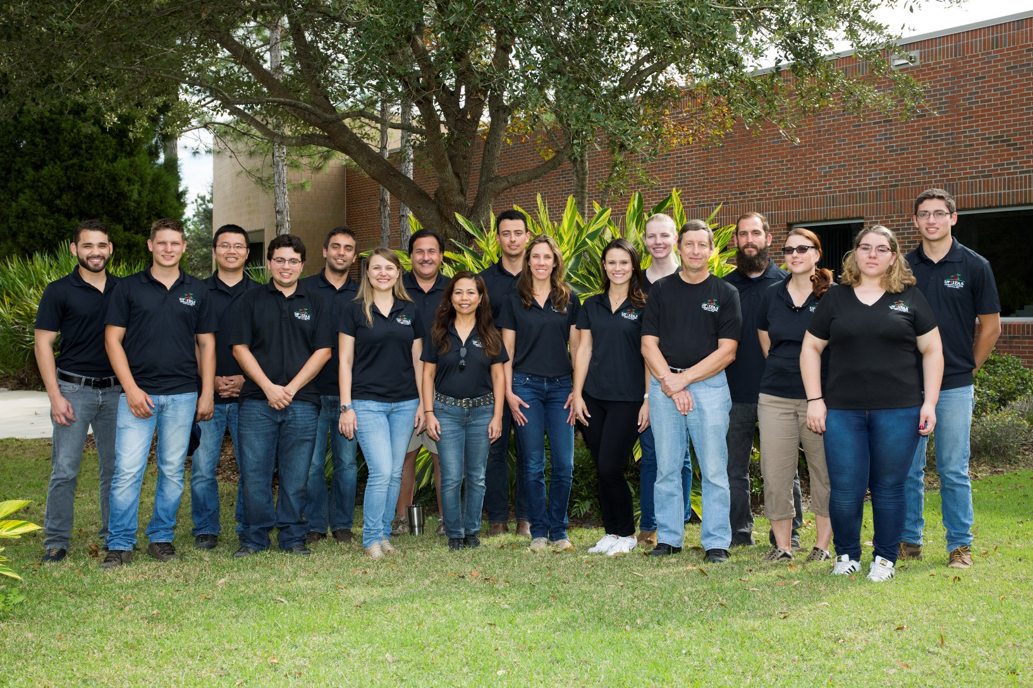
GCREC Strawberry Pathology Team

Slide 23
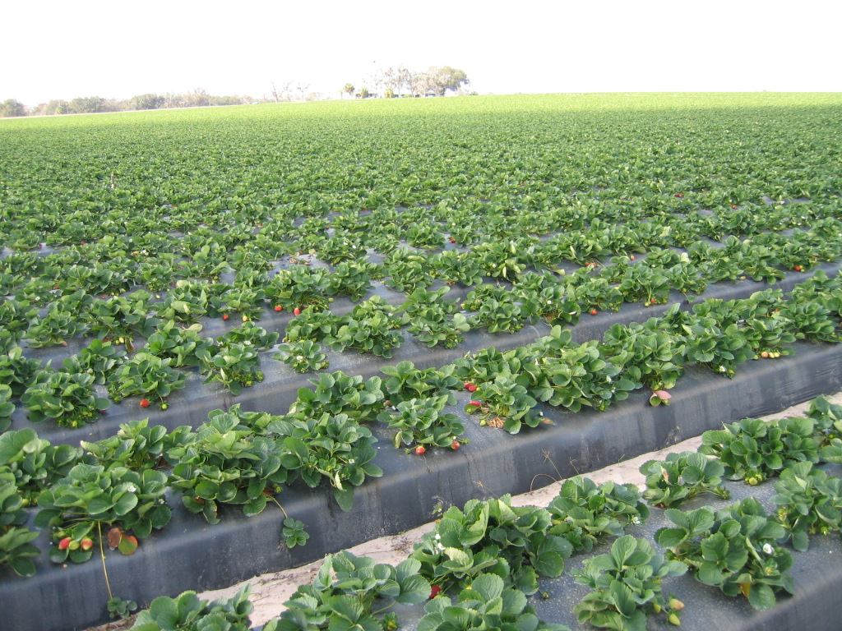

Thank you!!
Questions?

