Slide 1
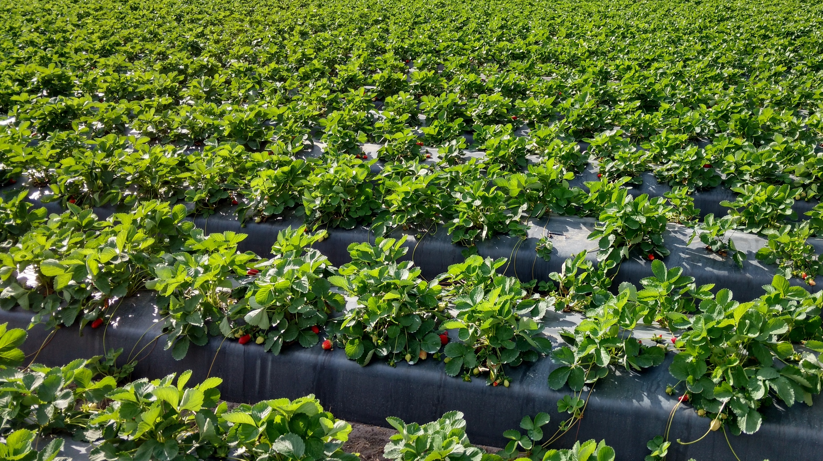
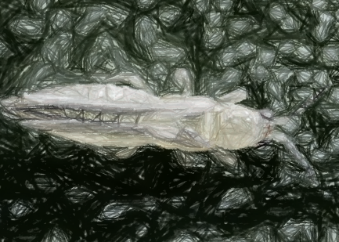
Thrips, spider mite and seed bug control with insecticides
Justin Renkema
Small Fruit Entomology
Gulf Coast Research and Education Center

Slide 2
Presentation available at:
https://jmrlab.wordpress.com
Recent Presentations

Slide 3
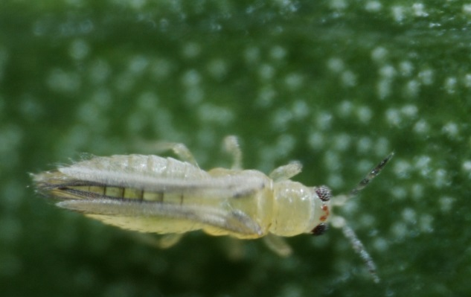
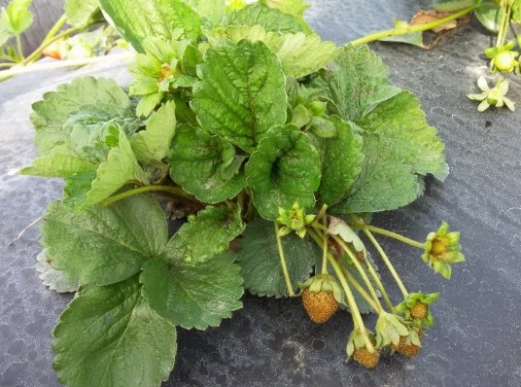
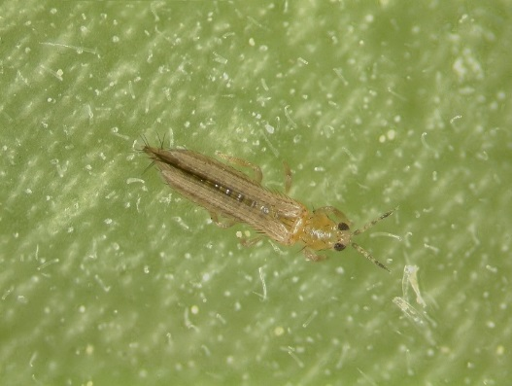
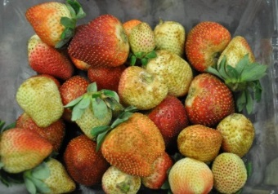
Chilli thrips (Scirtothrips dorsalis)
Flower thrips (Frankliniella spp.)
Invasive
Early-season, warm temperatures
Foliar damage
Fruit damage
Two species:
F. bispinosa (Florida flower thrips)
Common, native, less damage
F. occidentalis (Western flower thrips)
Uncommon, invasive, more damage
Throughout the season
Flower damage
Fruit damage
Management of Radiant SC (spinetoram)

Slide 4
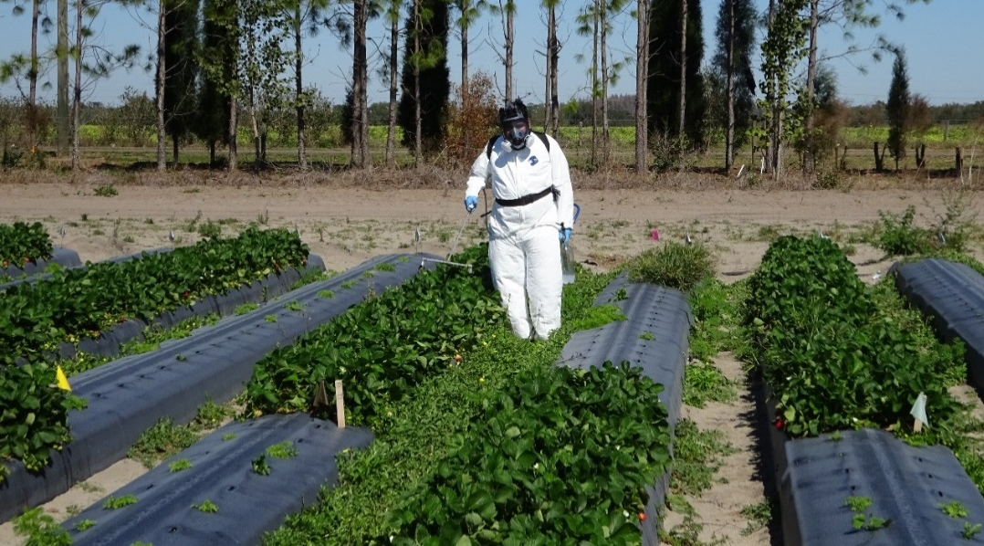
What are the most effective rotations of insecticides?
How effective are unregistered insecticides?
Spray date | Rotation 1 | Rotation 2 | Rotation 3 | Rotation 4 | Insecticide 5 | Insecticide 6 | Rotation 7 | Insecticide 8 | Insecticide 9 | Insecticide 10 | Rotation 11 | Control
17-Nov | Voliam flexi | Voliam flexi | Voliam flexi
2-Dec | Radiant | Radiant | Radiant | Radiant | Apta | Exirel | Grandevo | Minecto Pro | Radiant | Closer | Radiant | water
5-Dec | Rimon
20-Dec | Assail | Assail | Sivanto | Assail | Apta | Exirel | Radiant | Minecto Pro | Radiant | Closer | Closer | water
8-Feb | Radiant | Radiant | Assail | Trilogy | Apta | Exirel | Grandevo | Minecto Pro | Radiant | Closer | Radiant | water
16-Feb | Rimon |  |  | Trilogy
24-Feb | Assail | Beleaf | Malathion | Trilogy | Apta | Exirel | Radiant | Minecto Pro | Radiant | Closer | Closer | water
10-Mar | Radiant | Sivanto | Actara | Radiant | Apta | Exirel | Venerate | Minecto Pro | Radiant | Closer | Radiant | water
Radiant – low rate, 6 fl oz/A
Radiant – high rate, 10 fl oz/A
Induce – non-ionic surfactant (0.25% v/v) used with all products & control except Grandevo, Venerate, Trilogy

Slide 5
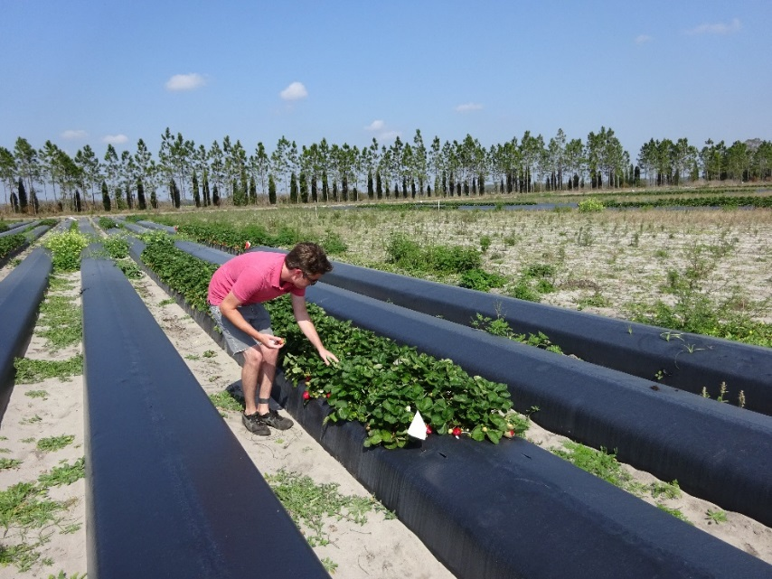
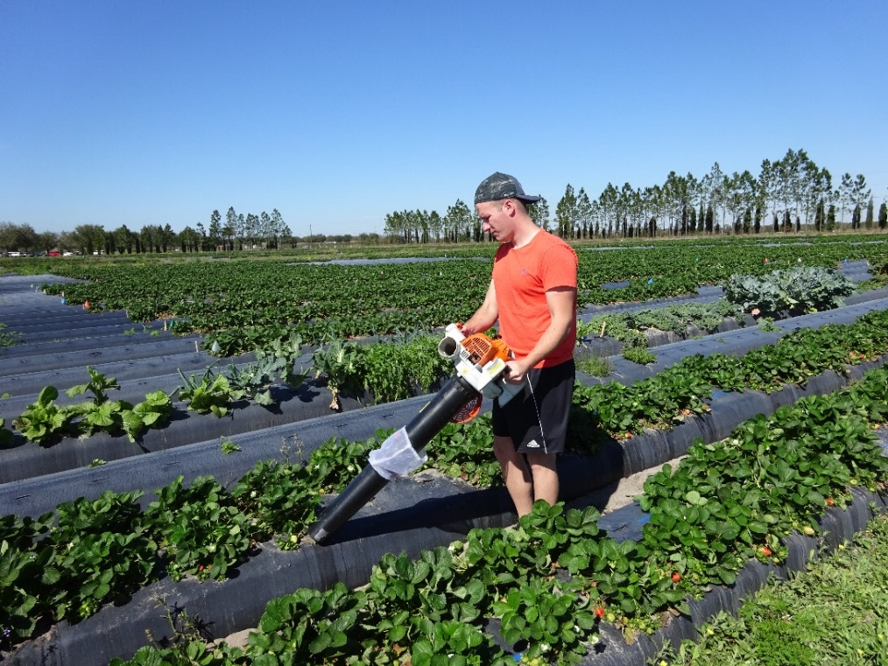
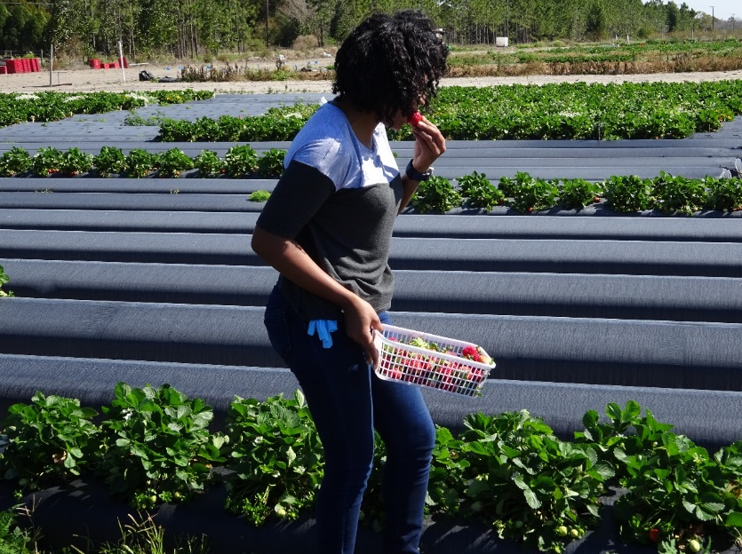
Data:
thrips on leaves
aphids on leaves
thrips in flowers
thrips in green fruit
seed bug on plants (Feb-Mar)
leaf damage ratings
marketable yield
% damaged berries

Slide 6
Data:
thrips on leaves
aphids on leaves
thrips in flowers
thrips in green fruit
seed bug on plants (Feb-Mar)
leaf damage ratings
marketable yield
% damaged berries

Slide 7
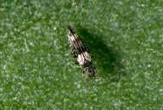
Thrips species distribution on leaves
347 thrips
94 thrips
142 thrips
Caliothrips fasciatus – American bean thrips
Found on strawberry in Brazil (one adult on a leaf in one location) (Pinent et al. 2011)
A pest of citrus in S. California – moves from weeds in fall, concern on exported navel oranges

Slide 8
Voliam flexi (thiamethoxam + cholorantraniliprole) may slow the rate of thrips increase
Rimon (novaluron) + Radiant (spinetoram) has little added value over Radiant alone
Grandevo (1 app.) is not highly effective
Radiant low rate almost equally effective as Radiant high rate
Sivanto is equally effective as Assail (acetamiprid) as a second option

Slide 9
Closer (sulfoxaflor) is less effective than other tested products
Exirel (cyantraniliprole) & Apta (tolfenpyrad) & Minecto Pro (cyantraniliprole + abamectin) are almost as effective as Radiant

Slide 10
Thrips species distribution on leaves
153 thrips
230 thrips
115 thrips

Slide 11
Rotations without Radiant have higher thrips numbers than rotations with Radiant
Beleaf, Sivanto, (& Closer) are as effective as Assail as second options
Trilogy is moderately effective
Venerate suppresses thrips after a Radiant application

Slide 12
Closer (sulfoxaflor) alone is not effective
Exirel (cyantraniliprole) & Apta (tolfenpyrad) are almost as effective as Radiant
Minecto Pro (cyantraniliprole + abamectin) is as effective as Radiant

Slide 13
High rates of damage: control & Closer (3 apps.)
Moderate rates of damage: Trilogy (3 apps.) + Radiant, Assail-Malathion-Actara
Low rates of damage: Apta (3 apps.), Exirel (3 apps)
All plots
10-Mar
All plots
8-Feb
Rimon & Trilogy
16-Feb
All plots
24-Feb

Slide 14
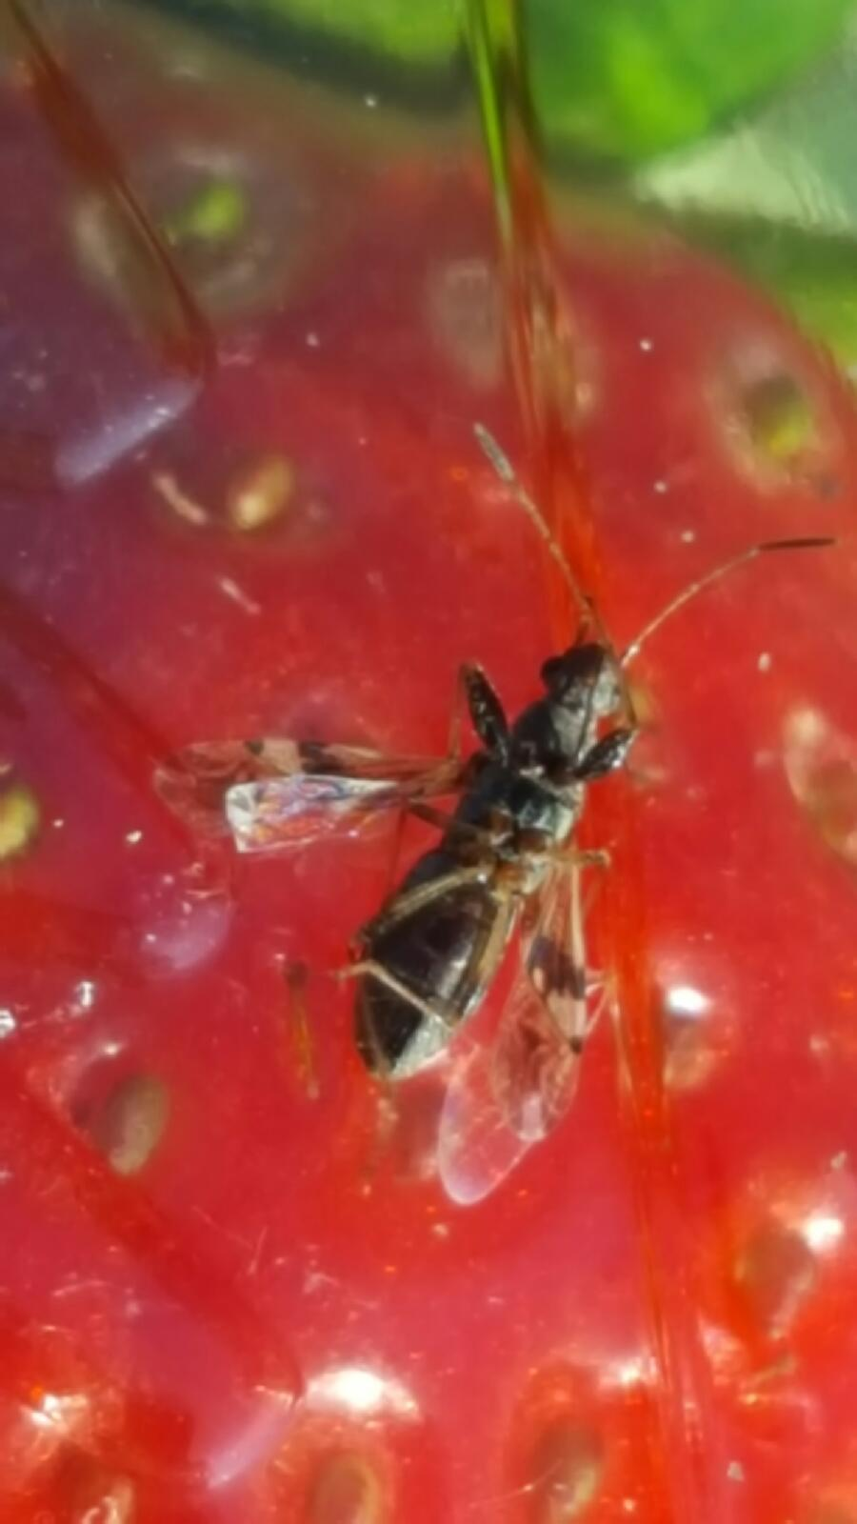
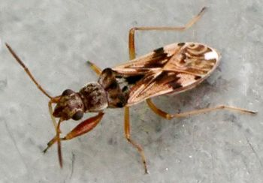
Pamera seed bug (Neopamera bilobata)
Jan. 11
Dec. 28
Active on plastic, underneath leaves
Jan. 11
Adult: 1/8 – 3/16”

Slide 15
Compare mortality of seed bug exposed to insecticides on ripening fruit in the laboratory
Product | active ingredient | IRAC-MOA | Rate | % ai | Surfactant (0.25%)
Radiant SC | spinetoram | 5 | 6 oz/A | 11.7 | Induce
Radiant SC | spinetoram | 5 | 10 oz/A | 11.7 | Induce
Sivanto 200 SL | flupyradifurone | 4D | 14 oz/A | 17.1 | Induce
Beleaf 50 SG | flonicamid | 9C | 2.8 oz/A | 50.0 | Induce
Trilogy | neem oil |  | 256 oz/A (2%) | 70.0 | (none)
Grandevo | Chromobacterium subtsugae |  | 3 lbs/A | 30.0 | (none)
Venerate XC | Burkholderia spp. |  | 256 oz/A | 94.5 | (none)
Control | water | - | - | - | Induce
Control | water | - | - | - | (none)
Washed, semi-ripe strawberries dipped for 15 s in insecticide solutions and dried before being placed with seed bug adults

Slide 16
Results
High mortality
Moderate mortality
No mortality
Low mortality

Slide 17
Compare formulations of the active ingredient bifenazate for control of twospotted spider mite
Product % active ingredient Rate
Banter WDG 50 bifenazate 1 lb/A
Banter SC 43.2 bifenazate 16 fl oz/A
Acramite 50WS 50 bifenazate 1 lb/A
Portal XLO 5 fenpyroximate 32 fl oz/A
Untreated control (UTC) water
Products applied 17 February to small plots (10 m x 1 row) with a CO₂ pressurized sprayer at 100 gal/A
Spider mite motiles and eggs counted weekly from 10 trifoliates per plot

Slide 19
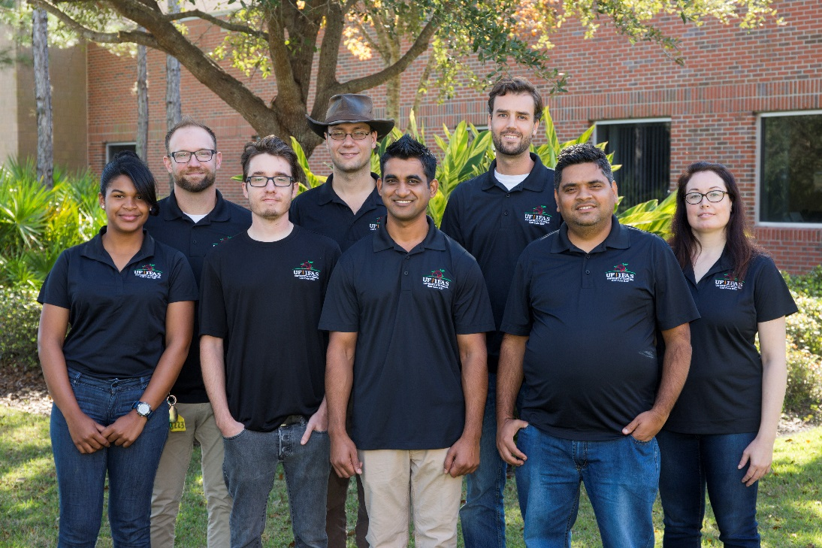
Acknowledgements
Specialty Crop
Block Grant
Program
Dow AgroSciences Nichino America
Bayer Crop Science Syngenta US
DuPont Crop Protection Marrone Bio Innovations
United Phosphorus Inc. Arysta Life Sciences
Shashan Devkota
Marc Santos
Ryan Batts
Deb Farr
Braden Evans
Babu Panthi
Iris Strzyzewski
Michael Hull
Phanie Bonneau
Rosa Ynfante
https://jmrlab.wordpress.com

